Slide 1
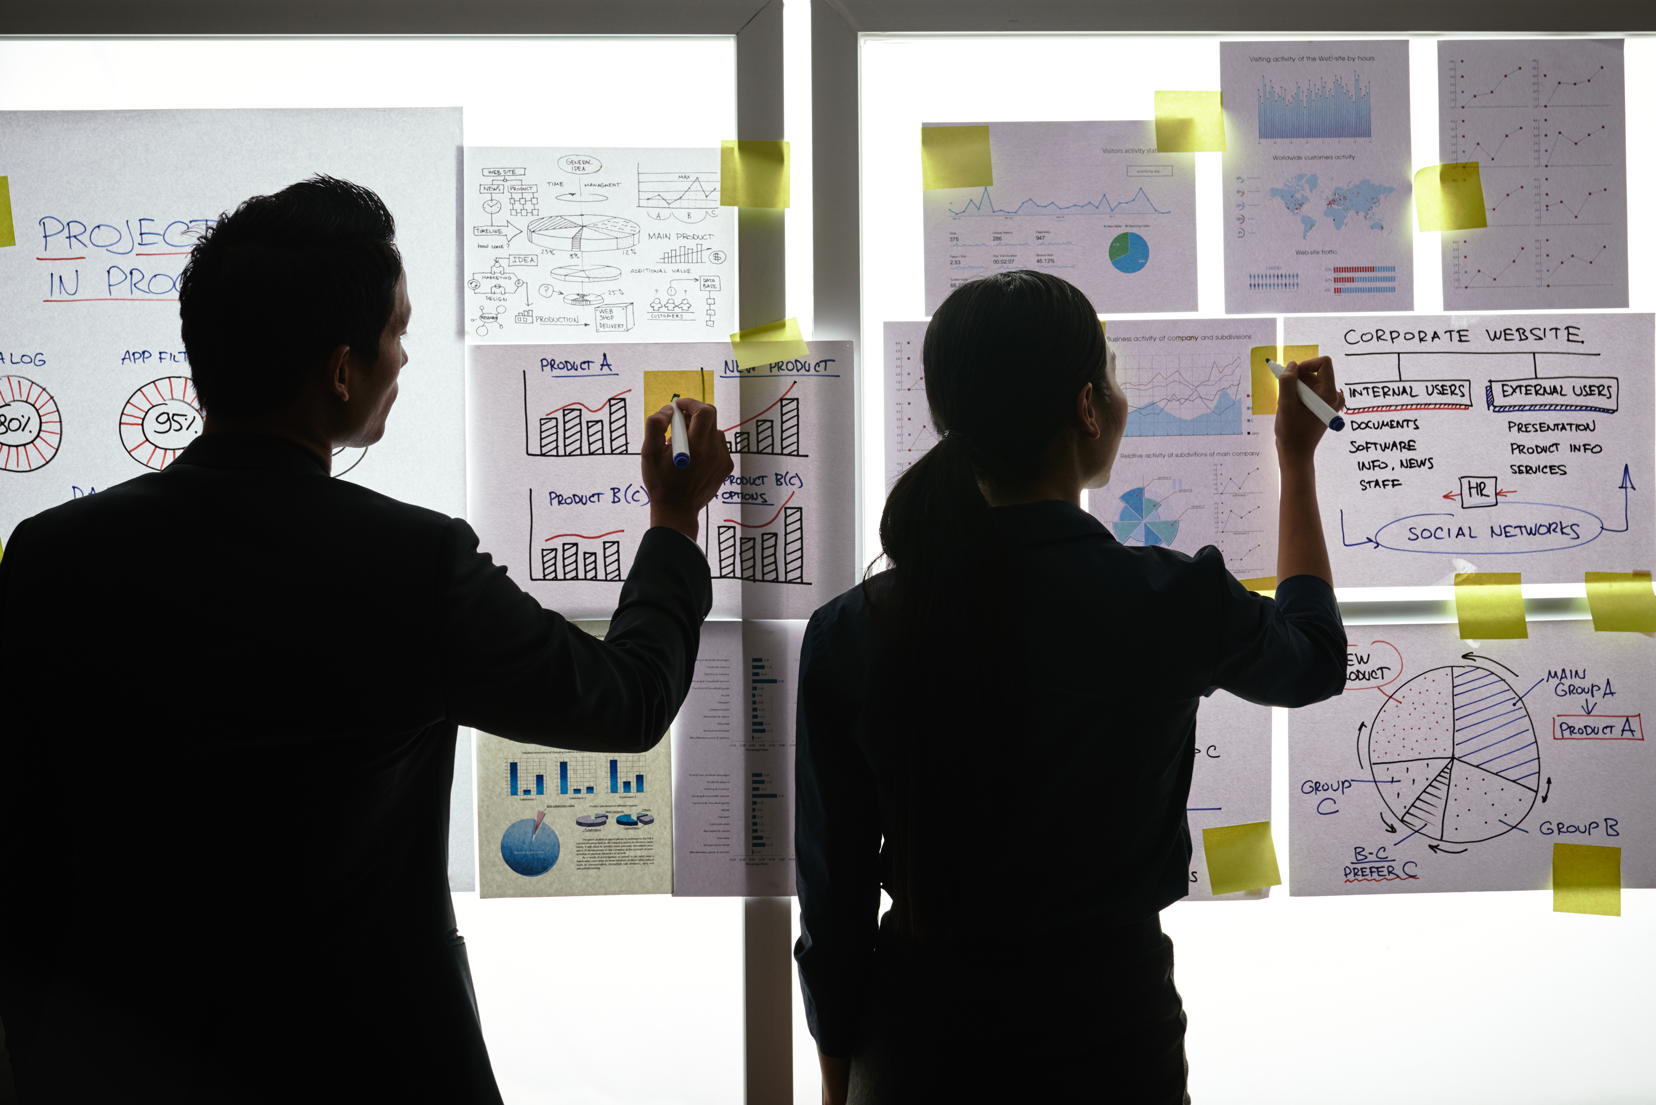
Practical Exercise

Slide 2
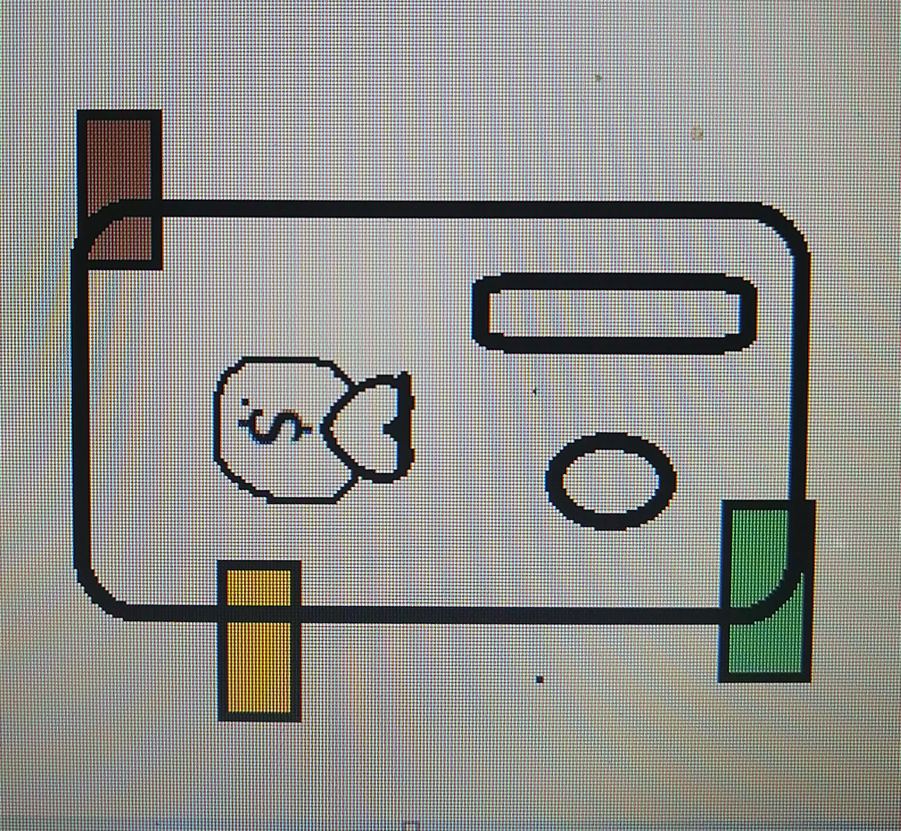
DESIGN YOUR IDEAL WALLET
Draw you ideal wallet in this block you have 5 min – Please take a photo and insert in the Powerpoint deck provided which you will upload later under your Wallet project

Slide 3
Empathy – Identify a partner and Engage
Dig Deeper – Considering what you learned really try to dig into your partners feelings and motivations - 5 min each
Interview your partner you each have - 5 min
Notes from first interview
Loading should not take long.
Needs to be easily accessable to all types of phones.
Prefer light colours.
Notes from second interview
Must have a saving option that can save to the cloud.
Must not consume way too much data.
Must not consume way much storage when downloading and using it.

Slide 4
Define and understand the problem and gain insights
Capture Findings - 5 min
Take a Stand with a point of view - 5 min
Needs: things your partner is trying to do Use verbs
Be able to use it easily
Be able to store information
Can connect to the internet
Violet Shadung
____________________________________________
Needs a way to be user friendly and efficient
Because … or but ……. or surprisingly…….
Her wallet stands out when holding due to the size of it and does not hold her cards, money, receipts e.tc very well.
Insights: new learnings about your partners feelings and motivations. What’s something you see about your partners experience that he she does not see? Use what you heard them say
She likes it to not be a hassle when coming into contact with it
Prefers it to be direct and accurate when receiving information
Insight

Slide 5
Ideate – Generate alternatives to test
Sketch at least 5 radical ways to meet your users needs - 10 min
Her wallet stands out when holding in public due to the size of it and does not hold her cards, money, receipts e.tc very well
Write your problem statement above
Share your solution with your partner and capture feedback - 5 min each
Notes: Will be way faster when needing to pay other than having to search the old physical wallet which can taken some time and be straining .

Slide 6
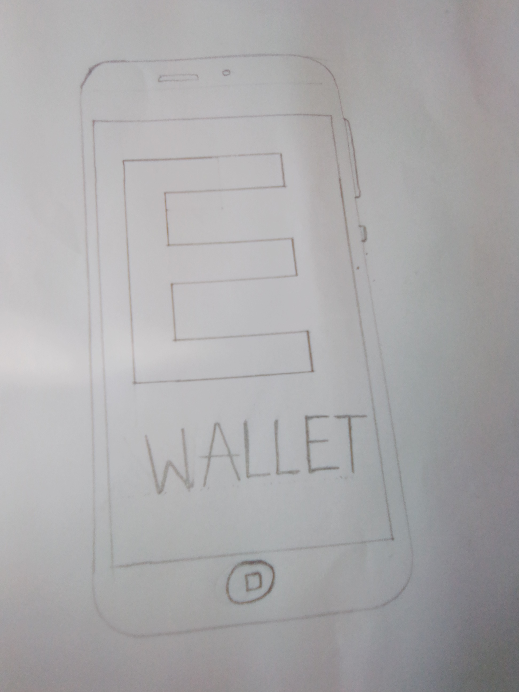
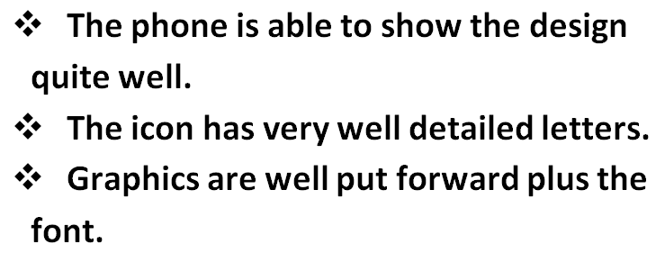
Iterate on Feedback
Reflect and generate a new solution 5 min
Sketch your idea and note details if necessary
Sketch of our ideal wallet’s icon on the phone

Slide 7
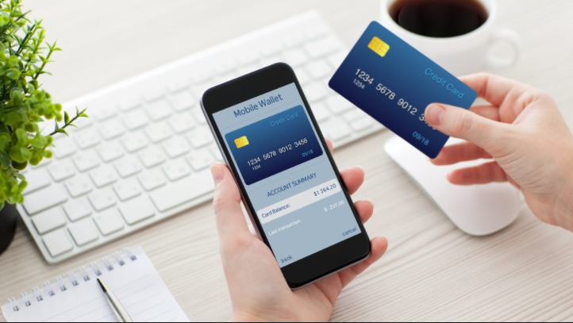
Build and Test
Build your solution
Share your solution and get feedback – 5min each
Make something your partner can interact with use anything you have paper cardboard etc. Place photo’s here (10min)
What worked?
The wallet was approaches as expected.
My partner has successfully tested the wallet without asking questions.
What can be improved?
The icon of the wallet can be improved by changing the graphics of the icon as challenges where met when having to identify the icon.
Questions
Does the wallet have a savings option?
Does it consume a lot of space or data?
Can it be used by more than 1 user.
Ideas
The are a few pointers that will be tested so we can improve our design.

Slide 8
Your experience
Please upload your completed wallet exercise project in the projects section tagging your partner
Please share your thoughts comments experiences during this work session in the Design thinking group.

