Slide 1
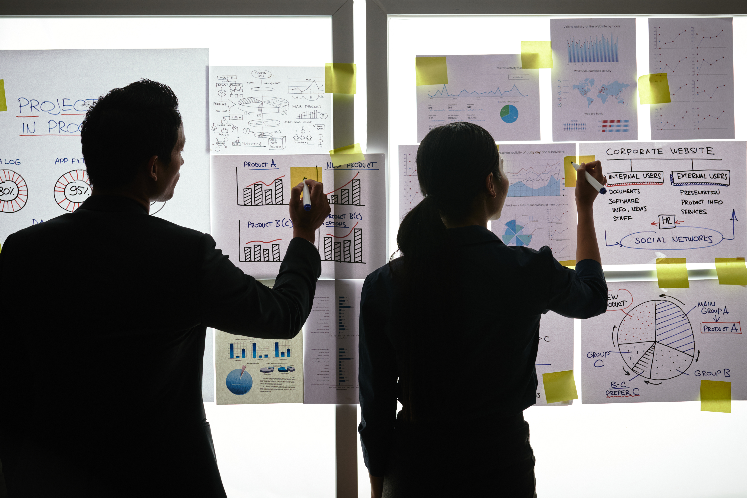

Practical Exercise

Slide 2
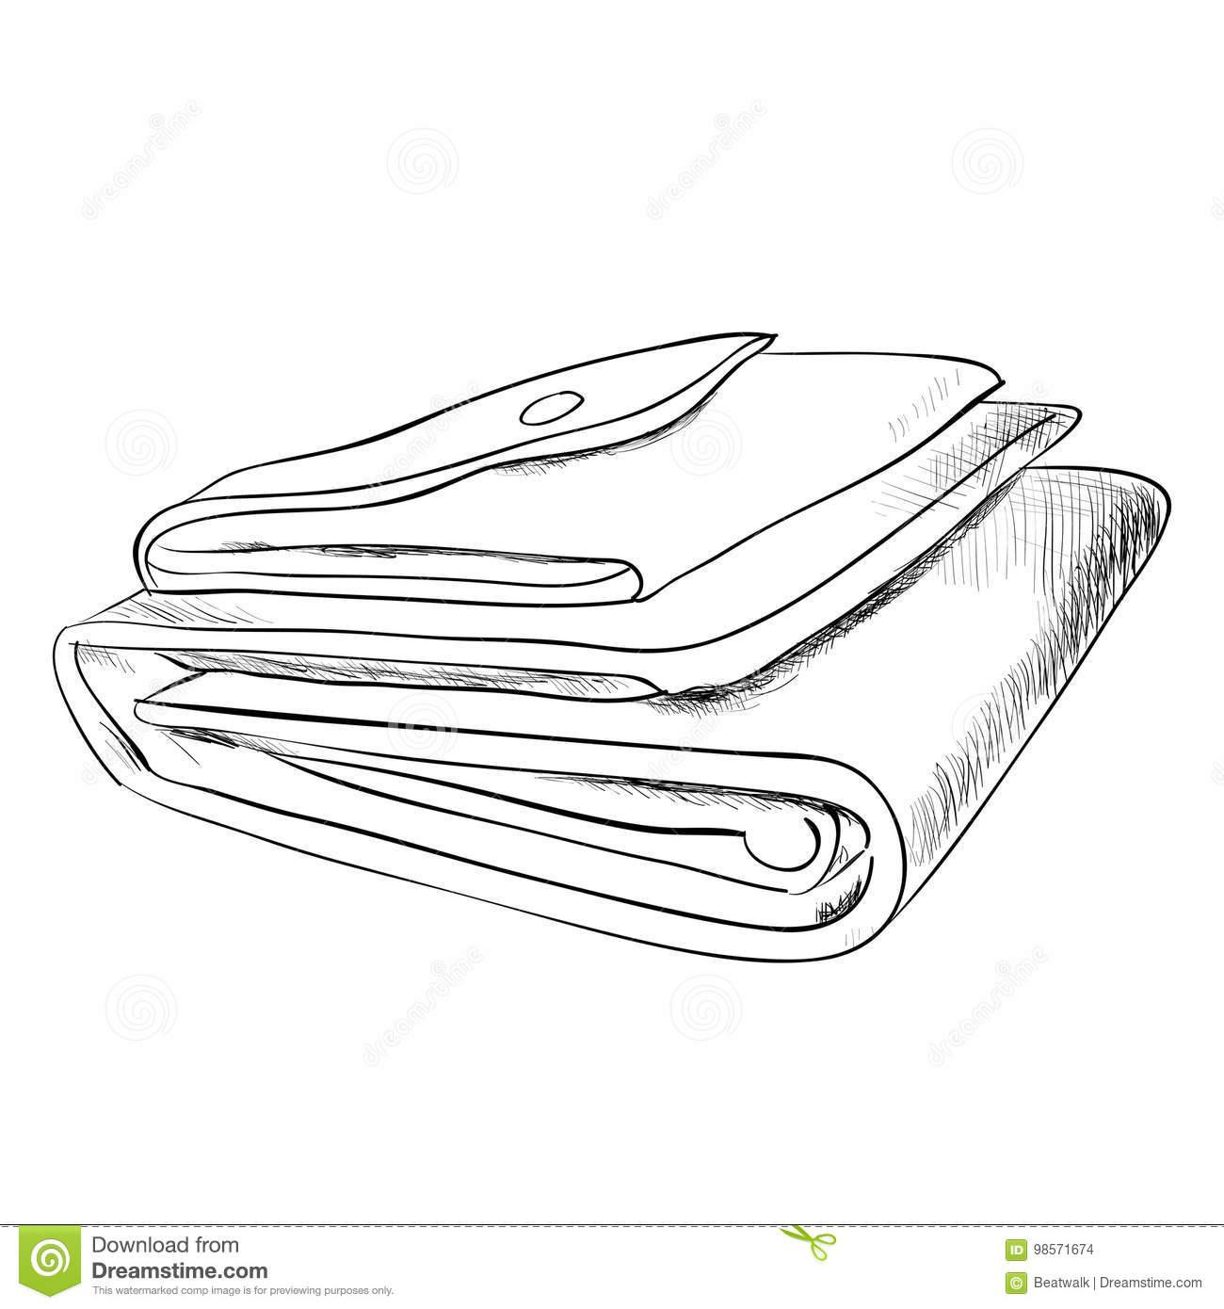
Design your Ideal Wallet
Draw you ideal wallet in this block you have 5 min – Please take a photo and insert in the Powerpoint deck provided which you will upload later under your Wallet project

Slide 3
Empathy – Identify a partner and Engage
Dig Deeper – Considering what you learned really try to dig into your partners feelings and motivations - 5 min each
Interview your partner you each have - 5 min
Notes from first interview
A big wallet that will carry more money
Something attractive
Portable and comfortable
Notes from second interview
He wants a small, portable wallet but still strong enough to protect his belongings
Enough pockets for his cards

Slide 4
Define and understand the problem and gain insights
Capture Findings - 5 min
Take a Stand with a point of view - 5 min
Needs: things your partner is trying to do Use verb
-Keep his belongings safe
-Protect his wallet
-Portable
_________Dumisani Mkhonto ______________
Needs a way to _____________________________
Because … or but ……. or surprisingly…….
The usual wallets are not strong enough to prevent
_____________________________________________
his cards from breaking
_____________________________________________
_____________________________________________
Partner’s Name
Keep his cards protected
Circle one
Insights: new learnings about your partners feelings and motivations. What’s something you see about your partners experience that he she does not see? Use what you heard them say
He can be a bit clumsy at times which could lead to breaking his cards or wetting his notes/ money
Insight

Slide 5
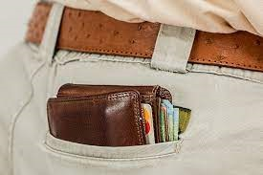
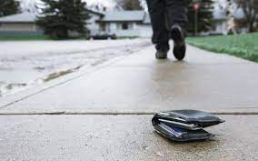
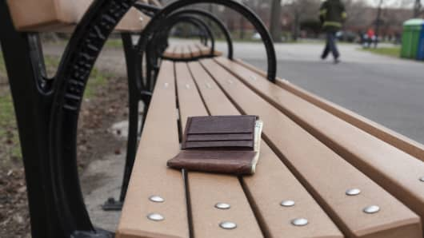
Ideate – Generate alternatives to test
Sketch at least 5 radical ways to meet your users needs - 10 min
__The wallet is to big to fit in the pocket and that makes it easy to slip off and fall__________________________
Write your problem statement above
Share your solution with your partner and capture feedback - 5 min each
Notes: must be small/slim and portable enough to fit into the pocket

Slide 6
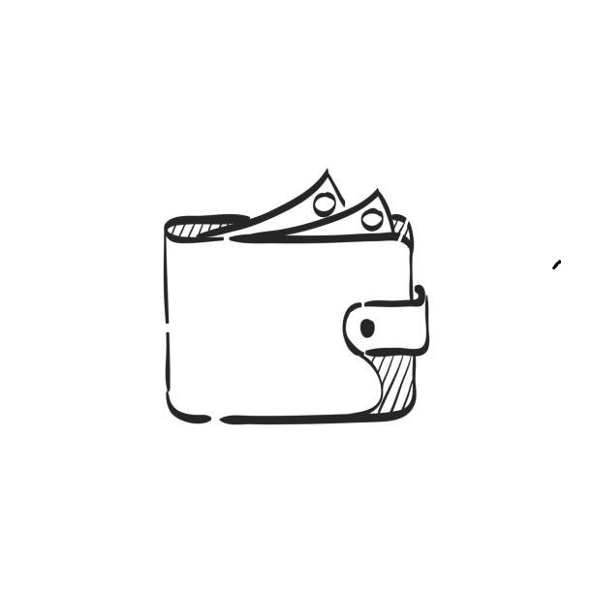
Iterate on Feedback
Reflect and generate a new solution 5 min
Sketch your idea and note details if necessary

Slide 7
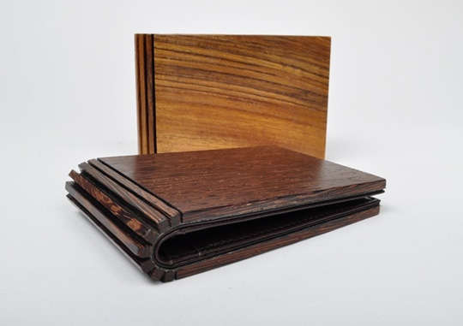
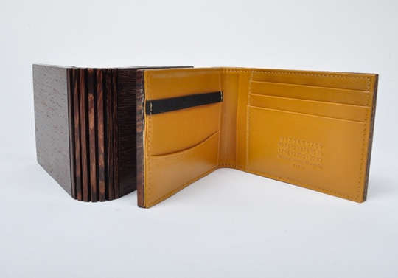
Build and Test
Build your solution
Share your solution and get feedback – 5min each
Make something your partner can interact with use anything you want paper cardboard etc. Place photo’s here (10min)
What worked
Its strong
Comfortable
What can be improved
The design
Questions
What colours should be used
What materials must be used
Ideas
Use a neutral colour that goes with different outfits
Use leather and wooden material for protection

Slide 8
Your experience
Please upload your completed wallet exercise project in the projects section tagging your partner
Please share your thoughts comments experiences during this work session in the Design thinking group.

