Slide 1
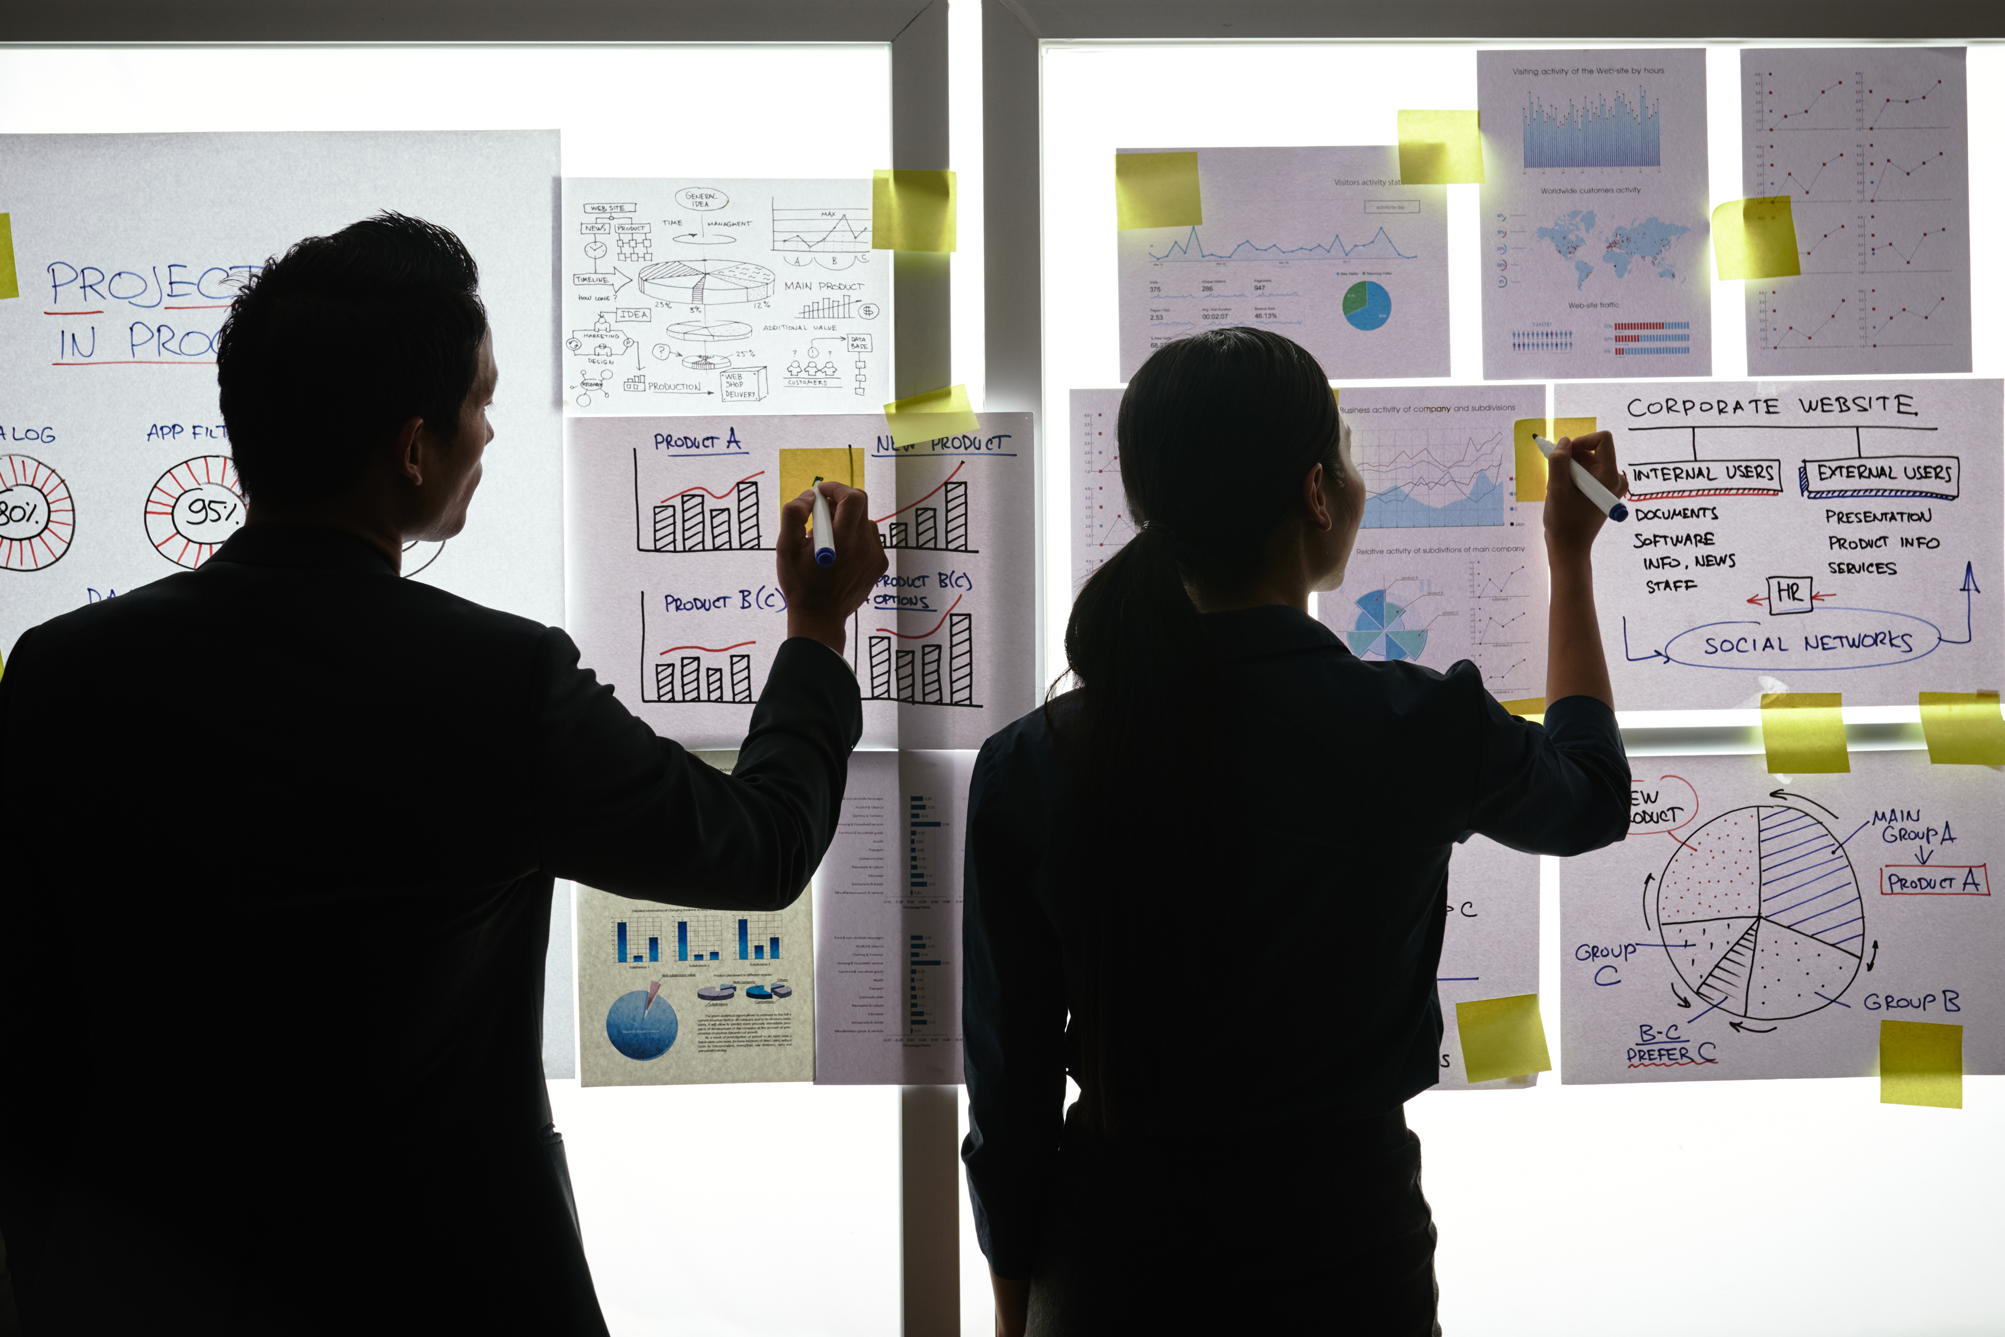
Practical Exercise

Slide 2
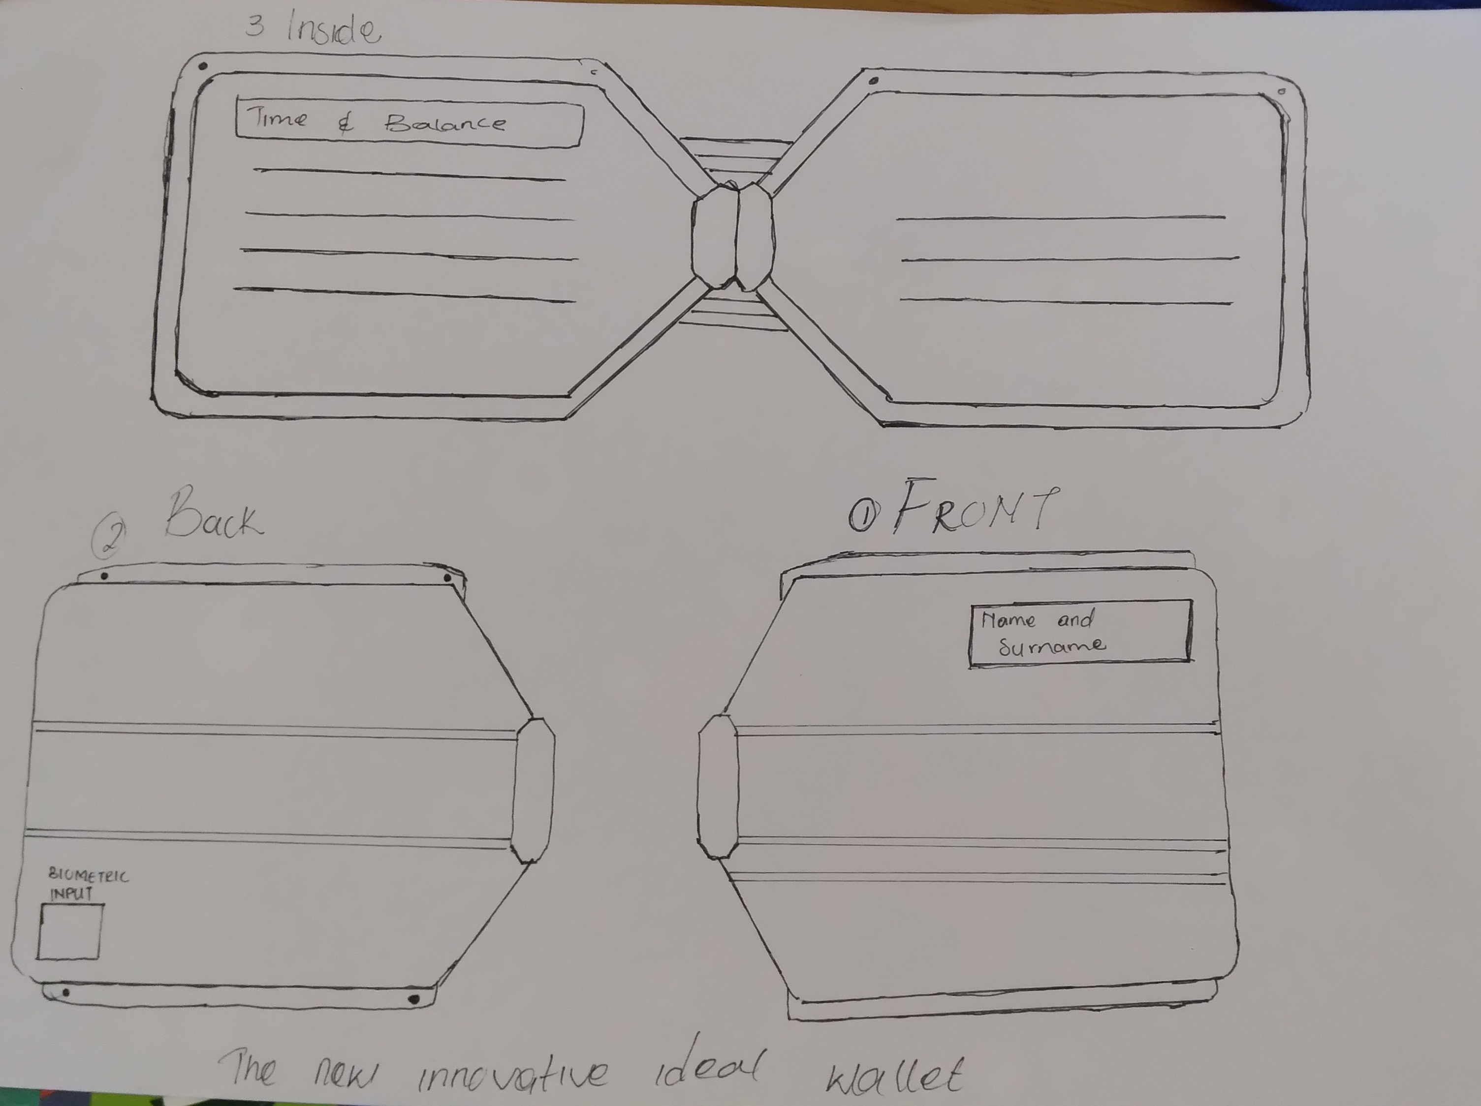
Design your Ideal Wallet
Draw you ideal wallet in this block you have 5 min – Please take a photo and insert in the Powerpoint deck provided which you will upload later under your Wallet project

Slide 3
Empathy – Identify a partner and Engage
Dig Deeper – Considering what you learned really try to dig into your partners feelings and motivations - 5 min each
Interview your partner you each have - 5 min
Notes from first interview
Notes from second interview
• A portable and stylish wallet
• A one that has cool features like a mini screen that
shows time
• A wallet that will be easy to locate (GPS tracker)
• A smooth wallet that can fit all my cards and cash
• A wallet that can can sync with my phone
• It needs to be portable and able to fit in a small pocket
•it shows time and holds a lot of cards and cash

Slide 4
Define and understand the problem and gain insights
Capture Findings - 5 min
Take a Stand with a point of view - 5 min
Needs: things your partner is trying to do Use verbs
__________ Neo Makwela________________
Needs a way to( store his cards and license in style)
Because … or but ……. or surprisingly…….
Because many wallets have old fashioned designs and it’s kind of boring. We need a wallet that accommodate the tittle innovative wallet or techno wallet
_____________________________________________
_____________________________________________
Partner’s Name
He needs a wallet that’s unique and
stands out from the other wallets
one with a new techno style and a
modern sense and beauty
User’s need
Insight

Slide 5
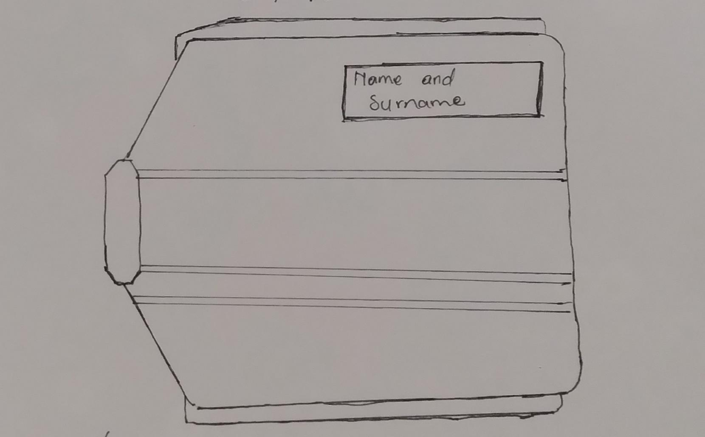
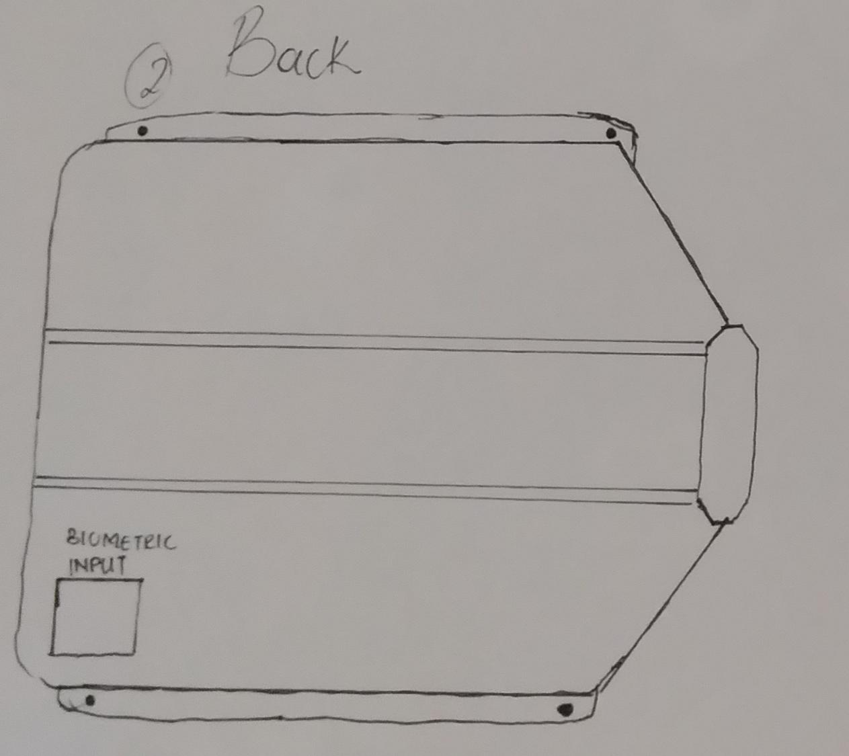
Ideate – Generate alternatives to test
Sketch at least 5 radical ways to meet your users needs - 10 min
Neo’s old wallet is a bit too big for his pockets and it’s old fashioned and has an old design
Write your problem statement above
And makes him the center of attention and can easily be found when lost because it’s features
It has a biometric input for safety and displays the time and balance for you
It can insert as many cards but doesn’t lose its original purpose and functionality
A design showing his name and is also stylish
It has a smooth body with a comfortable design for finger texture
Share your solution with your partner and capture feedback - 5 min each
The wallet displays so many advanced features and will not cost that much on the market and has a carbon fiber body
Making it weight less and it is waterproof and durable than most wallets it can fit in a pocket and it’s unique design is
made for future of technology and will be used for many years depending on the established of technology to the world

Slide 6
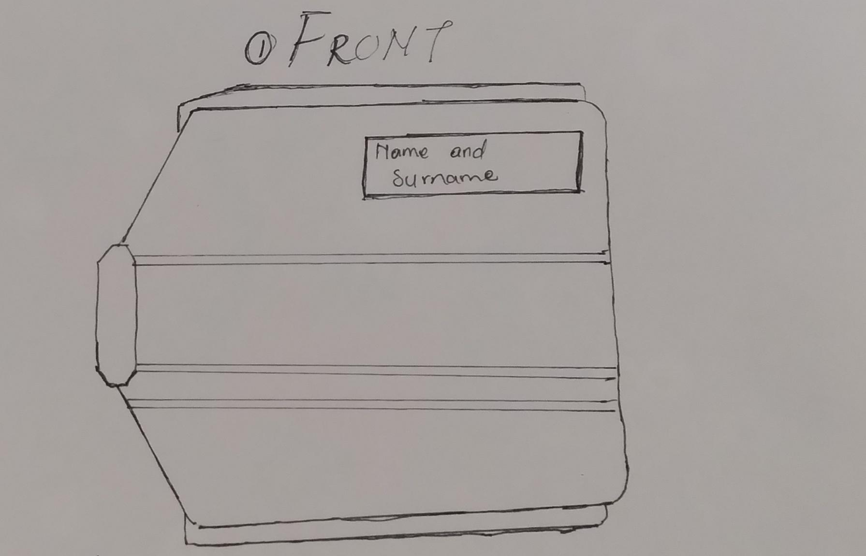
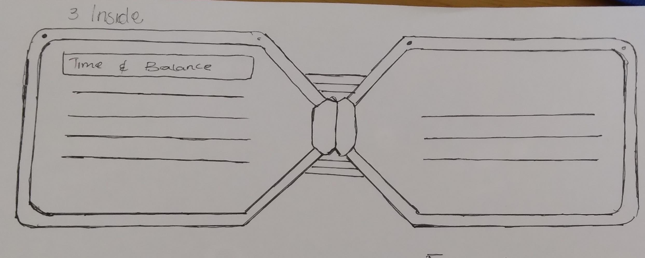
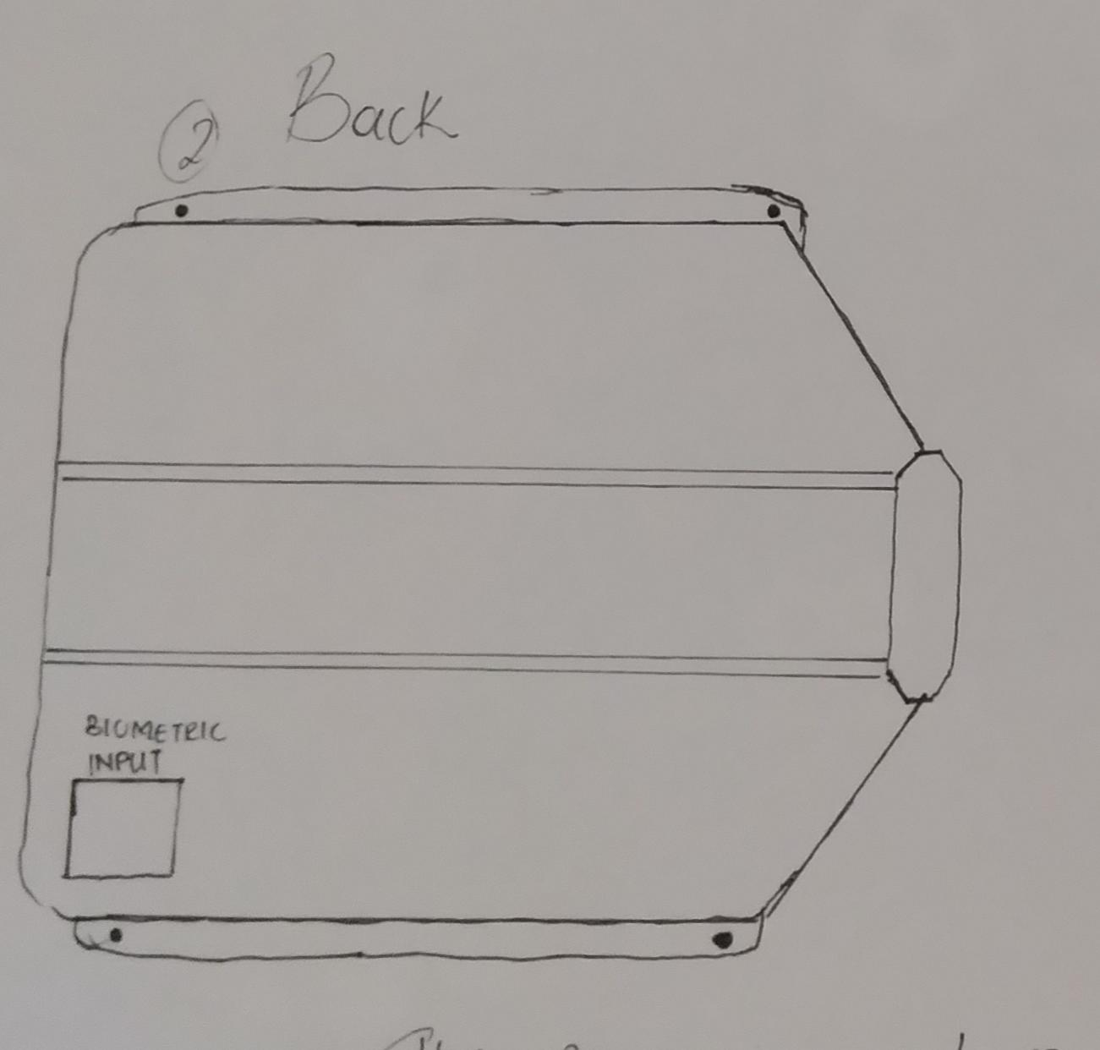
Iterate on Feedback
Reflect and generate a new solution 5 min
Sketch your idea and note details if necessary
The( front)of the wallet will display a light grey and indigo color with the logo showing on the screen ,made out of smooth carbon fiber and has a it’s portable with a size made costum for your hand size
(Back) the finger print on the left edge corner made to keep your wallet locked and secured and can only be unlocked by the user only which is a cool feature with the the waterproof cover so that it can handle extreme pressure
(Interior) it will have eight card pockets with magnets on the edges to make it lock if closed it’s also water proof and portable to hold with a GPS tracker chip in the middle

Slide 7
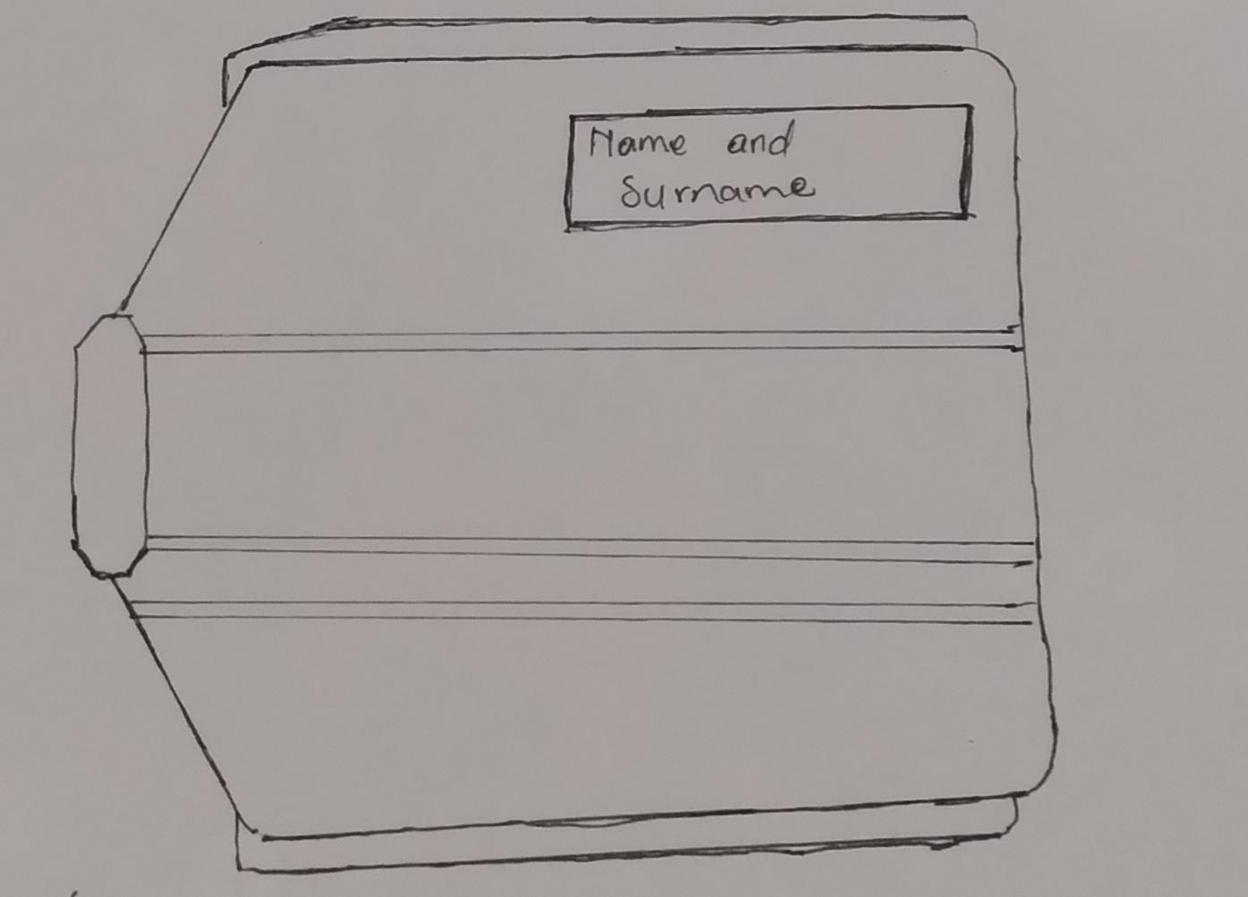
Build and Test
Build your solution
Share your solution and get feedback – 5min each
Make something your partner can interact with use anything you want paper cardboard etc. Place photo’s here (10min)
What worked
The features have worked pretty well /correctly (even the screen displayed it’s main purpose
The water proof part because it only lasts minutes until the mother board fries so it needs an upgrade
Questions
Ideas
•How much might the price of the wallet cost on the market?
• Give the wallet a wire less charging feature
• Will the wallet come in different colors or forms then the ones it has?
•It must have an 5000mAh battery so it can last for weeks

Slide 8
Your experience
Please upload your completed wallet exercise project in the projects section tagging your partner
Please share your thoughts comments experiences during this work session in the Design thinking group.

