Slide 1
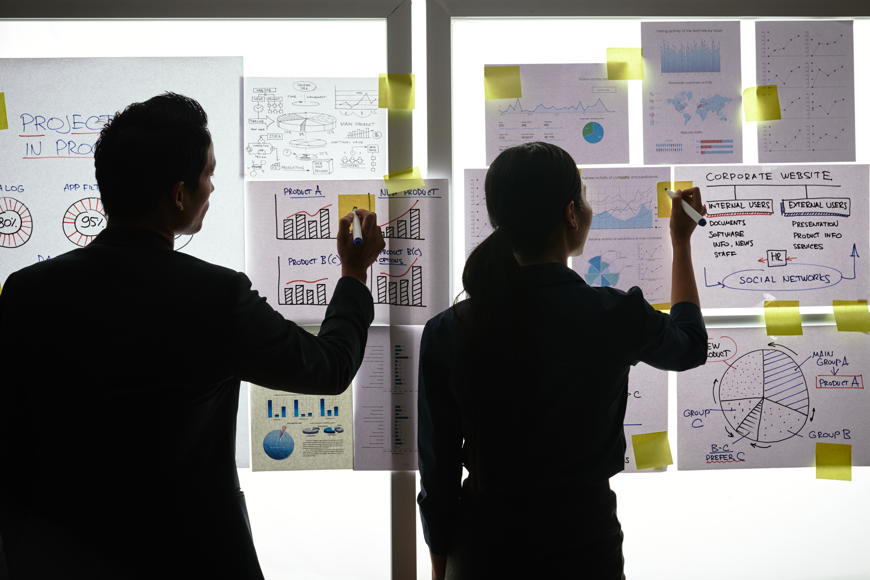
Practical Exercise

Slide 2
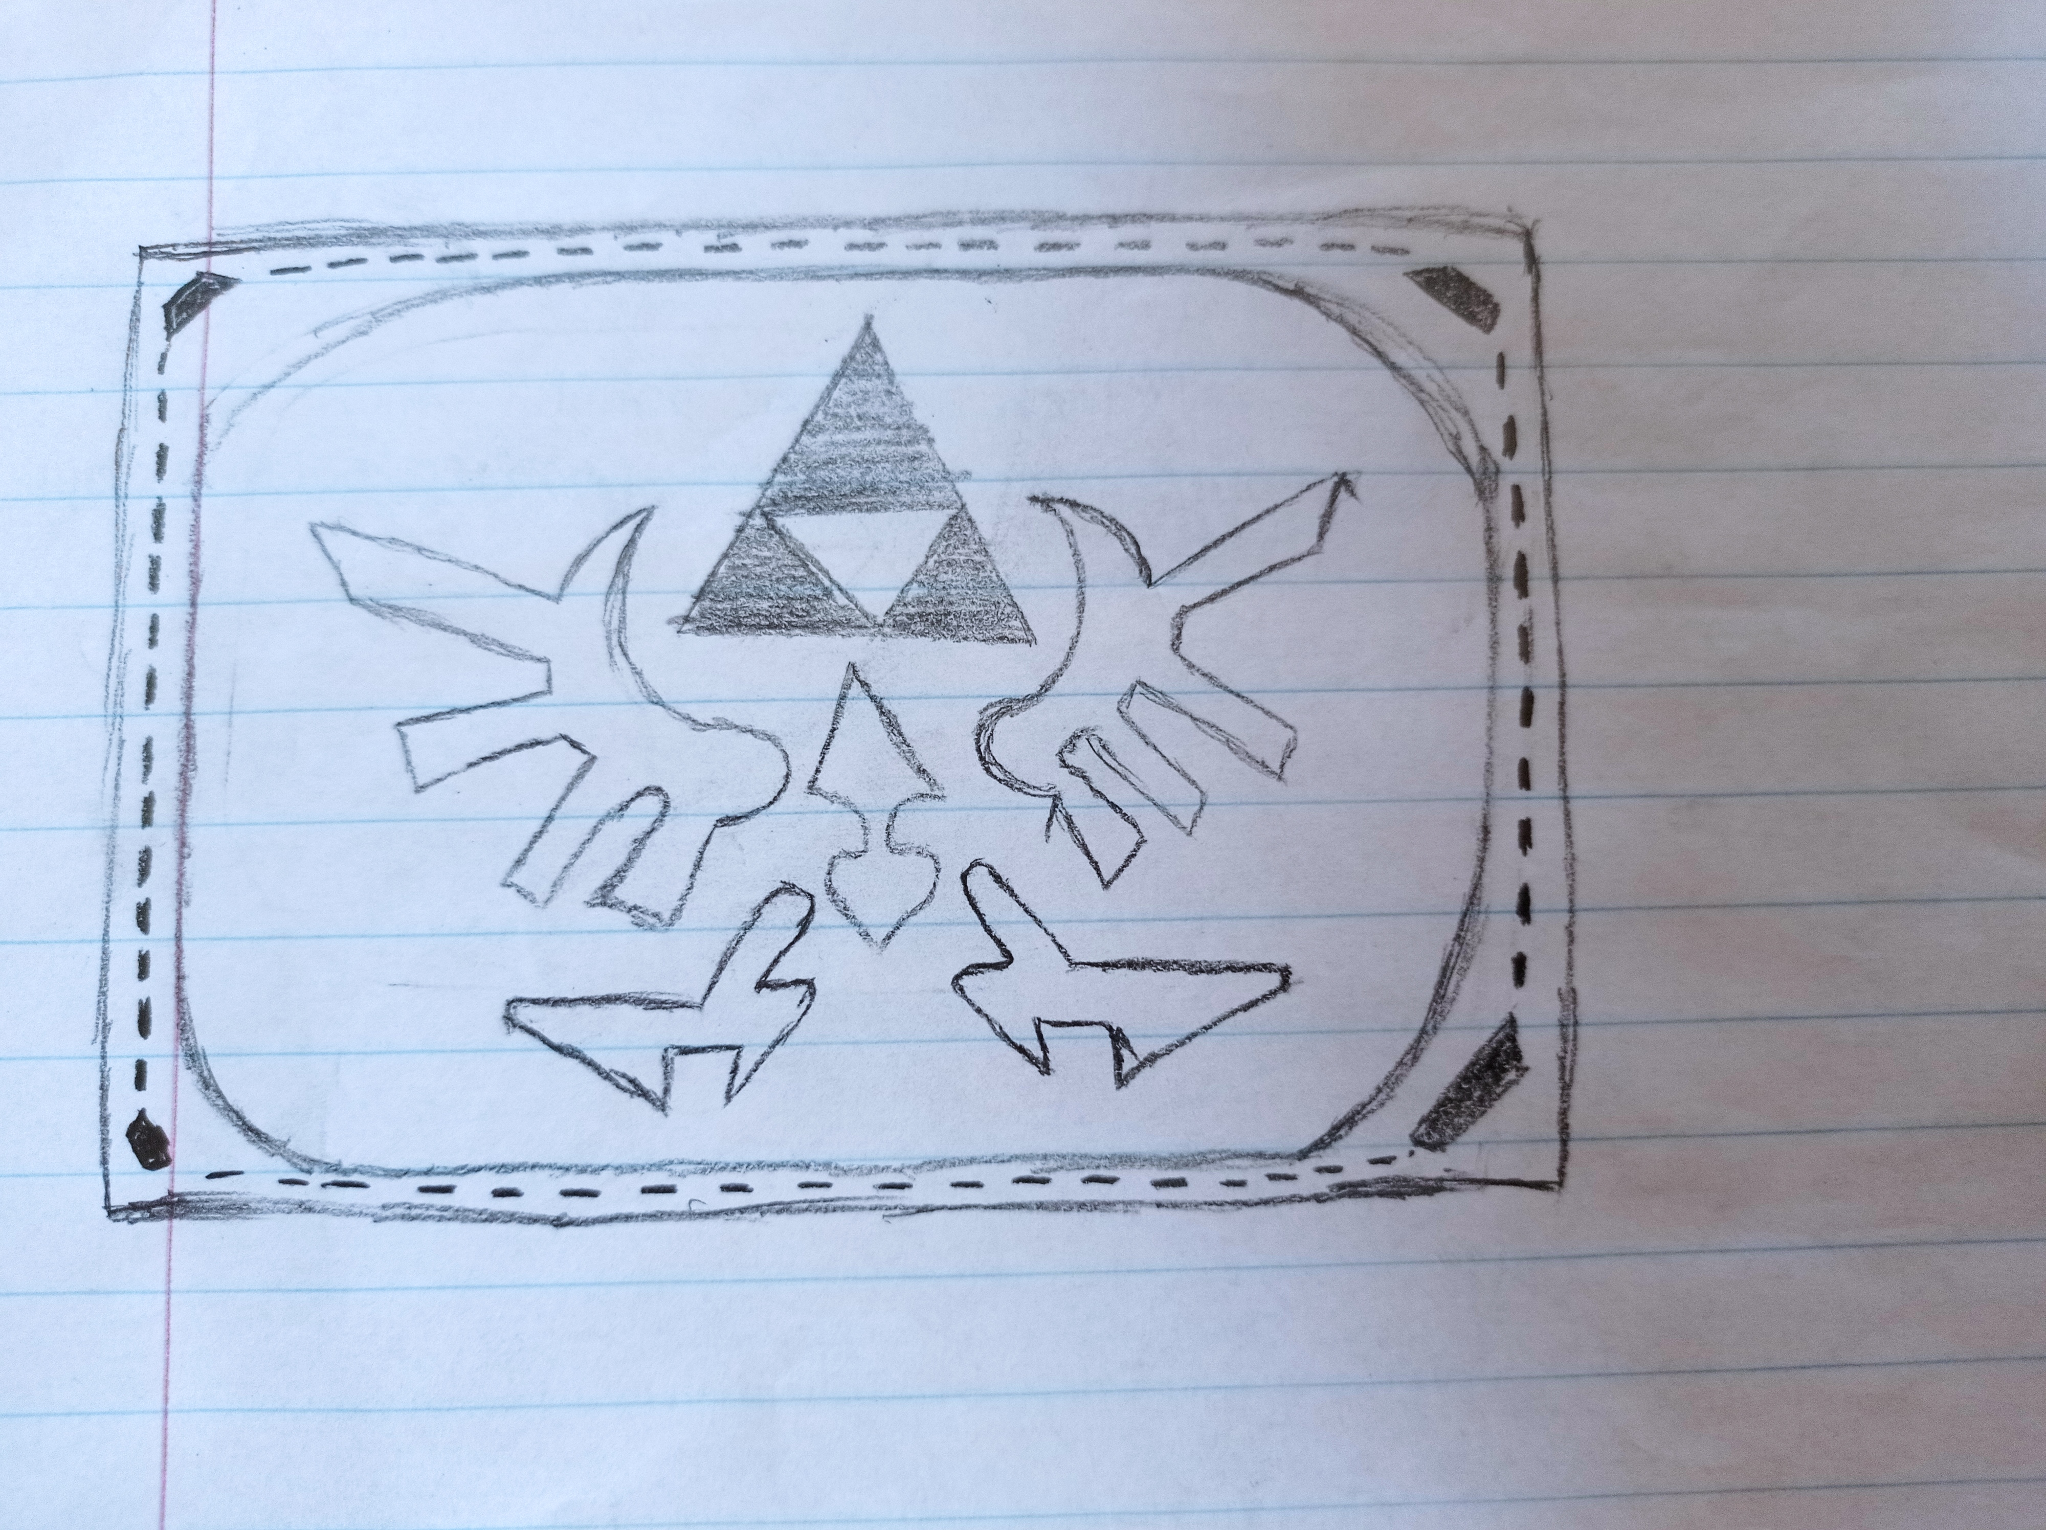
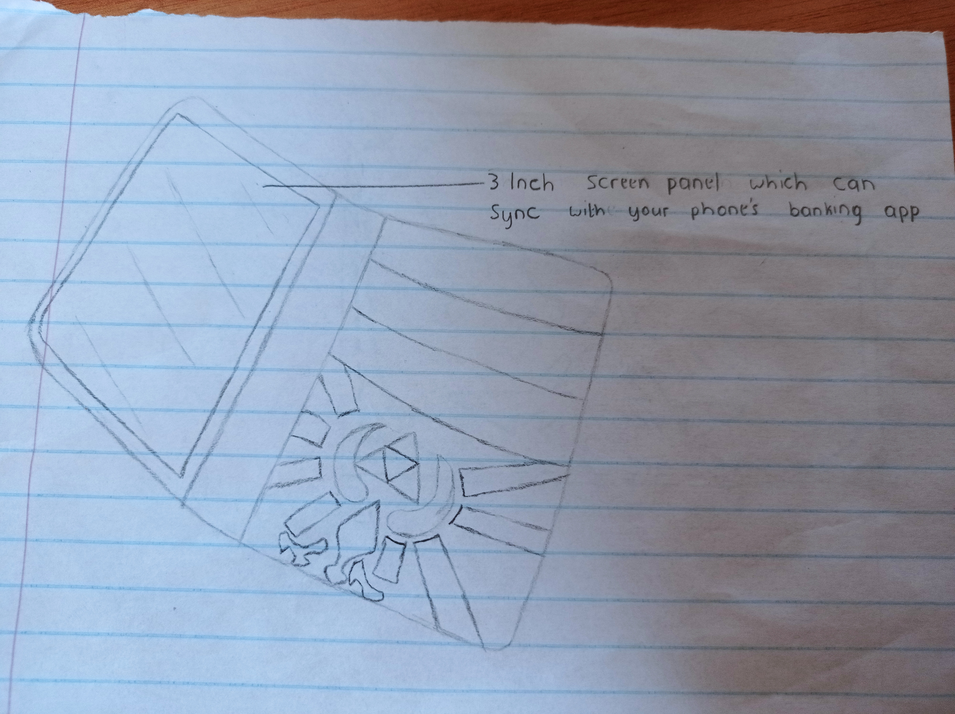
Design your Ideal Wallet
Draw you ideal wallet in this block you have 5 min – Please take a photo and insert in the PowerPoint deck provided which you will upload later under your Wallet project

Slide 3
Empathy – Identify a partner and Engage
Dig Deeper – Considering what you learned really try to dig into your partners feelings and motivations - 5 min each
Interview your partner you each have - 5 min
Notes from first interview
Notes from second interview
A Wallet that feels good in the hands
A thin stylish & one of a kind type of wallet
One that has a mini screen inside able to display
time
One that’s small but can fit all of my cards
A wallet that’s able to fit in a small pocket
One that has that luxury feel and look to it
One I can track and sync my phone with
One that shows the time
Compact but can hold a lot of cards and cash

Slide 4
Define and understand the problem and gain insights
Capture Findings - 5 min
Take a Stand with a point of view - 5 min
Needs: things your partner is trying to do Use verbs
____________________________________________
Needs a way to _____________________________
Because … or but ……. or surprisingly…….
Today’s wallets lack in some departments such as style and feel. Most of them still adapt to that old school kinda vibe and its getting lame as all wallets share the same aspects, we need new wallets that fit into the tittle “wallets of the future” or “techno wallets”
George Chauke
Partner’s Name
He wants a wallet that stands out from all the rest of the wallets, one that has that new modern sense of style, and also functions as a power bank.
Put his cards away in style
User’s need
Insight

Slide 5
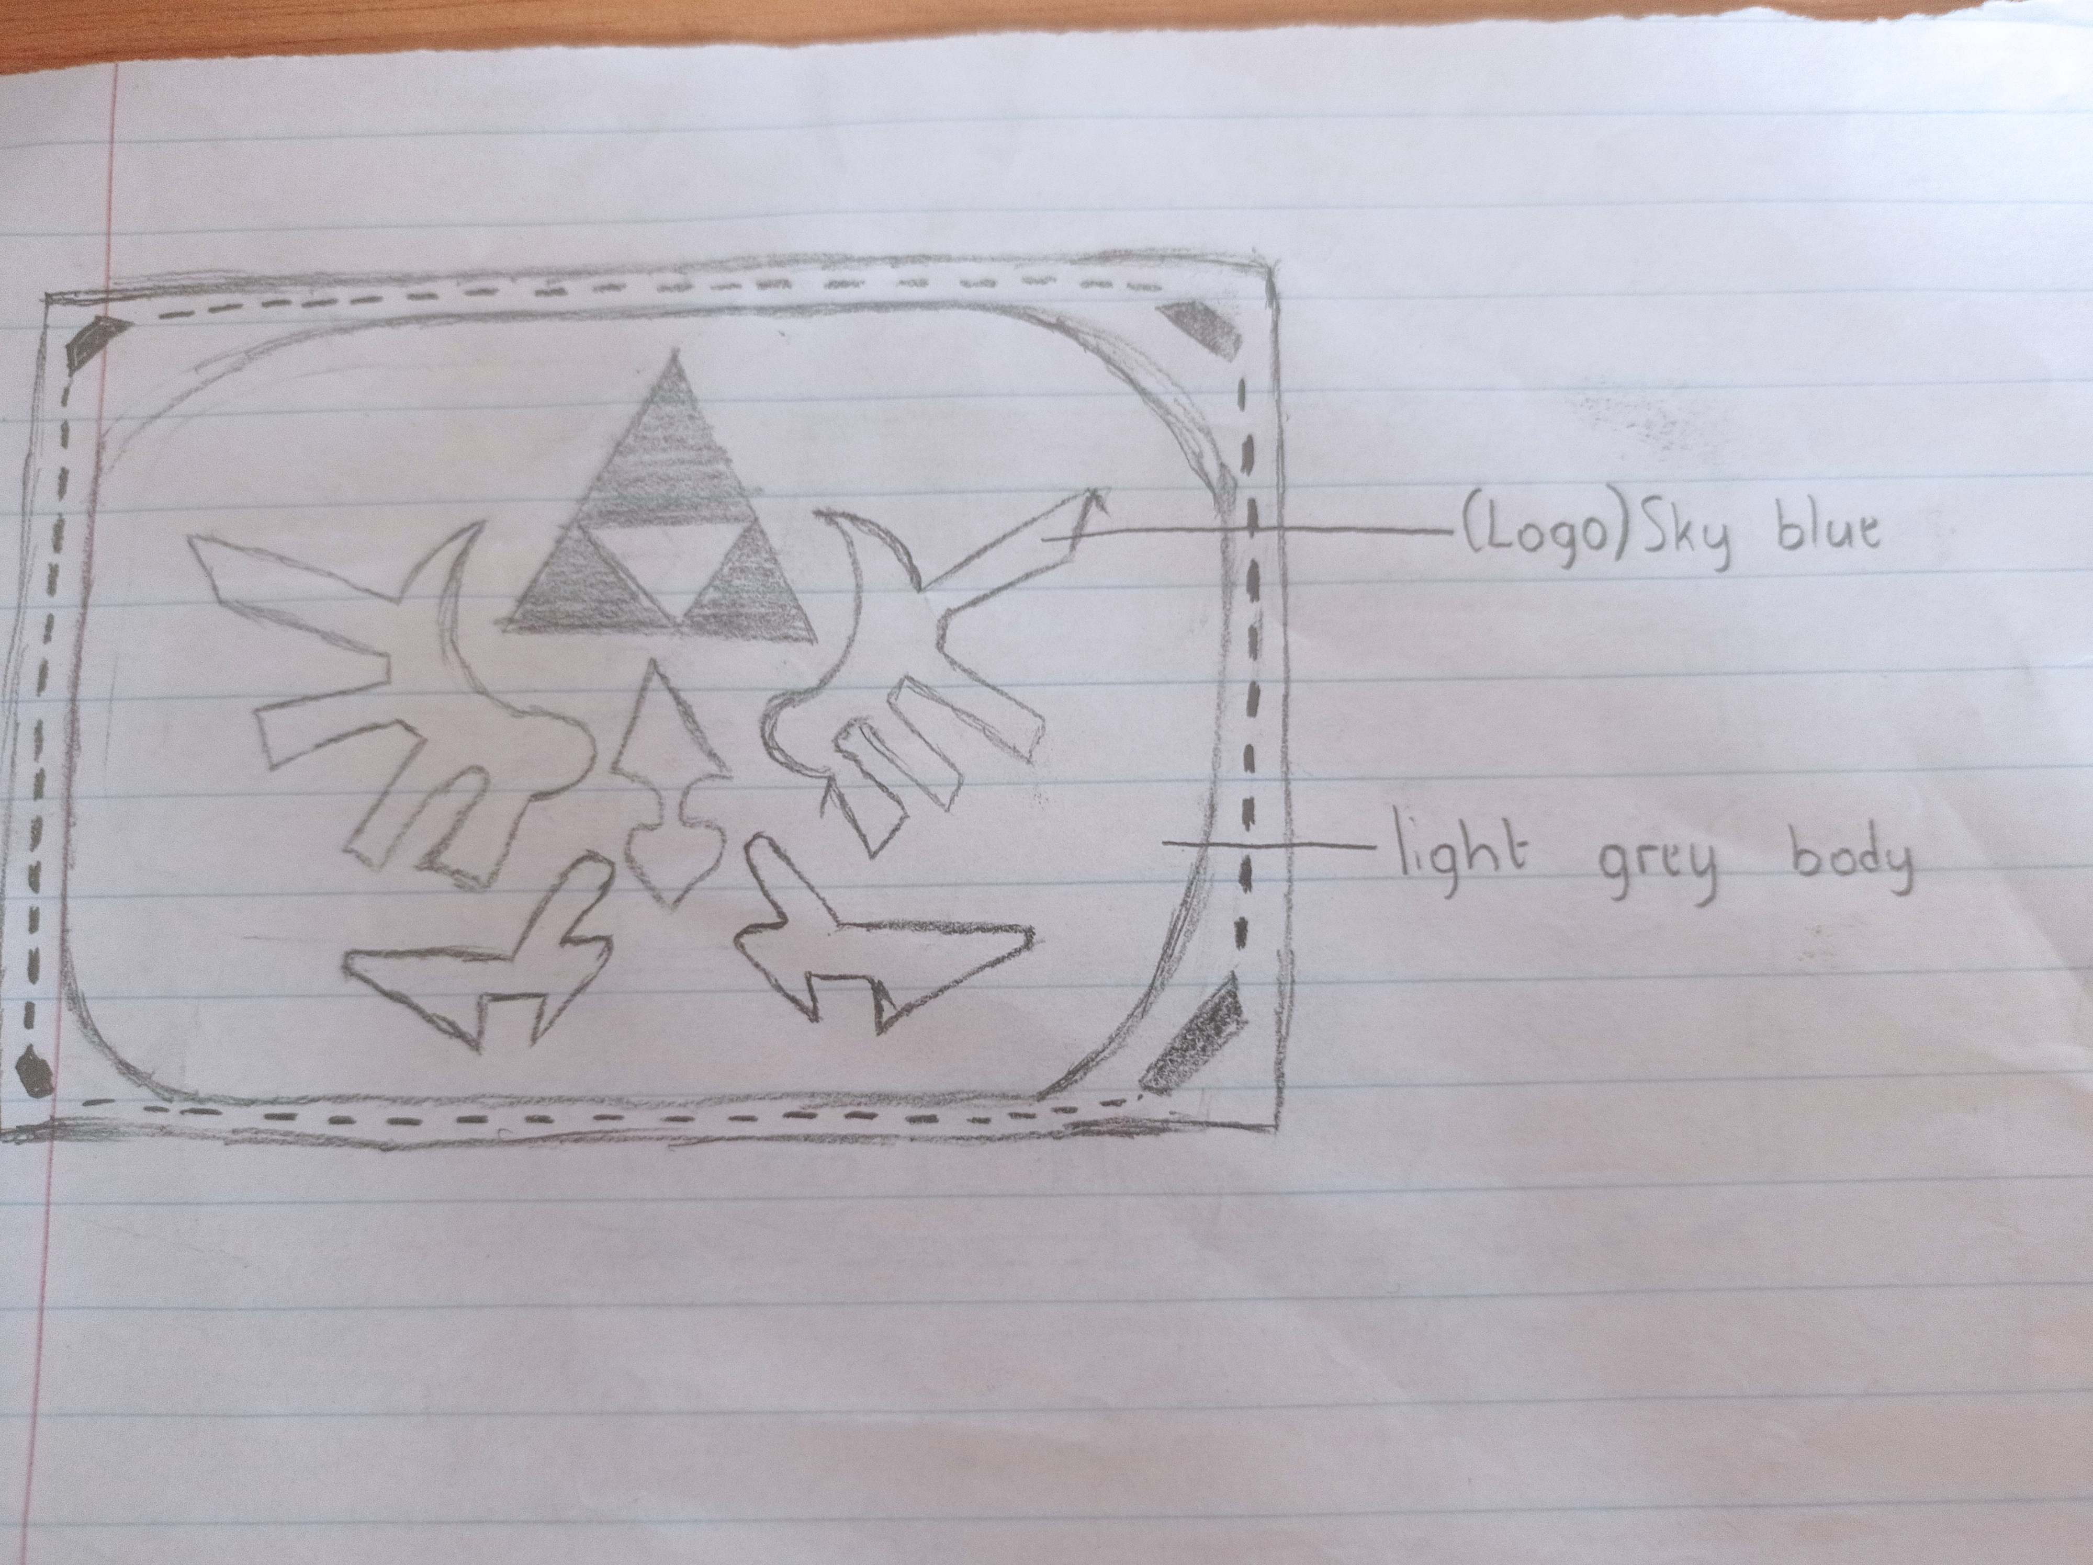
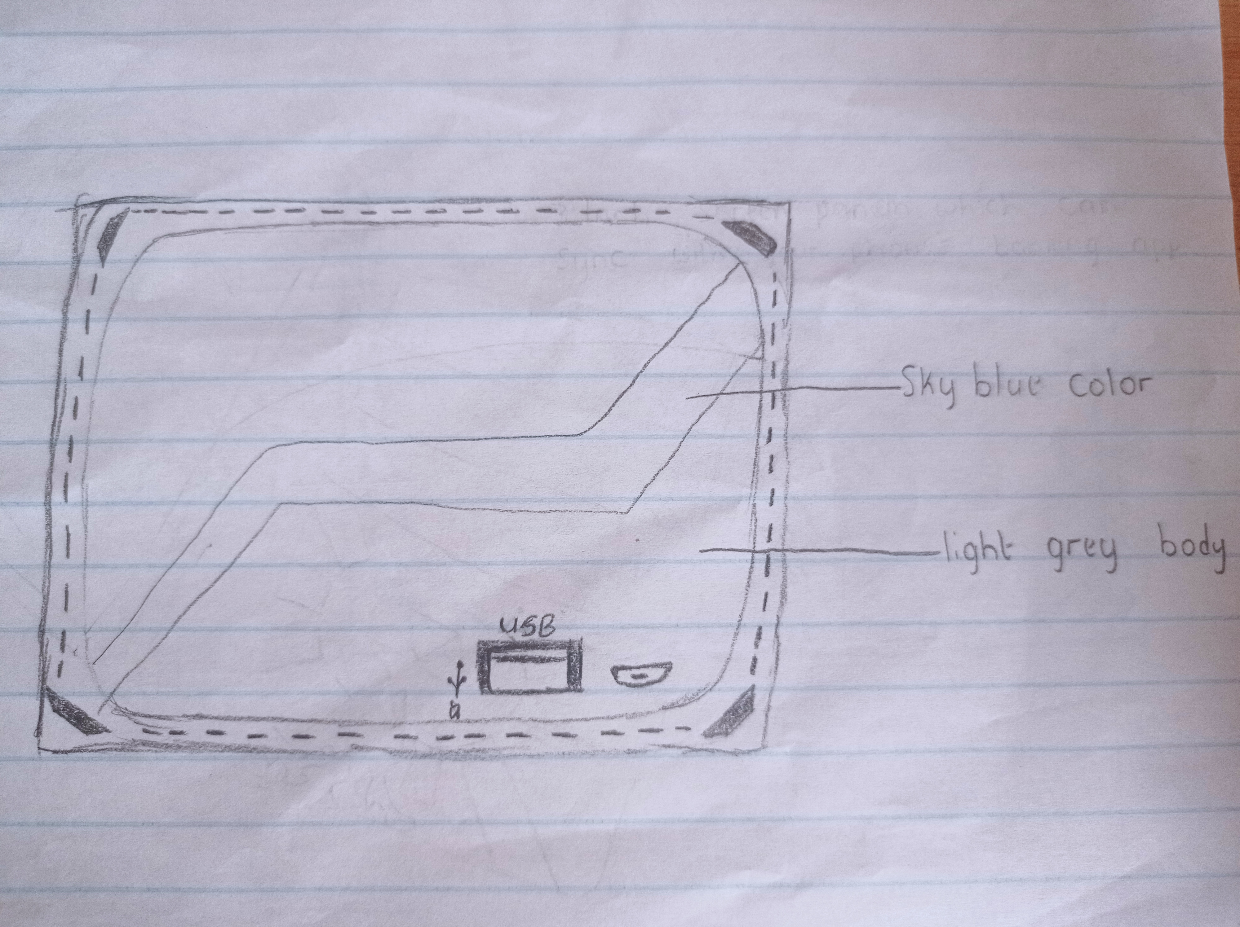
Ideate – Generate alternatives to test
Sketch at least 5 radical ways to meet your users needs - 10 min
George’s current wallet is bulky and doesn’t fit into his pocket, he feels that all wallets have the same boring old school design
But on that doesn’t lose the original purpose of a wallet and functionality
power bank powered by a huge but thin 5020 mAh Li-poly battery
A design that’s sure gonna bring him all the attention he needs
A design able that fits into the name techno wallet
Your phone’s battery low?, No fear as your wallet can also act as a
Share your solution with your partner and capture feedback - 5 min each
Note: The wallet appears to be very helpful and handy with 4 to 5 card slots which allow users to fit or put as many cards they can and also a large sized cash slot in case the user decides to withdraw large amounts of cash. And the wallet introduces much more advanced features of a modernized wallets and it takes the user a step close to the modern world .

Slide 6
Iterate on Feedback
Reflect and generate a new solution 5 min
Sketch your idea and note details if necessary
(Front)The wallet will show a sky blue falcon logo stitched on to a light grey shell cordovan leather body and with a sky blue (exposed) stitching surrounding the body
(Interior)Will feature a 3 inch thin screen that can sync with your phone’s cell banking app and display it, and of course show the time, and underneath the screen, there is also a card sleeve. On Right hand side there are also card and cash slots
(Back)Will feature a simple sky blue line with a type-c charging port & usb port which are connected to an ultra thin 5020 mAh Li-poly battery that powers the wallets screen, which can also basically turn your wallet into a power bank

Slide 7
Build and Test
Build your solution
Share your solution and get feedback – 5min each
Make something your partner can interact with use anything you want paper cardboard etc. Place photo’s here (10min)
What worked
What can be improved
All the features of the wallet worked correctly (including the main feature, sync phone screen)
The touch response time of the screen and brightness
Questions
Ideas
How much will it be to such kind of a wallet?
Will there be other color themes either than sky blue and light grey?
Use a IPS LCD screen instead of an AMOLED screen
Use a bigger display
Give the user the option of choosing what logo they want

Slide 8
Your experience
Please upload your completed wallet exercise project in the projects section tagging your partner
Please share your thoughts comments experiences during this work session in the Design thinking group.

