Slide 1
Safe toys for toddlers
TOKOLOGO MALULEKE
MH BALOYI SECONDARY SCHOOL

Slide 2
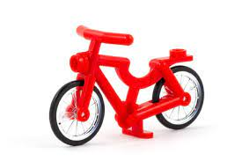
“ BIKES AND PLANES AREN’T ABOUT GOING FAST OR HAVING FUN; THEY’RE TOYS, BUT SERIOUS ONES “ HARRISON FORD

Slide 3
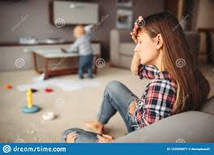
EMPATHIZE
Each year approximately two billion toys are manufactured, and some of these toys are unsafe and may cause injuries to the children.
Toys like marbles ,plastic keys etc , are the ones that are unsafe for toddlers to play with . Apparently a lot of toddlers tend to eat whatever they find on the floor. This is therefore a serious matter to deal with.
Its painful to see a child being rushed to the hospital due to the fact that they swallowed a toy. Imagine the pain that this kid and their parent will be going through.
Notes:
the hospital due to the fact that they swallowed a toy. Imagine the pain that this kid and their parent will be going through.

Slide 4
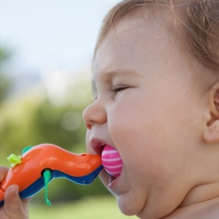
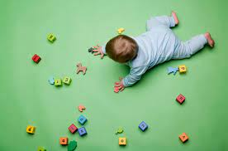
Define
Some of the toys that our children use are dangerous and probably not safe .
Parents sometimes do not read the tags in the toys that indicate the age of a child who is supposed to be using this specific type of toys
A lot of children have been injured and some of them died.
Toddlers need something safe to play with, because most of the toys that parents buy for their kids are dangerous and probably more expensive.

Slide 5
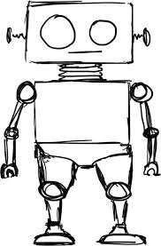
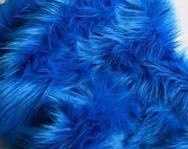
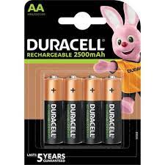
Ideate
Based on what toddlers go through while using certain types of toys, the solution here is to create a much more safer toy that these children can play with.
We cannot create a toy with sharp edges, also small types of toys are also not good for a toddler because they might swallow it.
A big sized toy would do ,with smooth edges, and it might include some features of a robot. It could maybe do some movements or sing a song.
The robot needs to have that soft feel, so that the kids can enjoy playing with it. The addition of a fluffy puffy fabric can make a huge difference.
The addition of the batteries can help to enable the robot to talk and make some kind of movement.
We need to add a speaker

Slide 6
Prototype
I created a toy called “ROBO PUFF”, that is able to say “HELLO” and “ how are you ”, now this is safe for the toddlers to use and doesn’t contain any harmful features.
Toddlers can be able to use and play with and this way parents can relax knowing that their kids have the correct toys to play with .
The robot will be combined with the fluffy fabric to hide edges from hurting the child .it will also be combined with some batteries, to enable the sound and movement …
When the batteries are inserted the robot will immediately say a word see the my robot scratch .
A typical example of the robot is going to say

Slide 7
Test
To test our prototype we gave this robot to two toddlers to see how they would use it.
It turns out that they where happy with the design of the robot ,however we realized that the robot was too big but we came up with another idea of making the robot in a medium sized robot.
We saw that their parents were happy with the design and were impressed by the way their kids were able to interact with the toy .

