Slide 1
Following Covid 19 Regulations
Made by
•Leokai02 (lethabo)
• NAL (Naledi)
• KARABO

Slide 2
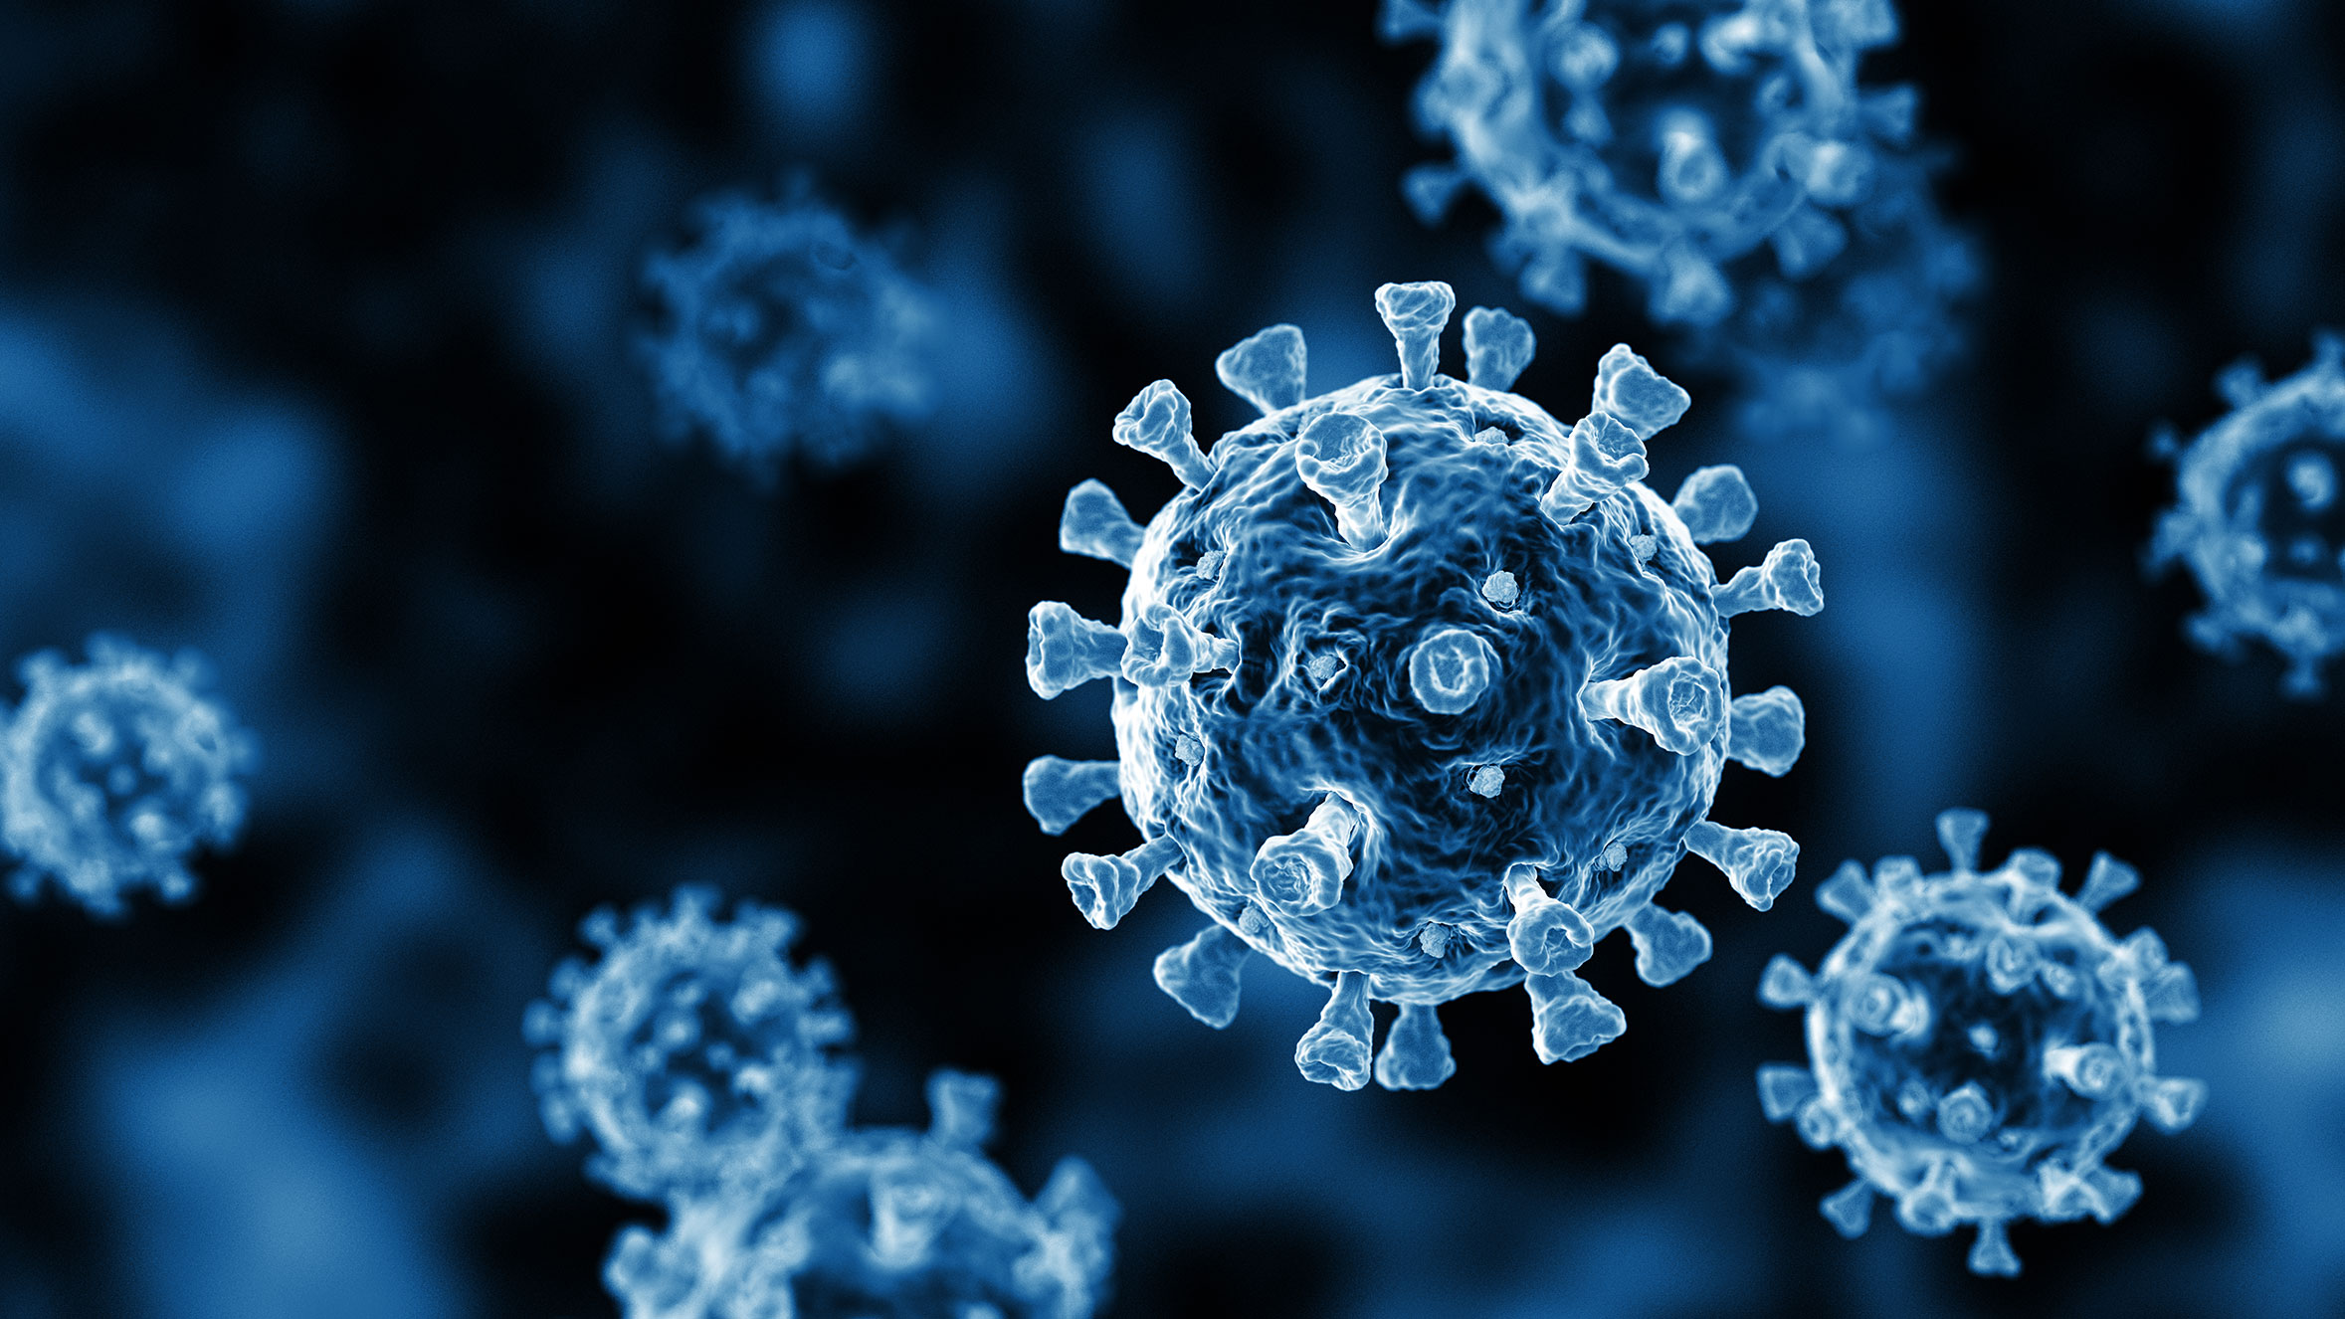
Emphasize
• Covid 19 has become an inconvenience for everyone around the world everyone’s lives has been put on hold due to the virus and the situation gets worse results to higher rates of death
• New infectious are constantly on the raise and some people are not following regulations which results into people being affected daily and it’s hard for health department to help them all at once because they is a pressure on making a cure

Slide 3
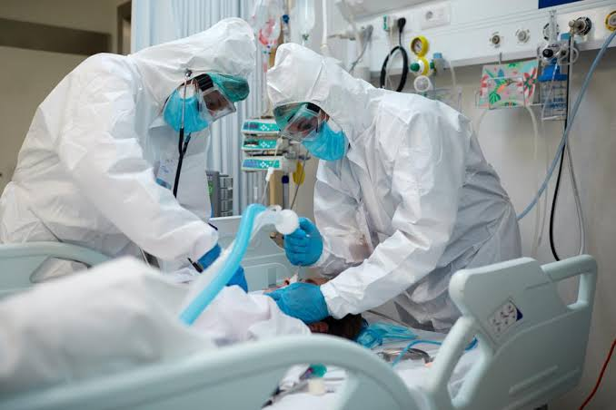
DEFINE
• People not following covid 19 regulations has resulted in the rise of new Infections and this has weighed heavily on the health system. The virus has caused tremendous inconvenience and financial difficulty on both government and households. Although government and authorities are trying by all means to reduce the spread of the virus by initiating lockdowns and shutting down businesses some people are not adhering to these measures If we could step in and try by all means to inform and educate people about the spread of the virus and also mention how following regulations can cause a huge and helpful impact then perhaps people would try to contribute towards stopping the spread of the virus.

Slide 4
Ideate
• Since today the world has entered the (FOURTH INDUSTRIAL REVOLUTION) we hope to use the technology in order to solve covid 19 problems that are affecting the people who are not wearing masks, having social distance, sanitizing and staying in quarantine. Robots this days are being made to solve huge problems in the world and the health Robots can make people to remember that they have to follow rules many countries have already started making AI to help communities, cities and many more in to fight against the virus
•The robot will be a great help to the people who need information about covid 19

Slide 5
Prototype
We have a prototye which is a help bot that can scan a person’s face if they are not wearing masks and if they forget sanitize and can sense if the virus is near by in the atmosphere and warn a person to wear a masks in order to protect them From being infected and it will progress in the future with a tablet to a let people so find information and update about the status of the virus and if not feeling well it provides the location of the nearest pharmacy,clinic and hospital in order to find help before its too late

Slide 6
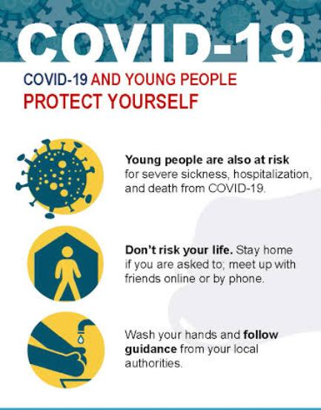
Test
The results came back showing that 65% of the public are following protocols about the covid 19 safety measures that are needed to be taken in order to stop the spread of the virus which is evolving and infecting every person it finds and results it more cases and deaths every week and it is important to follow
The public are taking safety measures thanks to the help bot(AI) that reminds them that it is important for them to wash Wash their hands ,wearing masks, social distancing and sanitizing . The public needs to see that the care bot(Robots) are made to keep them safe. The help bot has been experiencing a malfunction and needs to be upgraded in order for it to last a long time and the mark price is made for business to afford and send their feedbacks.

