Slide 1
My Covid-19 App
By Relentless-cyber

Slide 2
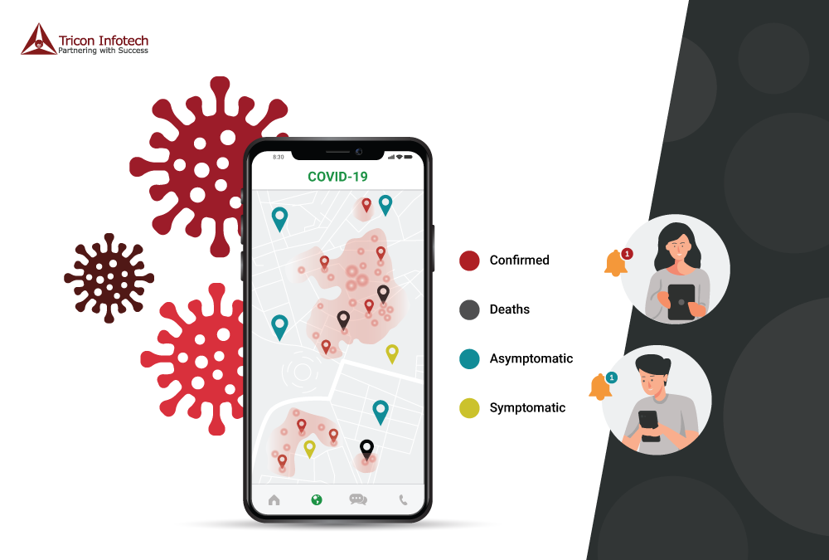
Design of my App

Slide 3
Empathy
Insights from elder users
App should be available for everyone.
App shouldn’t consume a lot of space on phone.
App should stand out informatively.
Insights from youth users
App should convey message that is on point.
App should also contain a simple game based on Covid 19, so the information can be grasped.

Slide 4
Define
User need app that will continually update him/her with latest covid-19 news.
App should be accessible by everyone & advertized virally to gain attention.
Because most adults do not have smart phones, some information in the app should be provided publicly(Radio/TV)
Why?
- Because, the more information obtained by people regarding Covid-19 the hazards can be spotted.
Where do we start?
Will start by creating an app which is prevailing coming to statistics.

Slide 5
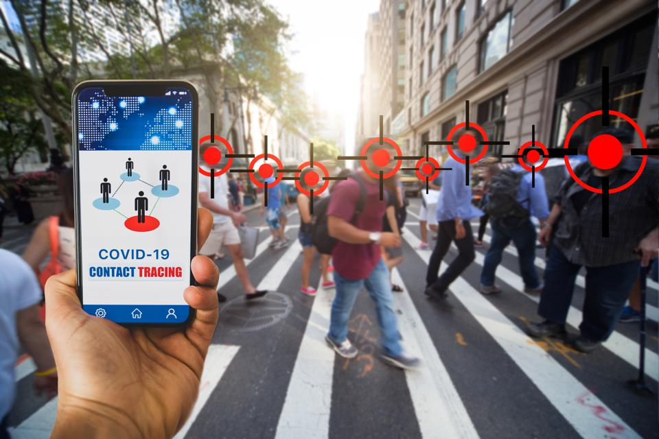
Ideate
User will gain more valuable info(like hazards) using app.
User will be mobilized in any public, knowing the statistics.
App should buzz when user enters danger locations.
Gauteng 60%
North-west 20%
Cape-town 45%

Slide 6
Prototype
Log in
Sign up
HOW IT SPREADS
AVOIDING HAZARDS

Slide 7
Testing
What can be improved?
Options to various African languages.
What worked?
App is efficient & reliable in information.
Ideas
It should focus more on tracing danger zones rather than giving info that we can get elsewhere.
Questions
Can we chat with other users using the app?

Slide 8
Conclusion
Based on the testing do you believe your solution meets the Desirable, Feasible, Viable criteria? Why?
Yes, because the app can be put to action and deliver the best results based on the users feedback and insights and it can be accessed by anyone anywhere.

