Slide 1


Slide 2

Topic : Design a way to educate the public on Covid-19

Slide 3
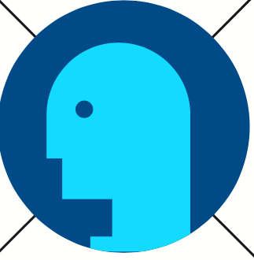
Empathise
Covid-19 has affected lot of people, its very painful to see people getting sick then end up dying due to covid-19 and the symptoms are more likely to go deeper than viruses like the common cold. The lungs might become inflamed,making it tough for you to breathe. This can lead to pneumonia, an infection of the tiny air sacs (called alveoli) inside your lungs were your blood exchanges oxygen and carbon dioxide.
Says
It is very stressing
It doesn't have a cure
Thinks
It will affect us all
Why its causing many death
Does
Get tested
Vaccinate
Feels
Anxiety
Depressed

Slide 4
Define
Coronaviruses are zoonotic. This means they first develop in animals before developing in humans. For the virus to pass from animal to humans, a person has to come into close contact with an animal that carries the infection.
Once the virus develops in people, coronaviruses can be spread from person to person through respiratory droplets. This is a technical name for the wet stuff that moves through the air when you cough or sneeze.
The viral material hangs out in these droplets and can be breathed into the respiratory tract (your windpipe and lungs), where the virus can then lead to an infection.
Coronavirus disease (COVID-19) is an infectious disease caused by a newly discovered coronavirus.
The virus that causes COVID-19 is mainly transmitted through droplets generated when an infected person coughs, sneezes, or exhales. These droplets are too heavy to hang in the air, and quickly fall on floors or surfaces.
People can be infected by breathing in the virus if you are within close proximity of someone who has COVID-19, or by touching a contaminated surface and then your eyes, nose or mouth.
Most people who fall sick with COVID-19 will experience mild to moderate symptoms and recover without special treatment.

Slide 5
Define
Common symptoms:
• Fever.
• Tiredness.
• Dry cough.
Some people may experience:
• Aches and pains.
• Nasal congestion.
• Runny nose.
• Sore throat. Diarrhoea.
On average it takes 5–6 days from when someone is infected with the virus for symptoms to show, however it can take up to 14 days.
Older people and people with certain health conditions have a higher risk for severe complications if they contract the virus. These health conditions include.
• lung conditions, such as COPD and asthma
• certain heart conditions
• immune system conditions, such as HIV
• cancer that requires treatment
• severe obesity
• other health conditions, if not well-controlled, such as diabetes, kidney disease, or liver disease
Pregnant women have a higher risk of complications from other viral infections, but it’s not yet known if this is the case for COVID-19.

Slide 6
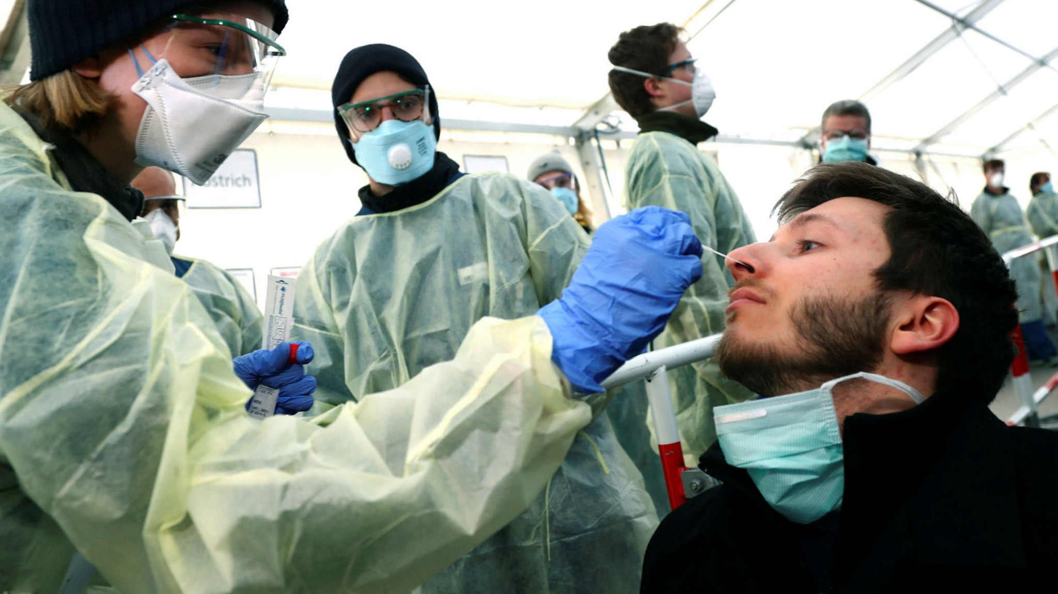
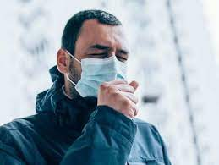
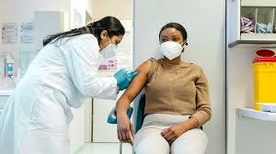
Ideate
Notes:
Avoid close contact to others
Get tested when having Covid-19 Symptoms
Isolate yourself for 14 days
Get Vaccinated when You are not sick

Slide 7
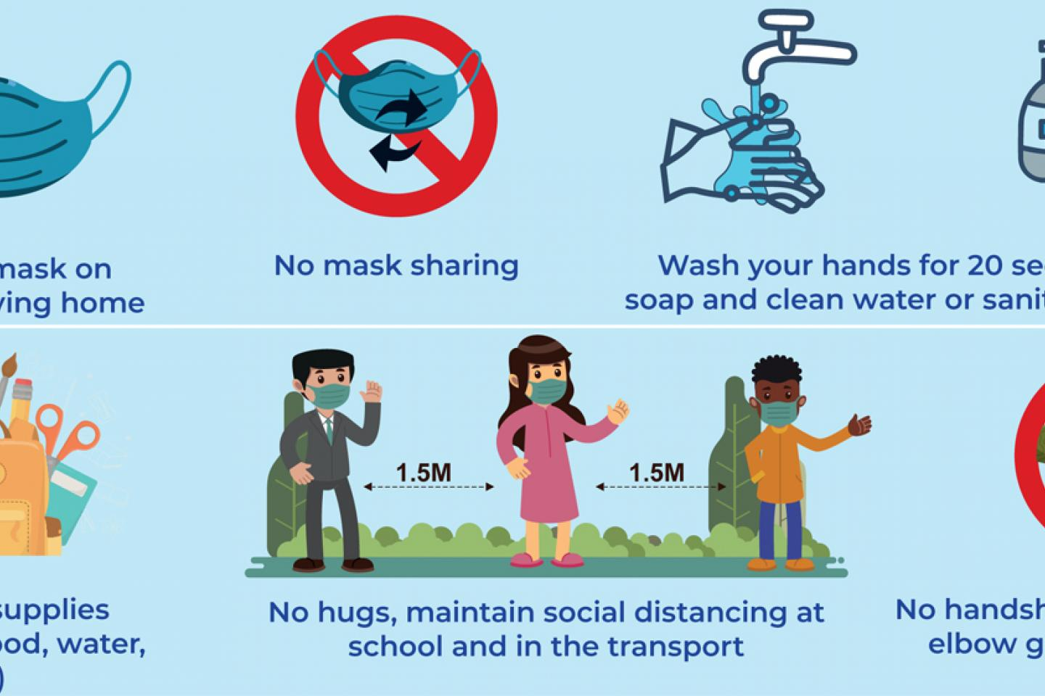
Prototype
Notes:
To prevent the spread of COVID-19:
• Avoid large events and mass gatherings.
• Avoid close contact (within about 6 feet, or 2 meters) with anyone who is sick or has symptoms.
• Stay home as much as possible and keep distance between yourself and others (within about 6 feet, or 2 meters) if COVID-19 is spreading in your community, especially if you have a higher risk of serious illness. Keep in mind some people may have COVID-19 and spread it to others, even if they don't have symptoms or don't know they have COVID-19.
• Wash your hands often with soap and water for at least 20 seconds, or use an alcohol-based hand sanitizer that contains at least 60% alcohol.
• Cover your face with a cloth face covering in public spaces, such as the grocery store, where it's difficult to avoid close contact with others, especially if you're in an area with ongoing community spread. Only use nonmedical cloth masks — surgical masks and N95 respirators should be reserved for health care providers.
• Cover your mouth and nose with your elbow or a tissue when you cough or sneeze. Throw away the used tissue.
• Avoid touching your eyes, nose and mouth.
• Avoid sharing dishes, glasses, bedding and other household items if you're sick.
• Clean and disinfect high-touch surfaces daily.
• Stay home from work, school and public areas if you're sick, unless you're going to get medical care. Avoid taking public transportation if you're sick.

Slide 8
Testing
COVID-19 can be diagnosed similarly to other conditions caused by viral infections: using a blood, saliva, or tissue sample. However, most tests use a cotton swab to retrieve a sample from the inside nostrils.
There’s currently no treatment specifically approved for COVID-19, and no cure for an infection. Instead, treatment focuses on managing symptoms as the virus runs its course.
Get Vaccinated

