Slide 1
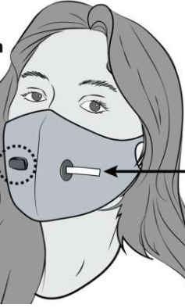
A way to educate the public with covid-19

Slide 2
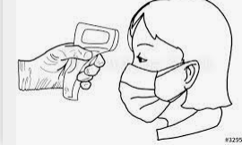
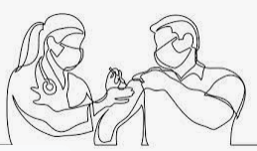
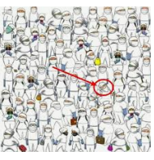
Empathise
Covid-19 has led to sweeping change and disruptions in nearly everyday life
It is important to practice empathy this time not only for others but also for yourself
Help others with their needs if you feel like helping others

Slide 3
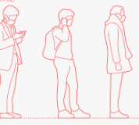
Define
The problem is that other people don’t make social distance
Others don’t even believe that covid-19 exist
If people keep on not wearing masks and not following covid-19 rules we wont be able to get rid of this various

Slide 4
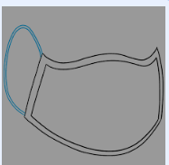
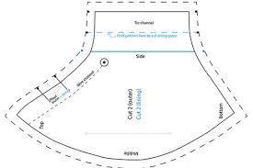
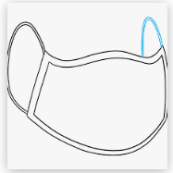
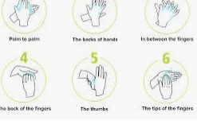
Ideate
A way to create your own mask
Step2
Step3
Step4
Step5
Step1

Slide 5
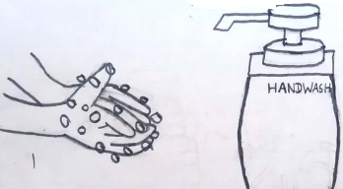
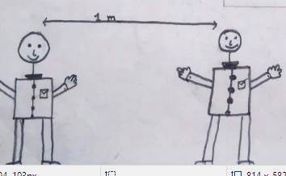
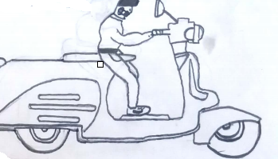
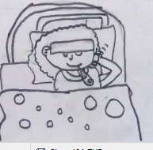
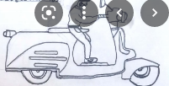
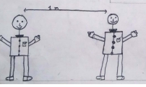
Prototype
Step 1
step2
step3
Step4
Wash hands for 20seconds with soap,handwash or with sanitiser
Keep social distance atleast one meter and also wear ur musk
If you cough regulary or you have high fever contact the helpline number
When you are going out wear your musk and go out for only important work and keep a distance from others in order for you to be save

Slide 6
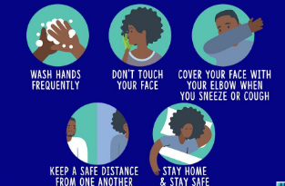
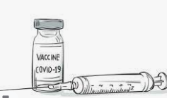
Testing
We’ve tested that there are only few ways that would prevent us from being infected with COVID-19
By washing our hands regularly
Don’t touch your face if you haven’t wash your hands
Cough using a tissue or your elbow
By keeping a distance of 2cm from one another
By getting yourself vaccinated from your near clinic or hospital
Also by getting tested

