Slide 1
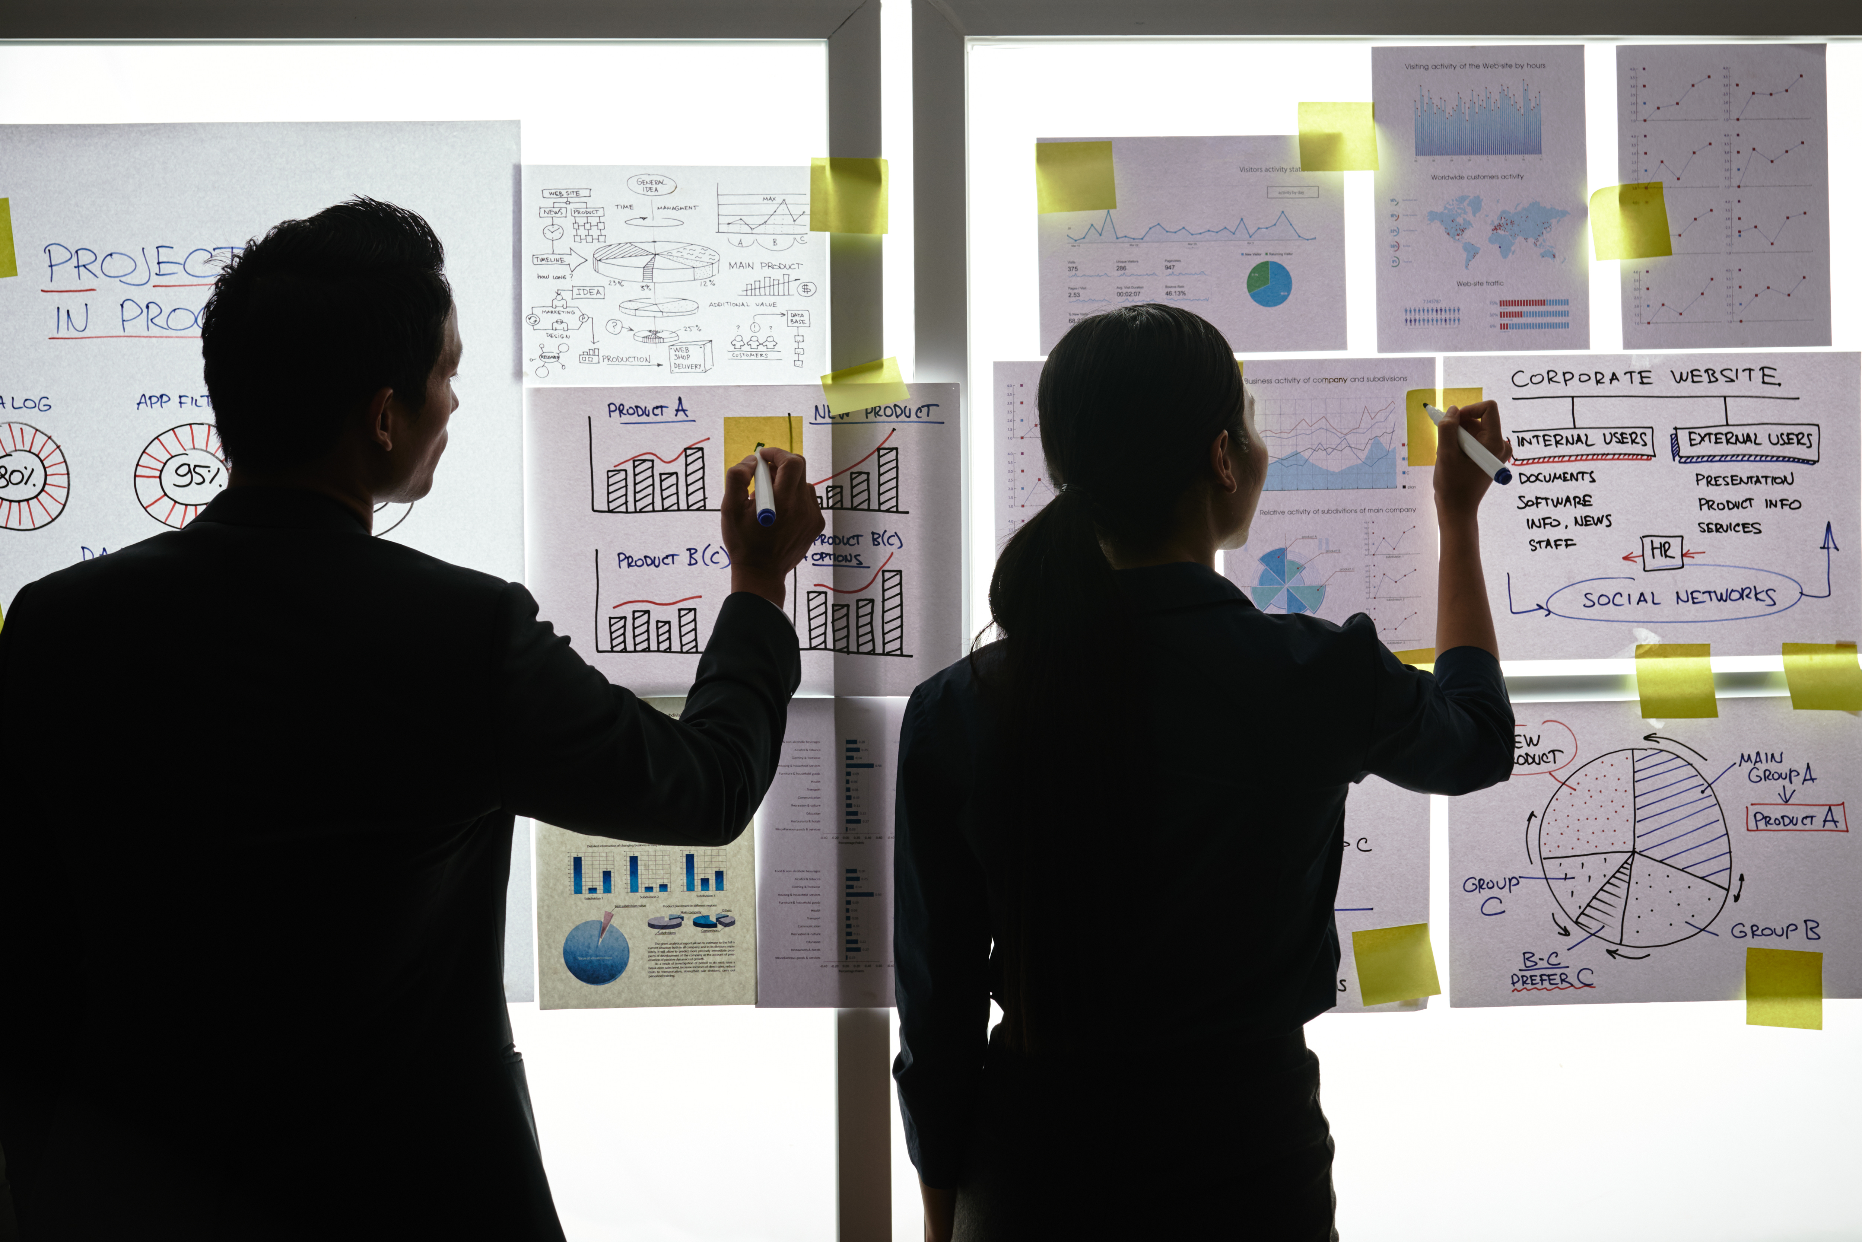

Practical Exercise

Slide 2
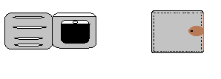
Design your Ideal Wallet
Draw you ideal wallet in this block you have 5 min – Please take a photo and insert in the Powerpoint deck provided which you will upload later under your Wallet project

Slide 3
Empathy – Identify a partner and Engage
Dig Deeper – Considering what you learned really try to dig into your partners feelings and motivations - 5 min each
Interview your partner you each have - 5 min
Notes from first interview
Notes from second interview
Likes light in colour and it is also thin
Likes it because of it is light in weight

Slide 4
Define and understand the problem and gain insights
Capture Findings - 5 min
Take a Stand with a point of view - 5 min
Needs: things your partner is trying to do Use verbs
_______________lethabo_____________________________
Needs a way to _____________________________
To make him feel comfortable
Because … or but ……. or surprisingly…….
It will help him by putting more things
_____________________________________________
And store lots of things
_____________________________________________
_____________________________________________
Need iD ,smart cart and licence
Partner’s Name
User’s need
Insights: new learnings about your partners feelings and motivations. What’s something you see about your partners experience that he she does not see? Use what you heard them say
Circle one
My partner fillings is that hes happy about this wallet because this wallet put more things
Insight

Slide 5


Ideate – Generate alternatives to test
Sketch at least 5 radical ways to meet your users needs - 10 min
________________________________________________________________________________________________
Write your problem statement above
Leather wallet help to put more things
A car can protect wallet for staying inside it..
Put money ,bank card ,licence and etc…
Share your solution with your partner and capture feedback - 5 min each
Notes:*he think it’s a good thing for putting his things inside a wallet..

Slide 6

Iterate on Feedback
Reflect and generate a new solution 5 min
Sketch your idea and note details if necessary
Special car for keeping all things inside it..and when they are inside a car they are always safe.

Slide 7
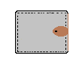
Build and Test
Build your solution
Share your solution and get feedback – 5min each
Make something your partner can interact with use anything you want paper cardboard etc. Place photo’s here (10min)
What worked
What can be improved
can inprove by putting maybe money ..
This wallet work for putting bank cards and etc…and it also store money
Questions
Ideas
What would you say about my wallet..
My idea is to make sure that this wallet is always save..

Slide 8
Your experience
Please upload your completed wallet exercise project in the projects section tagging your partner
Please share your thoughts comments experiences during this work session in the Design thinking group.

