Slide 1
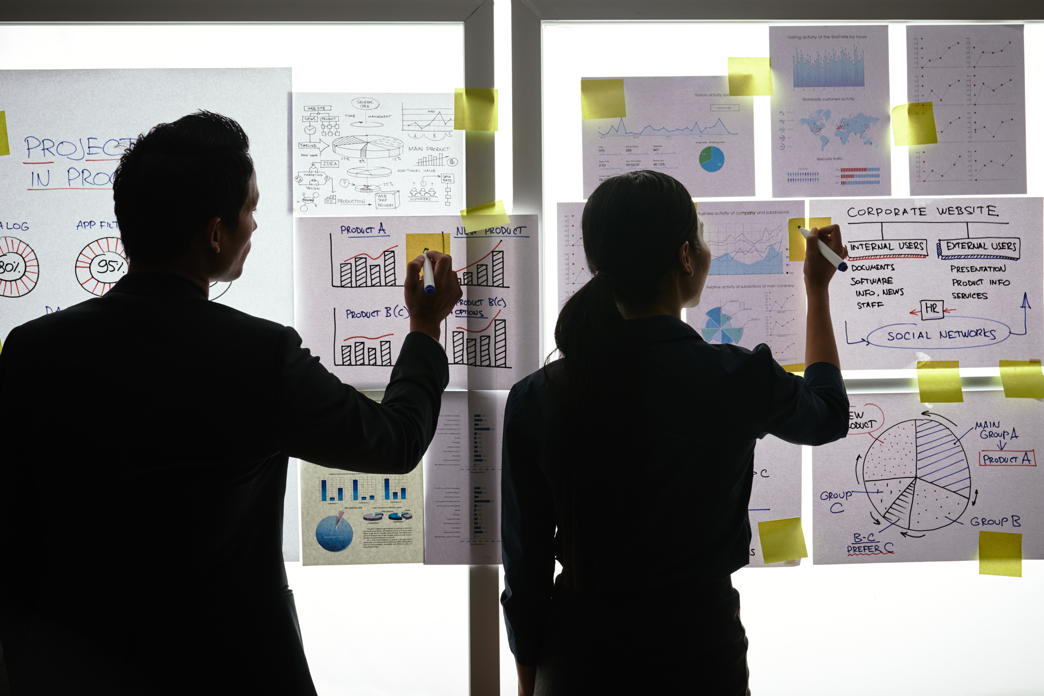
My wallet
BY
RELENTLESS-CYBER

Slide 2
Design your Ideal Wallet
Draw you ideal wallet in this block you have 5 min – Please take a photo and insert in the Powerpoint deck provided which you will upload later under your Wallet project
TOP
FRONT
INSIDE
wallet

Slide 3
Empathy – Identify a partner and Engage
Dig Deeper – Considering what you learned really try to dig into your partners feelings and motivations - 5 min each
Interview your partner you each have - 5 min
Notes from first interview
Notes from second interview
She prefers it small & made from durable material.
Fits – Cards , keys & Cash separately.
Easy to find
Things don’t fall out easily.
Portable and strong material
Enough Space for different compartments.
Elastic & must zip

Slide 4
Define and understand the problem and gain insights
Capture Findings - 5 min
Take a Stand with a point of view - 5 min
Needs: things your partner is trying to do Use verbs
Mom
____________________________________________
Feel Portable & Secure
Needs a way to _____________________________
Because … or but ……. or surprisingly…….
Her wallet is unnecessarily big, thus compels her
_____________________________________________
to carry it by hand which is not safe.
_____________________________________________
_____________________________________________
Secure items inside wallet
Portable
Distinguishable
Partner’s Name
User’s need
Insights: new learnings about your partners feelings and motivations. What’s something you see about your partners experience that he she does not see? Use what you heard them say
Circle one
A small size & a prevailing material triggers
Security.
Needs to be elastic for protection(objects inside).
Insight

Slide 5
Ideate – Generate alternatives to test
Sketch at least 5 radical ways to meet your users needs - 10 min
________________________________________________________________________________________________
Write your problem statement above
Mom needs a wallet that is portable and secure because her wallet is too big which compels her to carry it by hand.
Separate compartments for various purposes
Must zip
Smaller sized (fits in her purse/pocket)
Colourful & strong material
Share your solution with your partner and capture feedback - 5 min each
Notes:
Losing her stuff is a problem, but with a smaller size and a zip she is able to preserve her things & fit her wallet in her purse or pocket. The colourful leather material will make it easy to spot her purse from various objects.

Slide 6
Iterate on Feedback
Reflect and generate a new solution 5 min
Sketch your idea and note details if necessary
Wallet can conveniently fit in her purse.
Wallet can zip which will keep all her
personal belongings safe.

Slide 7
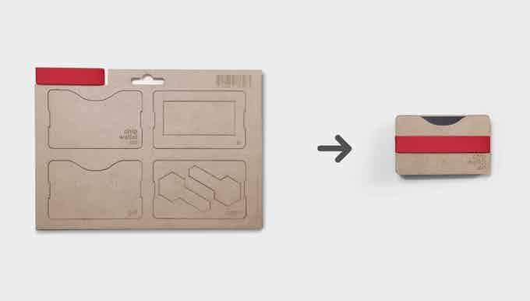
Build and Test
Build your solution
Share your solution and get feedback – 5min each
Make something your partner can interact with use anything you want paper cardboard etc. Place photo’s here (10min)
What worked
What can be improved
Wallet size is portable &
tiny (can fit anywhere).
Material elasticity and
colour.
Questions
Ideas
How can we encrypt the
wallet to recognize
Its real user?
How can we make it
change colours?
In future it can
evolve to being a
Powerbank-wallet,
whereby it can also
charge your phone.

Slide 8
Your experience
Please upload your completed wallet exercise project in the projects section tagging your partner
Please share your thoughts comments experiences during this work session in the Design thinking group.

