Slide 1
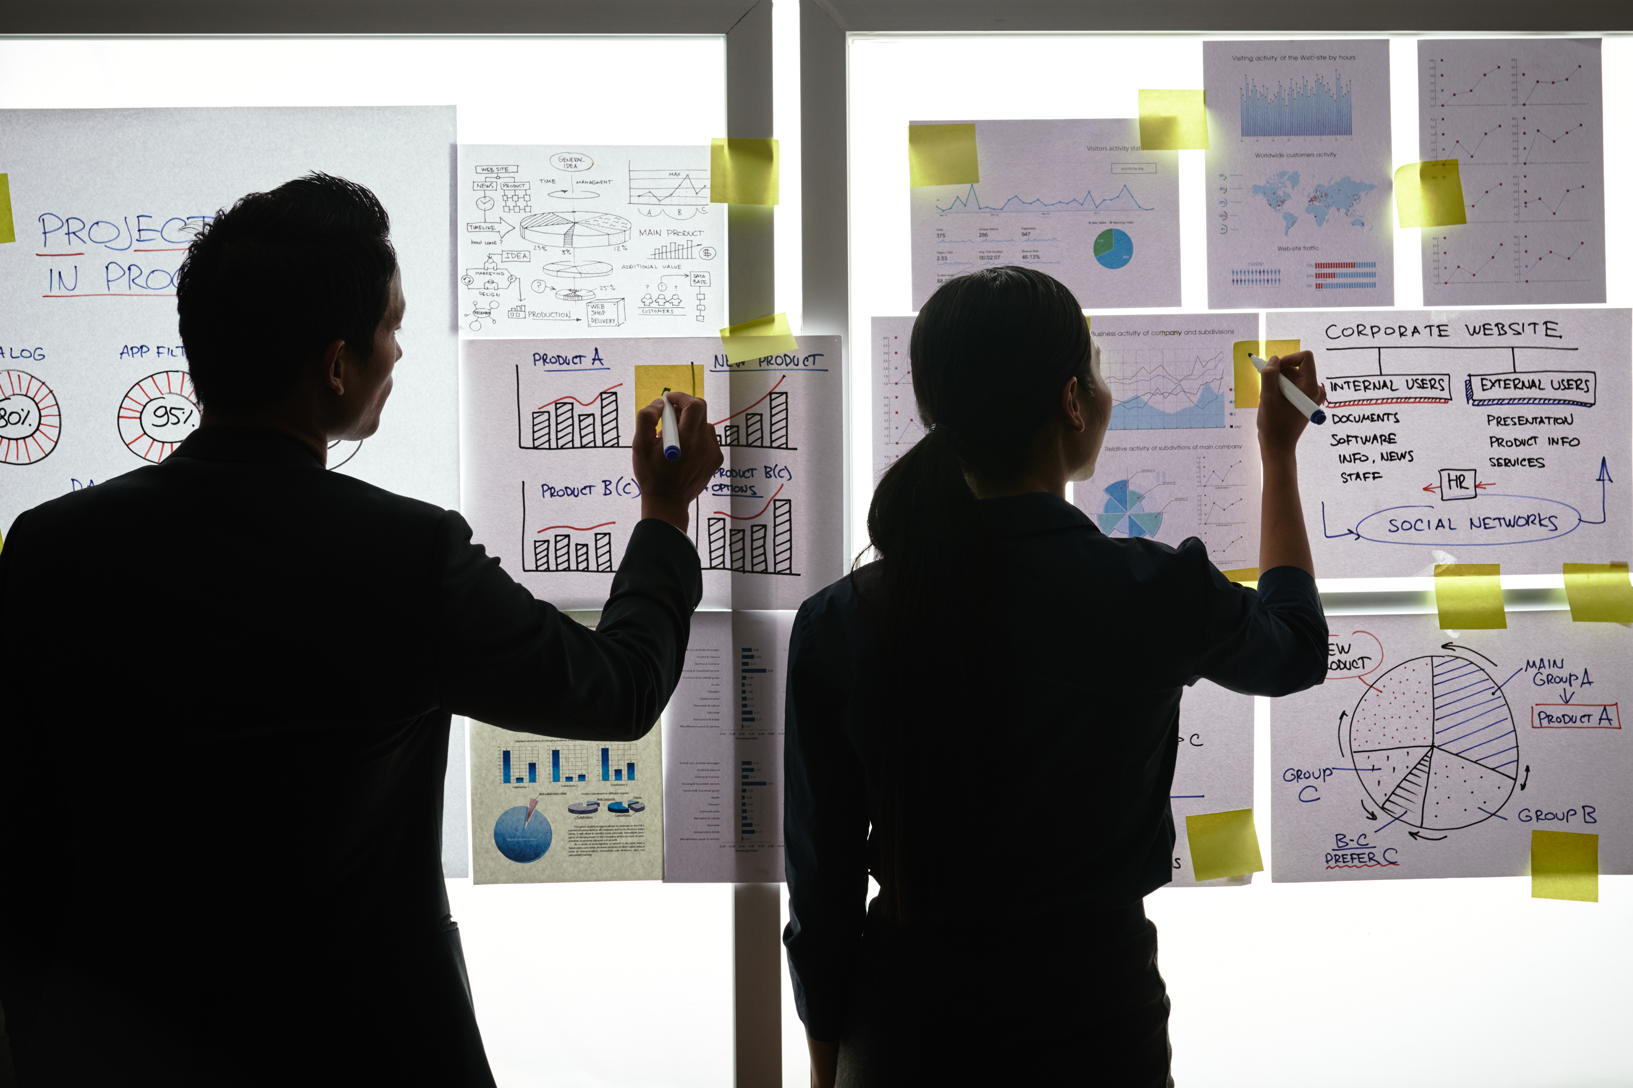
Practical Exercise

Slide 2
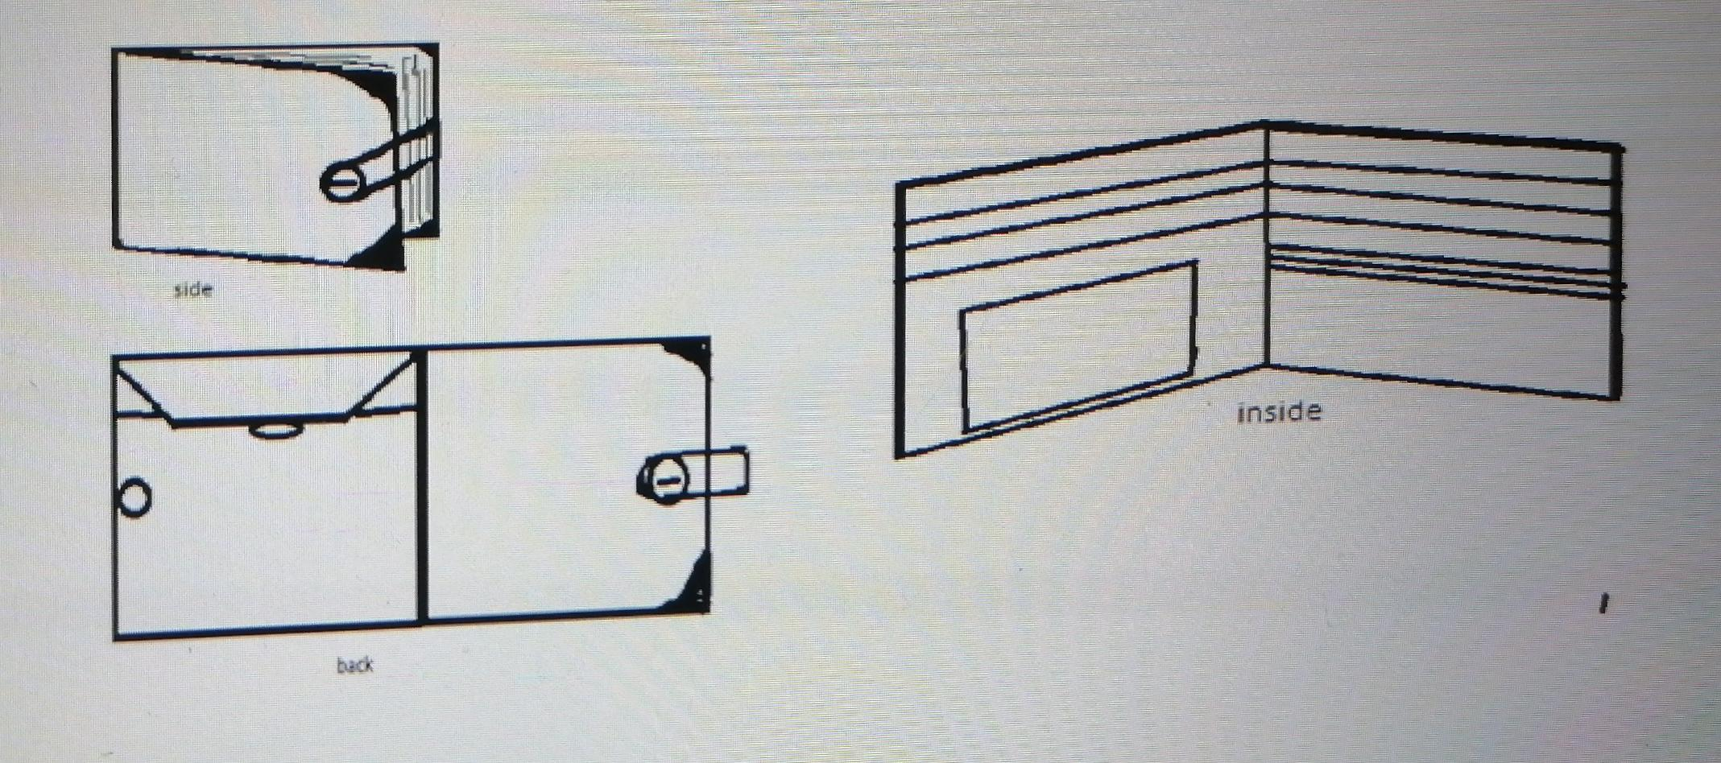
Design your Ideal Wallet
Draw you ideal wallet in this block you have 5 min – Please take a photo and insert in the Powerpoint deck provided which you will upload later under your Wallet project

Slide 3
Empathy – Identify a partner and Engage
Dig Deeper – Considering what you learned really try to dig into your partners feelings and motivations - 5 min each
Interview your partner you each have - 5 min
Notes from first interview
Notes from second interview
that stands out from the others in terms of design
One that can last a bit longer maybe 4 to 5 years
Must have a screen that can upload digital cards
Doesn’t have to contain unnecessary slots or pockets
Must be flexible
Must be thin
Have a cool print or logo on it

Slide 4
Define and understand the problem and gain insights
Capture Findings - 5 min
Take a Stand with a point of view - 5 min
Needs: things your partner is trying to do Use verbs
Tsoarelo Mosala
Needs a way to one of a kind modern wallet
Because … or but ……. or surprisingly…….
Has to contain multiple color options
Tap to pay optiona
Must be water resistant
Partner’s Name
User’s need
Insights: new learnings about your partners feelings and motivations. What’s something you see about your partners experience that he she does not see? Use what you heard them say
We are living in a modern world of internet of things, and he needs to change with the times.. Since we’re living in a world such as all of our devices are communicating with each other hance he need a sort of digital modern wallet…
Insight

Slide 5
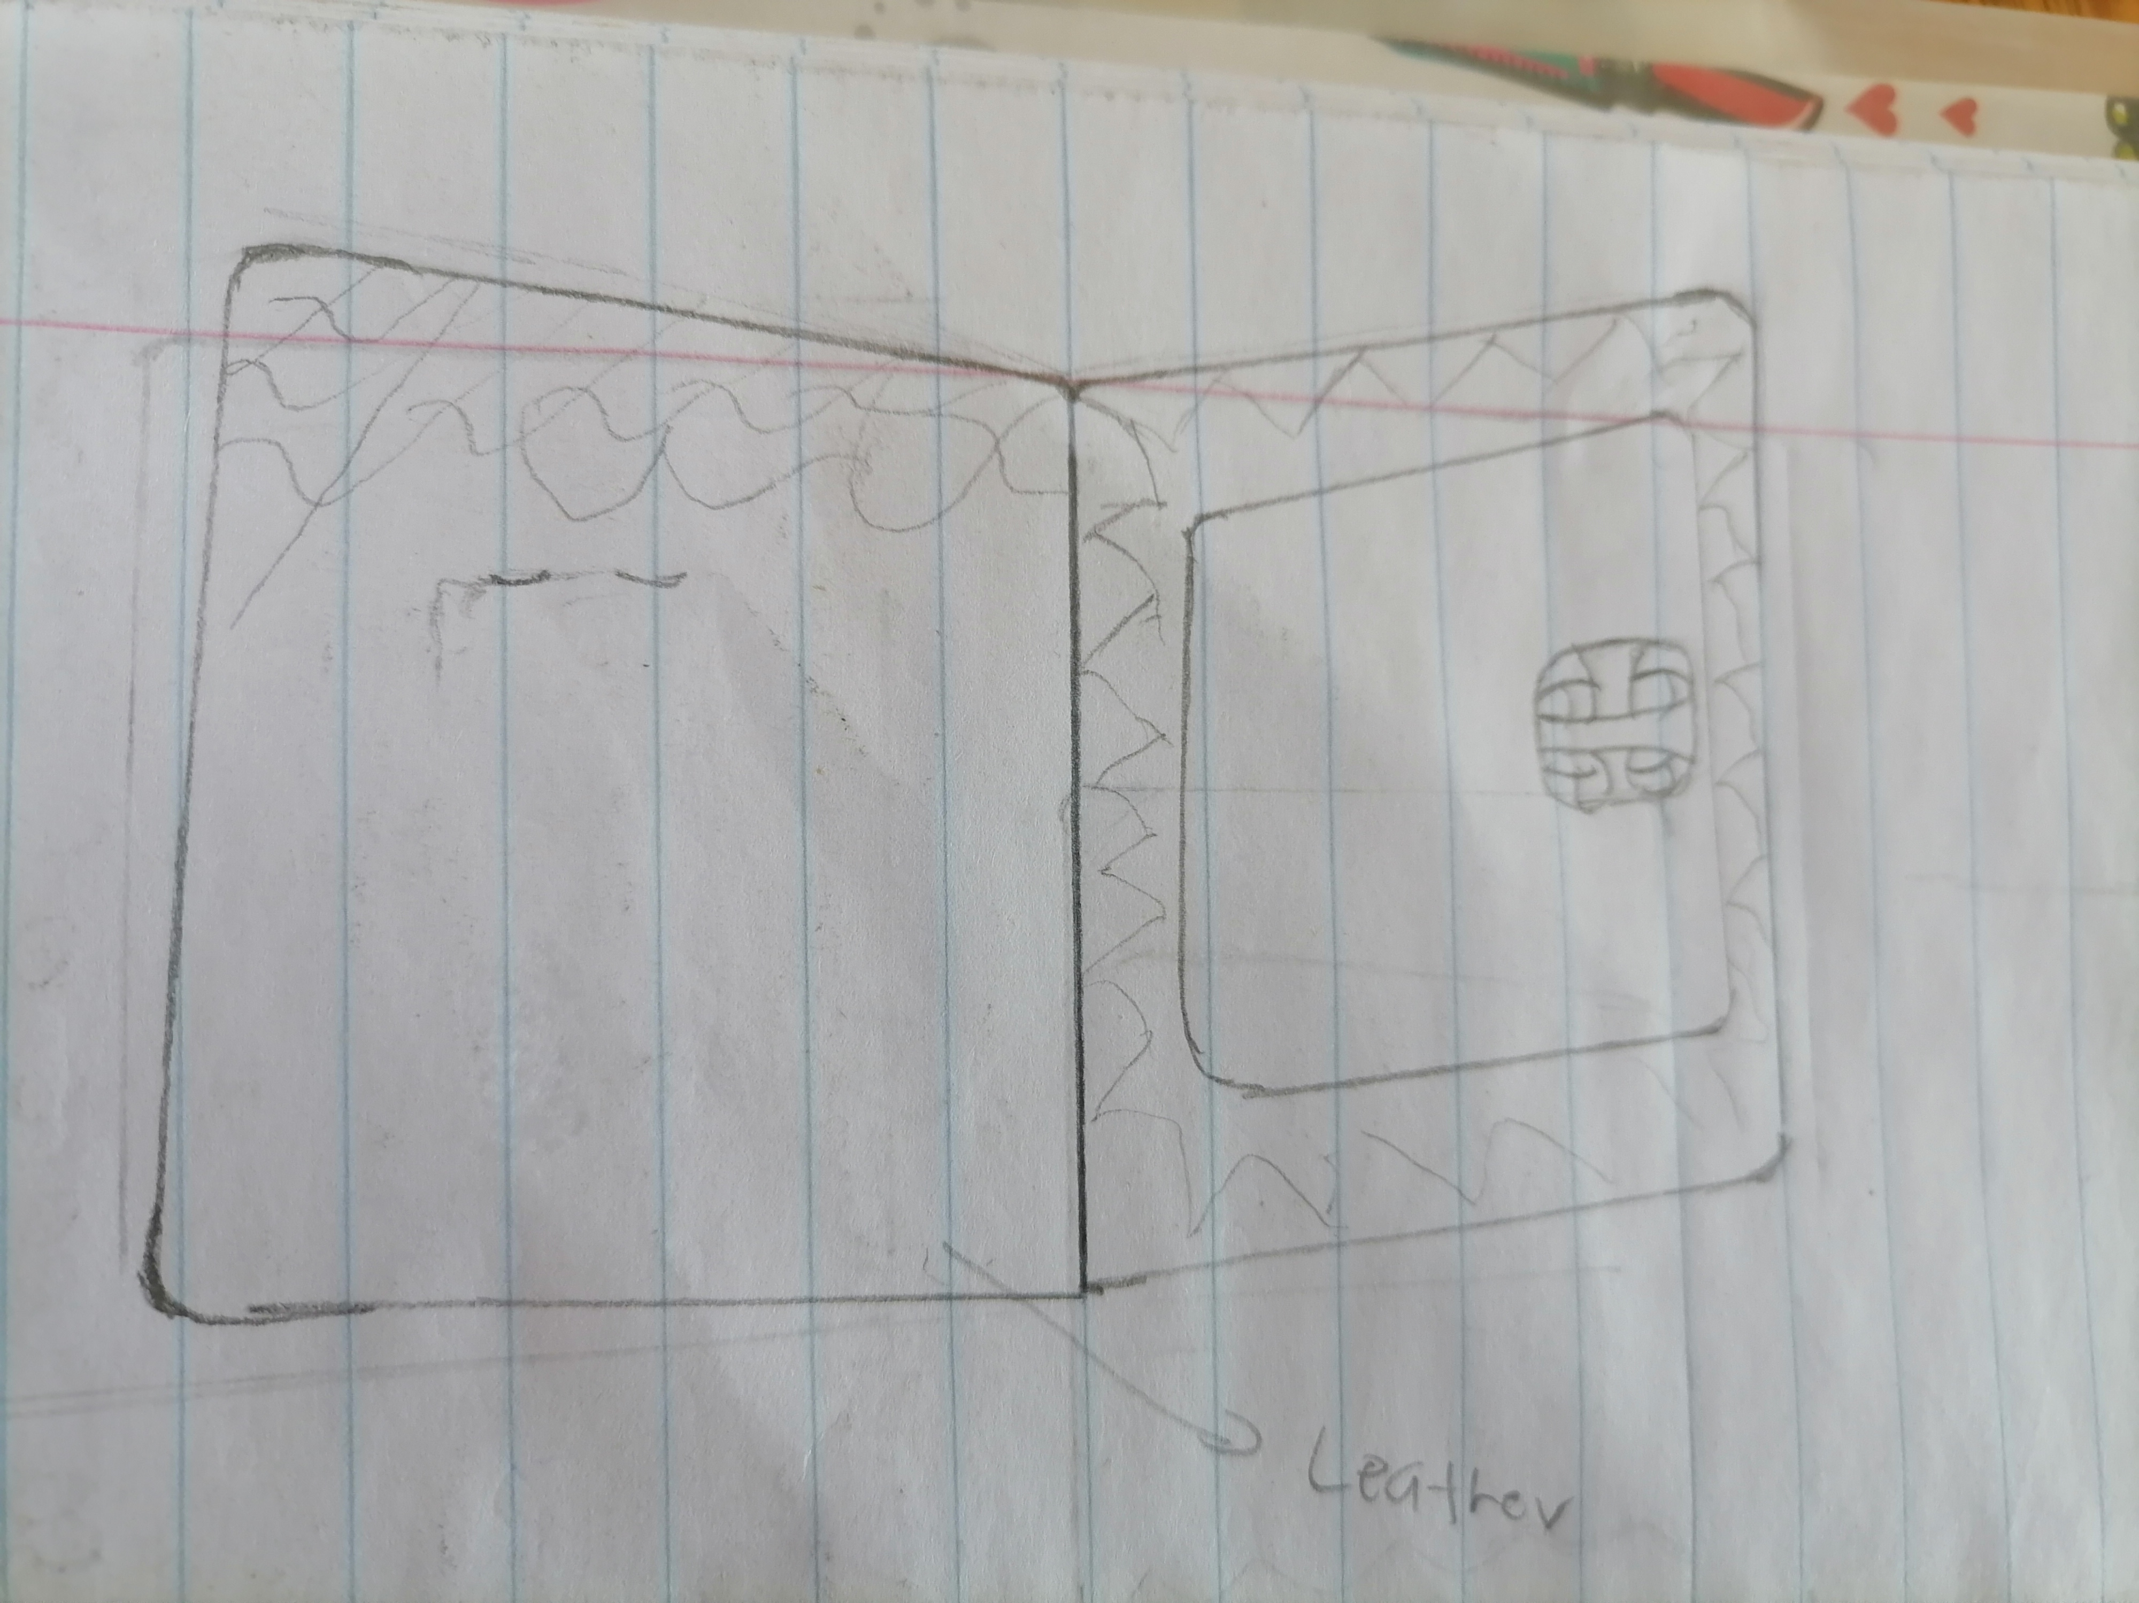
Ideate – Generate alternatives to test
Sketch at least 5 radical ways to meet your users needs - 10 min
A digital modern wallet is needed in order to make Tsoarelo happy and to kind of put him into a modern world .
Write your problem statement above
Materials such as
Leather and
Polyurethane will be
Needed in order to
Make the wallet to
Stand out .
The addition of
A screen that
Displays phone’s
Content
Only necessary
Slots and pockets
Will be added
Share your solution with your partner and capture feedback - 5 min each
Notes:
He thinks that I should add a cool print or drawing to make the wallet more attractive
Also make a pocket for coins

Slide 6
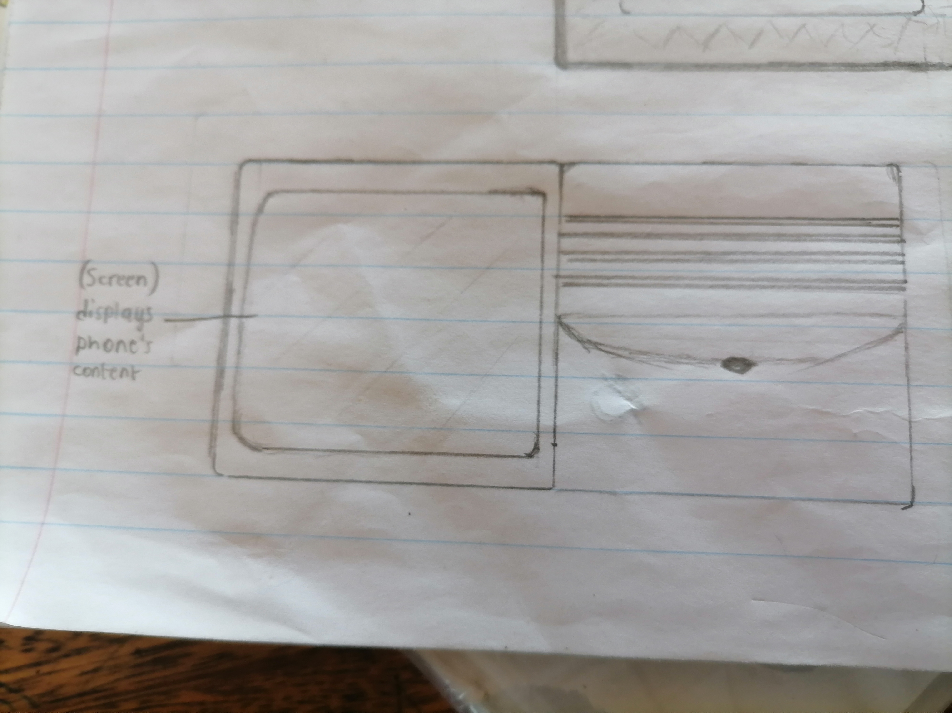
Iterate on Feedback
Reflect and generate a new solution 5 min
Sketch your idea and note details if necessary
Addition of a cool picture or drawing
The addition of the pocket for coin money

Slide 7
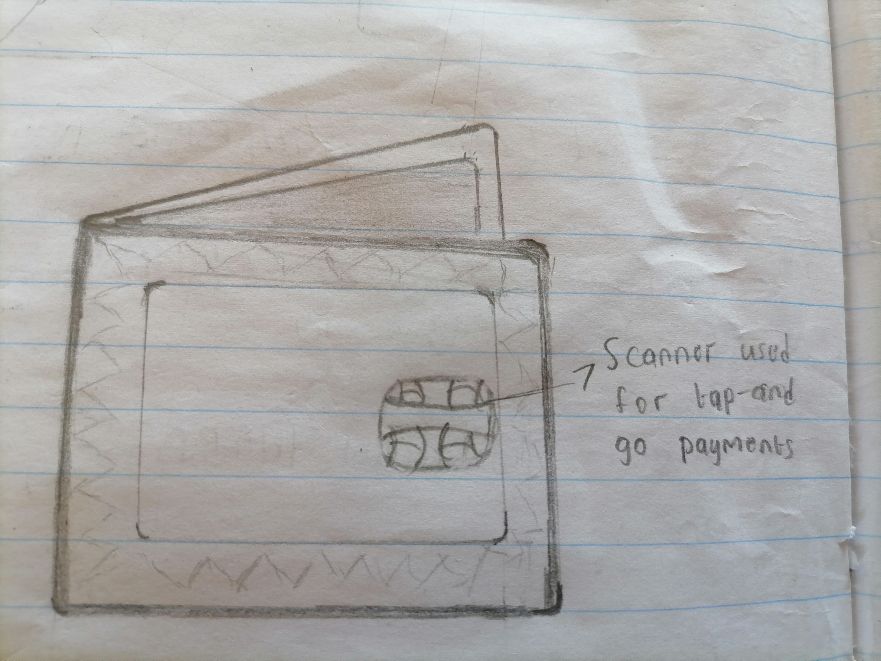
Build and Test
Build your solution
Share your solution and get feedback – 5min each
Make something your partner can interact with use anything you want paper cardboard etc. Place photo’s here (10min)
What worked
What can be improved
The scanner for tap
And go payments.
The screen for the
Content of the phone to be displayed
However we can
Improve the
Functionality of the
Screen.
Questions
Ideas
Not more than 1000
Rands
How much does it
Cost for this wallet

Slide 8
Your experience
Please upload your completed wallet exercise project in the projects section tagging your partner
Please share your thoughts comments experiences during this work session in the Design thinking group.

