Slide 1
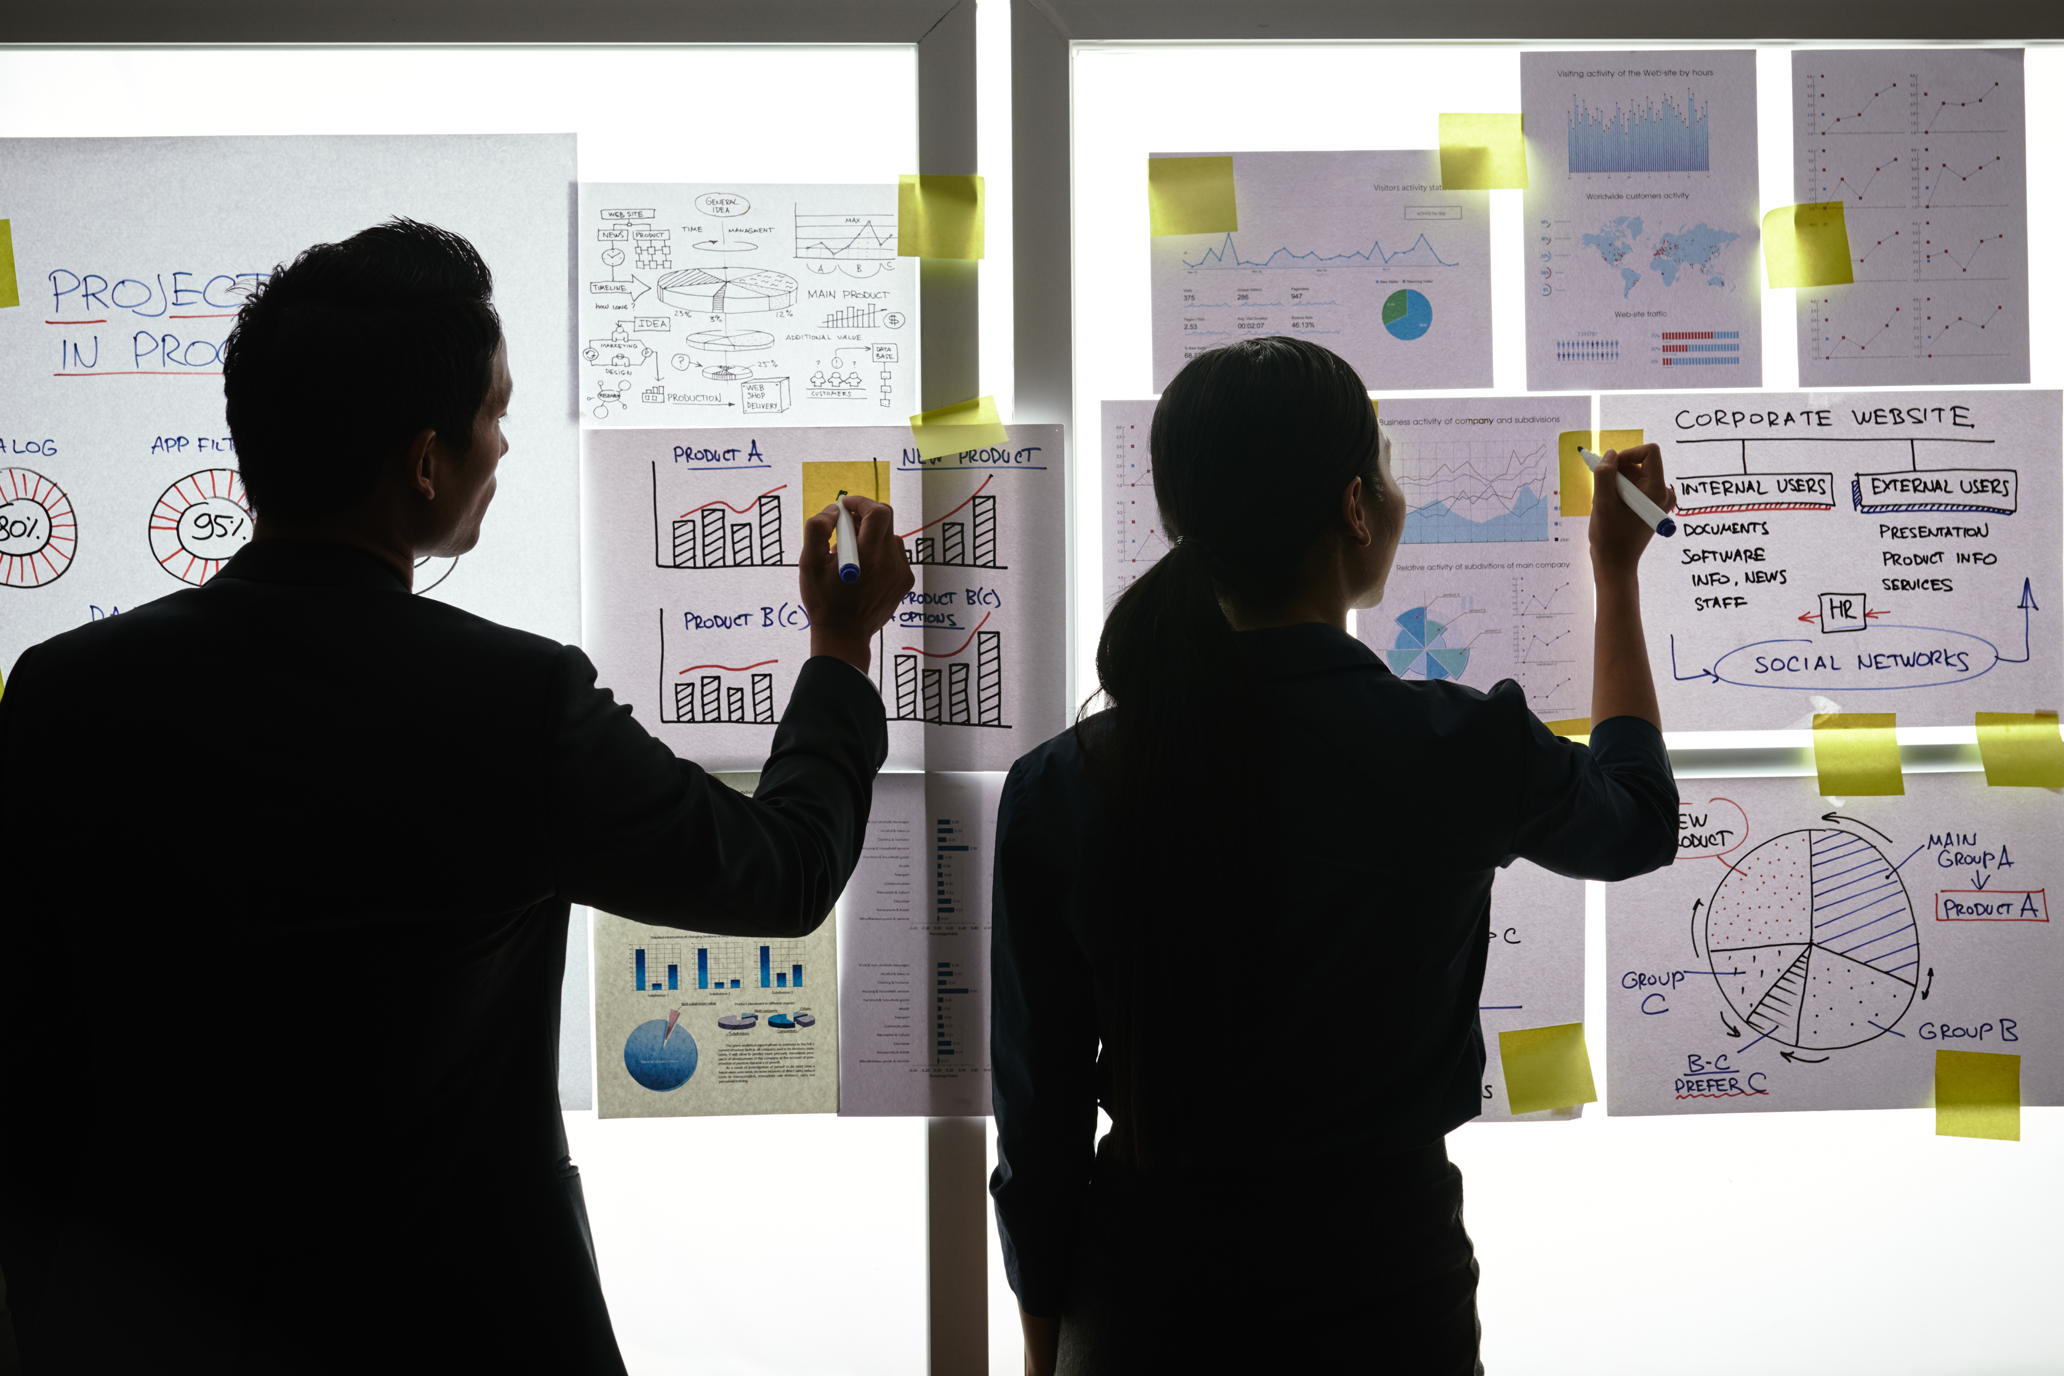
Practical Exercise

Slide 2
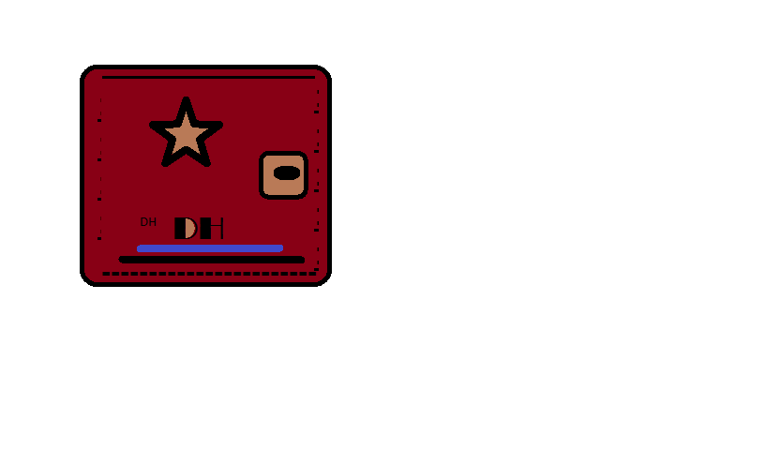
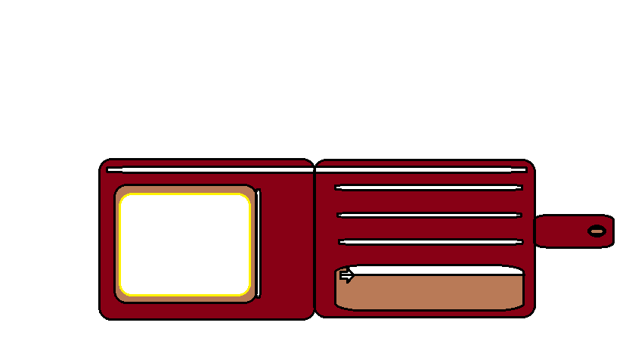
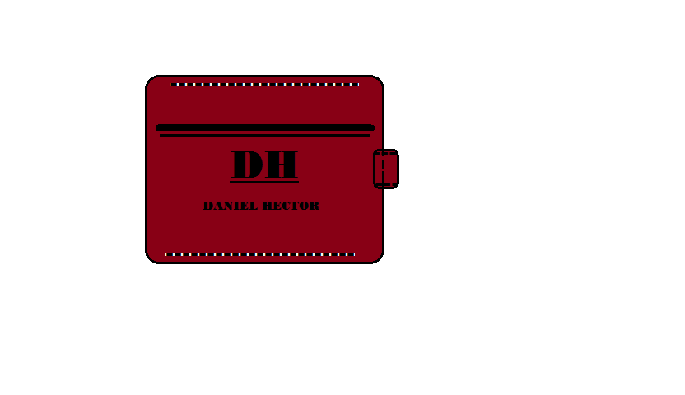
Design your Ideal Wallet
Draw you ideal wallet in this block you have 5 min – Please take a photo and insert in the Powerpoint deck provided which you will upload later under your Wallet project

Slide 3
Empathy – Identify a partner and Engage
Dig Deeper – Considering what you learned really try to dig into your partners feelings and motivations - 5 min each
Interview your partner you each have - 5 min
Notes from first interview
Notes from second interview
He said that he want his wallet light n small so that he can put it in his pocket.And because the is a lot of crime his wallet must fit will in the pocket
He said that he want his wallet brownish in colour,and be a little musive inside

Slide 4
Define and understand the problem and gain insights
Capture Findings - 5 min
Take a Stand with a point of view - 5 min
Needs: things your partner is trying to do Use verbs
Siyanda Hlongwane
____________________________________________
Needs a way to _feel confortable
Because … or but ……. or surprisingly…….
_Because he want to keep his wallet safe____________________________________________
_____________________________________________
_____________________________________________
Partner’s Name
User’s need
Insights: new learnings about your partners feelings and motivations. What’s something you see about your partners experience that he she does not see? Use what you heard them say
Circle one
Insight

Slide 5
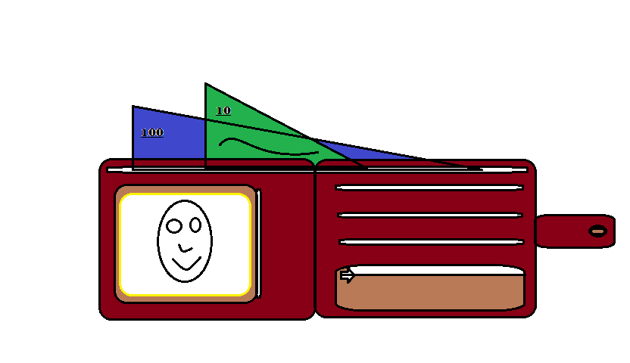
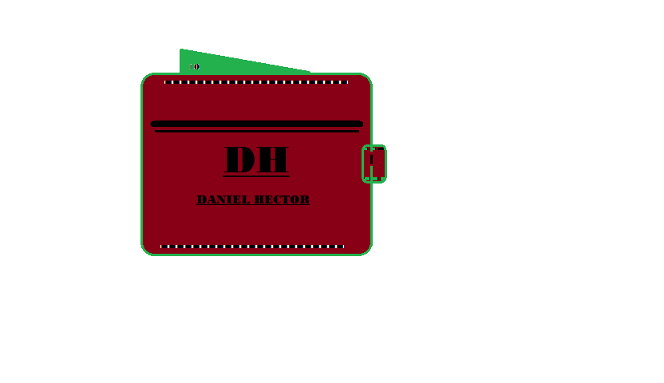
Ideate – Generate alternatives to test
Sketch at least 5 radical ways to meet your users needs - 10 min
________________________________________________________________________________________________
Write your problem statement above
Share your solution with your partner and capture feedback - 5 min each
thi
Notes:
This is a best wallet ever that you can ever get ,it is a light and smat wallet ever

Slide 6
Iterate on Feedback
Reflect and generate a new solution 5 min
Sketch your idea and note details if necessary

Slide 7
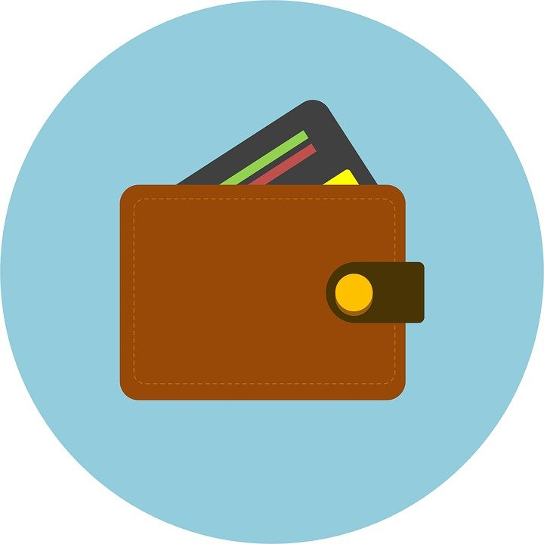
Build and Test
Build your solution
Share your solution and get feedback – 5min each
Make something your partner can interact with use anything you want paper cardboard etc. Place photo’s here (10min)
What worked
What can be improved
My wallet is able to carry as many card as it can n you can put large amount of money.
I can also make it little big so that a person can put things like USB sticks.
Questions
Ideas
What does a person want his\her wallet to be like?
How about I make a wallet bag fo a person to put more thing,and can I make it light.

Slide 8
Your experience
Please upload your completed wallet exercise project in the projects section tagging your partner
Please share your thoughts comments experiences during this work session in the Design thinking group.

