Slide 1
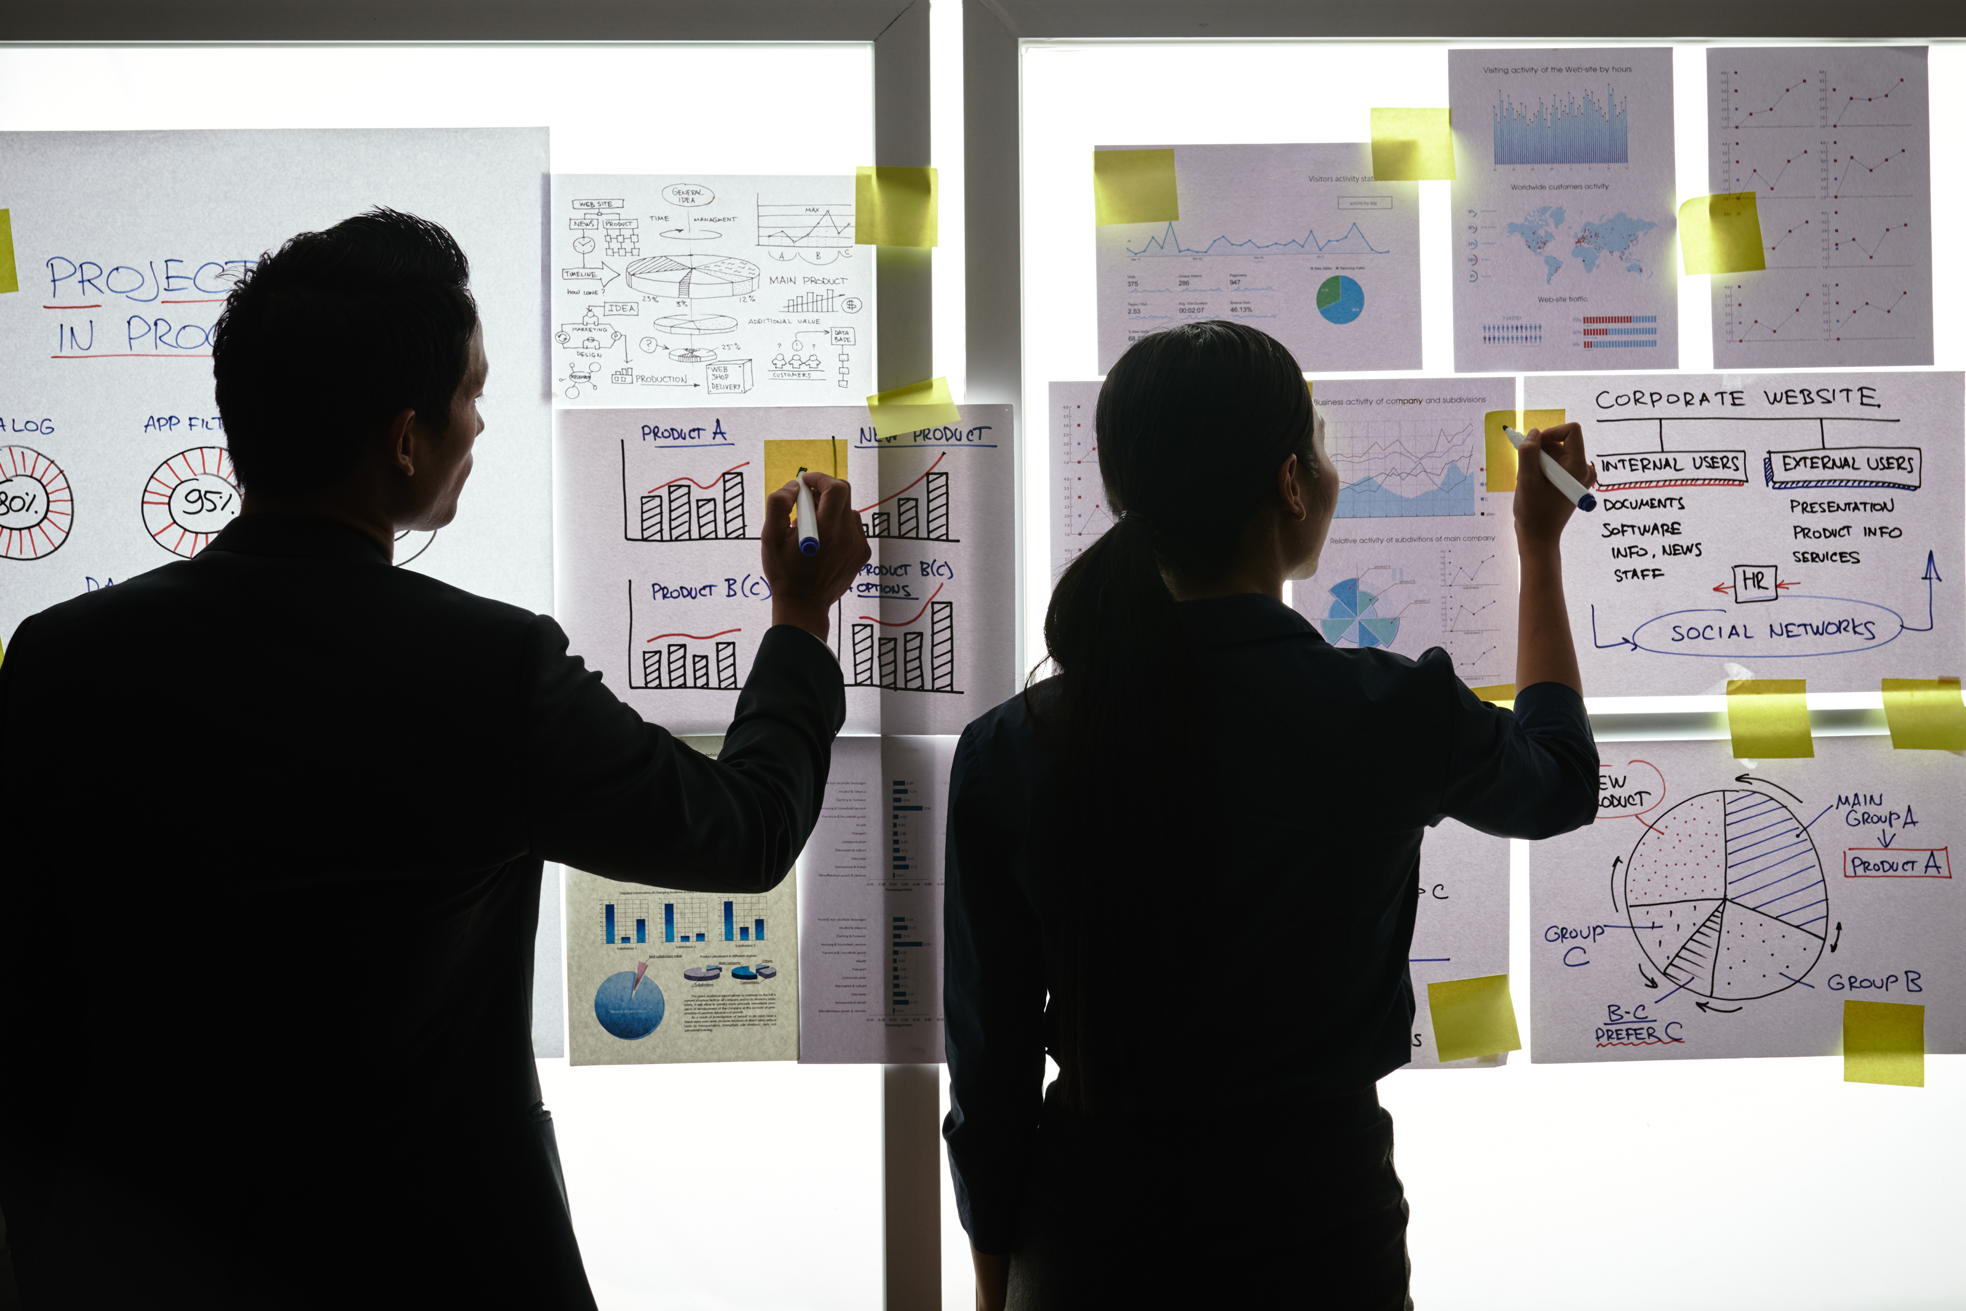
Practical Exercise

Slide 2
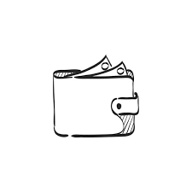
Design your Ideal Wallet
Draw you ideal wallet in this block you have 5 min – Please take a photo and insert in the Powerpoint deck provided which you will upload later under your Wallet project

Slide 3
Empathy – Identify a partner and Engage
Dig Deeper – Considering what you learned really try to dig into your partners feelings and motivations - 5 min each
Interview your partner you each have - 5 min
Notes from first interview
Notes from second interview
His ideal wallet
#portable
#secrete pockets
#pressure sensor
#money clips
#enough pockets
My thoughts on the wallet
#it should be portable
#must have a bright enough colour for him to see
and it can be easy to spot
#ID windows for identification
#a tracker so he can find it if its lost

Slide 4
Define and understand the problem and gain insights
Capture Findings - 5 min
Take a Stand with a point of view - 5 min
Needs: things your partner is trying to do Use verbs
Thandolwlenkosi khumalo
____________________________________________
Needs a way to keep all his belongings save
Because …. or but ……. or surprisingly…….
Because the wallet does not have enough pockets
_____________________________________________
He can not keep all his things together
_____________________________________________
_____________________________________________
#Keep his cards safe
#he is trying to keep his money save
(personal belongings)
Partner’s Name
User’s need
Insights: new learnings about your partners feelings and motivations. What’s something you see about your partners experience that he she does not see? Use what you heard them say
Circle one
They have a hard time keeping their things together and
This could lead to them losing their wallet and losing
Their personal belongings
Insight

Slide 5
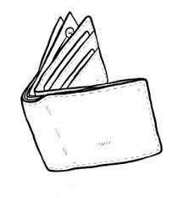
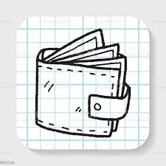
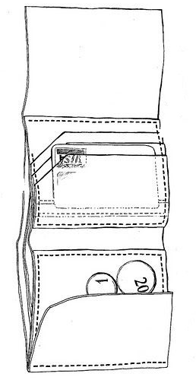
Ideate – Generate alternatives to test
Sketch at least 5 radical ways to meet your users needs - 10 min
I need to create the ideal wallet for my partner
Write your problem statement above
Share your solution with your partner and capture feedback - 5 min each
Notes:
The most quickest way to help would be to test out the first wallet and improve on that one wallet

Slide 6
Iterate on Feedback
Reflect and generate a new solution 5 min
Sketch your idea and note details if necessary

Slide 7
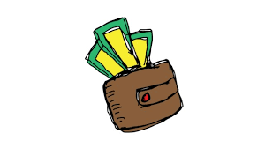
Build and Test
Build your solution
Share your solution and get feedback – 5min each
Make something your partner can interact with use anything you want paper cardboard etc. Place photo’s here (10min)
What worked
What can be improved
The size of the wallet
Should be increased
To put in more stuff
The increased a mount
Of pockets
The high toned colours
# wallet with high toned colours
Questions
Ideas
He actually wants the
Tracker in the wallet
And he asked when will
It be put in???
Put in a slot for the coins
Less weight
More ID windows

Slide 8
Your experience
Please upload your completed wallet exercise project in the projects section tagging your partner
Please share your thoughts comments experiences during this work session in the Design thinking group.

