Slide 1
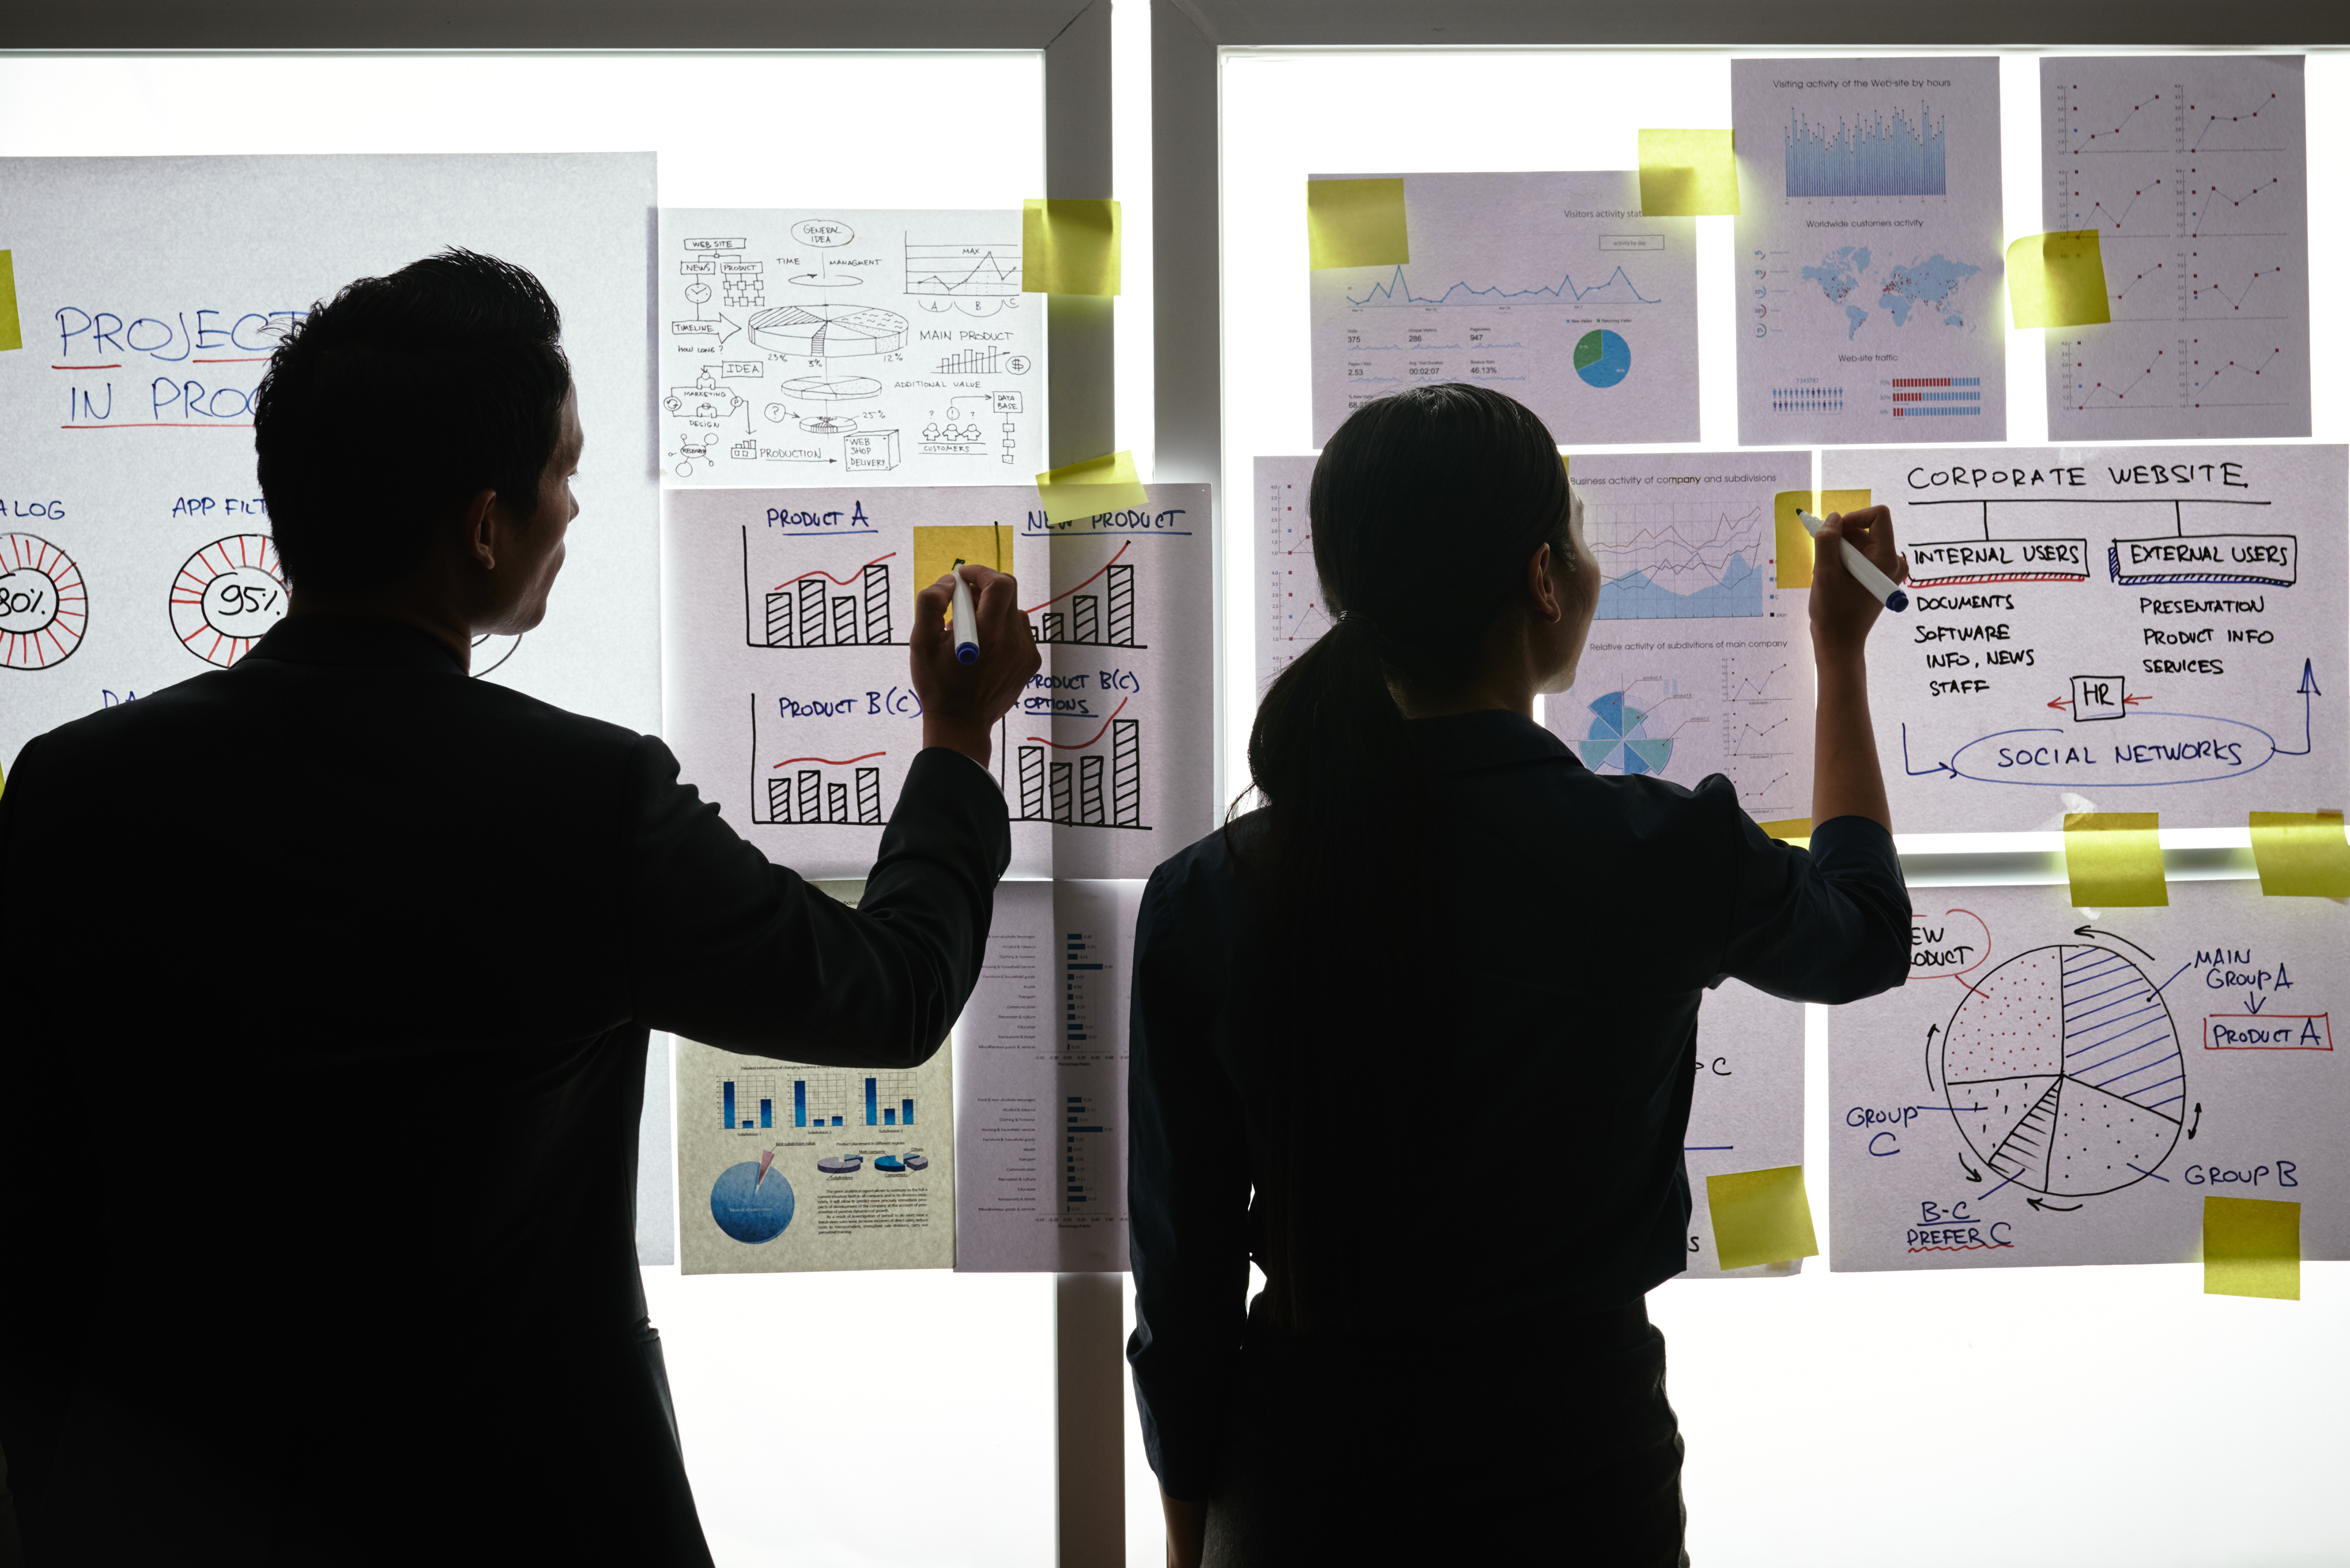
Queenbee Palace

Slide 2
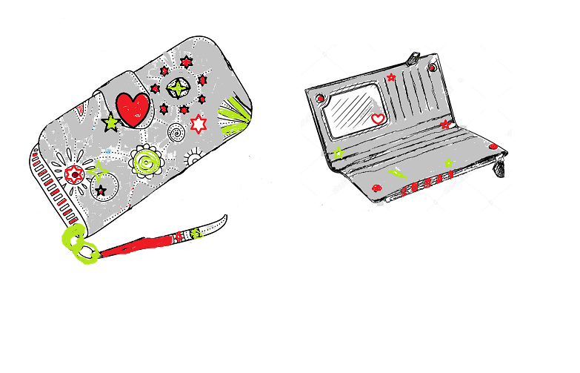
Design your Ideal Wallet
Draw you ideal wallet in this block you have 5 min – Please take a photo and insert in the Powerpoint deck provided which you will upload later under your Wallet project

Slide 3
Empathy – Identify a partner and Engage
Dig Deeper – Considering what you learned really try to dig into your partners feelings and motivations - 5 min each
Interview your partner you each have - 5 min
Notes from second interview
Big enough to put all personal staff
Quality to handle all kinds of conditions
Everyday purse
Cheerful bright colours
Notes from first interview
Portable and colourful
Big enough to put all cards and personal receipts
Quality enough to handle all kinds of conditions
Put large amount of money without other people noticing it.

Slide 4
Define and understand the problem and gain insights
Capture Findings - 5 min
Take a Stand with a point of view - 5 min
Needs: things your partner is trying to do Use verbs
Make convenient to carry around when doing shopping and other regular activities.
Some little items like USB can able to put it inside the purse.
___________________Rosu_________________________
Needs a way to _modest and powerful_________
Because … or but ……. or surprisingly…….
So that it won’t be shuttered so easily
_____________________________________
_____________________________________________
_____________________________________________
Partner’s Name
User’s need
Insights: new learnings about your partners feelings and motivations. What’s something you see about your partners experience that he she does not see? Use what you heard them say
My partner she loved the designer
Circle one
Insight

Slide 5
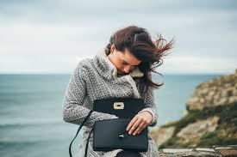
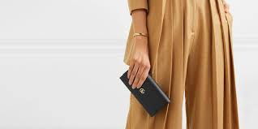
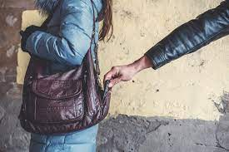
Ideate – Generate alternatives to test
Sketch at least 5 radical ways to meet your users needs - 10 min
Purse is big for small bags
Write your problem statement above
Share your solution with your partner and capture feedback - 5 min each
Notes:
Make it to be comfortable.
Have enough space to put all cards and money .

Slide 6
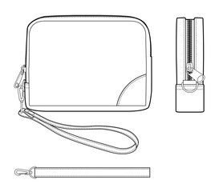
Iterate on Feedback
Reflect and generate a new solution 5 min
Sketch your idea and note details if necessary

Slide 7
Build and Test
Build your solution
Share your solution and get feedback – 5min each
Make something your partner can interact with use anything you want paper cardboard etc. Place photo’s here (10min)
What worked
It is big enough to put all
personal stuff like all the
cards ,money and personal
receipts.
What can be improved
The structure of the
wallet.
By using leather instead
of vinyl.
Questions
Is the wallet strong?
Will the wallet be useful?
Ideas
It must comfortable
Have a hand belt so that
when the thief tries to steal
it he/she will not be able to
take it out.

Slide 8
Your experience
Please upload your completed wallet exercise project in the projects section tagging your partner
Please share your thoughts comments experiences during this work session in the Design thinking group.

