Slide 1
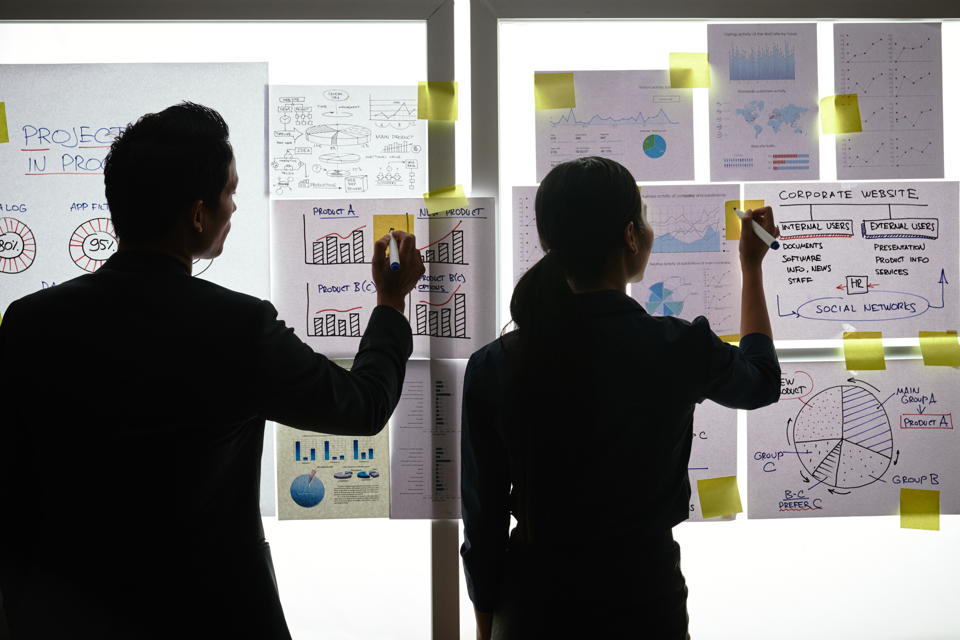
Practical Exercise

Slide 2
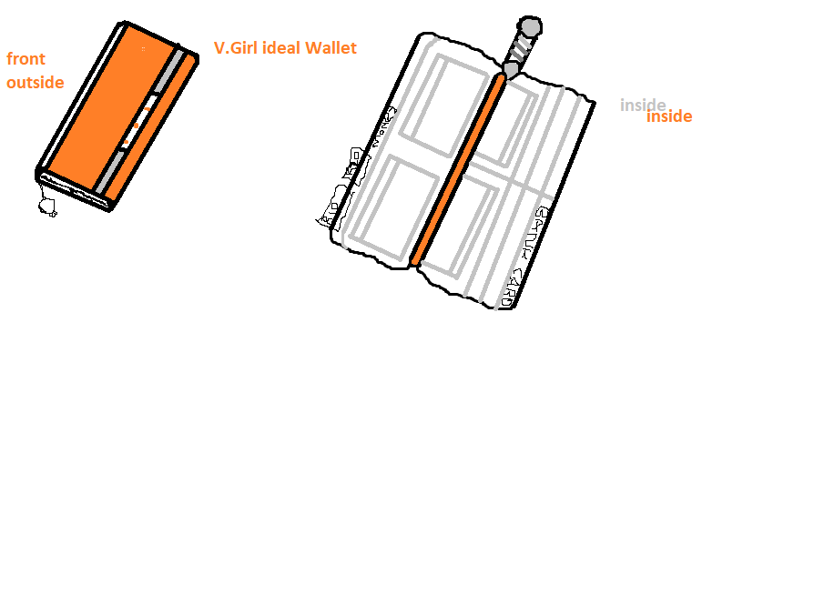
Design your Ideal Wallet
Draw you ideal wallet in this block you have 5 min – Please take a photo and insert in the Powerpoint deck provided which you will upload later under your Wallet project

Slide 3
Empathy – Identify a partner and Engage
Dig Deeper – Considering what you learned really try to dig into your partners feelings and motivations - 5 min each
Interview your partner you each have - 5 min
Notes from first interview
Notes from second interview
Keep it simple on the outside
Space-Efficient Storage for the bank cards
Like bright colours
Keep Money Flat Or Folded
Driver's License Holder
A zipped inside pocket to put coins money

Slide 4
Define and understand the problem and gain insights
Capture Findings - 5 min
Take a Stand with a point of view - 5 min
Needs: things your partner is trying to do Use verbs
Innocentia
____________________________________________
Needs a way to _keep her card safe and easy to get them
Because … or but ……. or surprisingly…….
_______she always misplace her cards and having the wallet will decrease misplacing bank cards and she will quickly make transactions
_____________________________________________
_____________________________________________
Feel safe and comfortable
Partner’s Name
Be responsible for the money, cards, Licence and house keys
User’s need
Insights: new learnings about your partners feelings and motivations. What’s something you see about your partners experience that he she does not see? Use what you heard them say
Feeling in charge to protect the cards from getting scratch, damaged and misplaced. The wallet is small to take it anywhere and can put inside the car or the hand bag.
Circle one
Insight

Slide 5
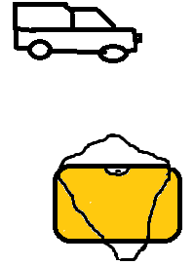
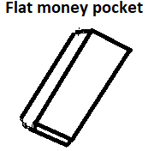
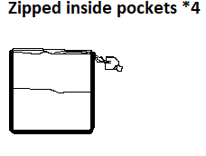
Ideate – Generate alternatives to test
Sketch at least 5 radical ways to meet your users needs - 10 min
Kept on misplacing the bank cards and its costly to create another ones ____________________________
Write your problem statement above
Put inside you car/hand bag
Share your solution with your partner and capture feedback - 5 min each
Notes:
The wallet will keep your card safe, you can able to put it in your hand bag or your car. The wallet is simple and has the bright colours

Slide 6
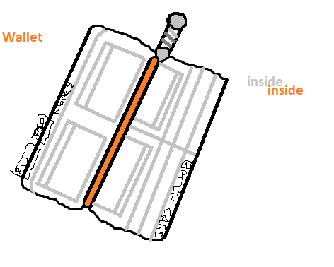
Iterate on Feedback
Reflect and generate a new solution 5 min
Sketch your idea and note details if necessary
Hand bag that can be used to insect the wallet, it has bright colour and its beautiful.
A Vehicle that will also assist on keeping the wallet safe by putting the wallet inside the car.
Inside pocket are clear and have a great space to insect cards, money and other stuff.

Slide 7
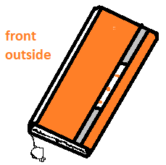
Build and Test
Build your solution
Share your solution and get feedback – 5min each
Make something your partner can interact with use anything you want paper cardboard etc. Place photo’s here (10min)
What worked
What can be improved
Synthetic materials
Getting more quality materials
Questions
Ideas
Creating different types of wallet with different shapes and decided to uses other materials like Cotton, Leather, Coin wallets, Long wallets etc….
Will the wallet have space for all the cards and money?

Slide 8
Your experience
Please upload your completed wallet exercise project in the projects section tagging your partner
Please share your thoughts comments experiences during this work session in the Design thinking group.

