Slide 1
Safe toys for toddlers
TOKOLOGO MALULEKE
MH BALOYI SECONDARY SCHOOL

Slide 2
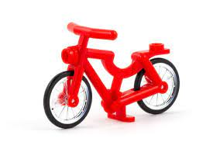
“ BIKES AND PLANES AREN’T ABOUT GOING FAST OR HAVING FUN; THEY’RE TOYS, BUT SERIOUS ONES “ HARRISON FORD

Slide 3
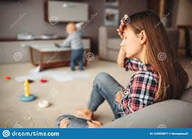
EMPATHIZE
Each year approximately two billion toys are manufactured, and some of these toys are unsafe and may cause injuries to the children.
Toys like marbles ,plastic keys etc , are the ones that are unsafe for toddlers to play with . Apparently a lot of toddlers tend to eat whatever they find on the floor. This is therefore a serious matter to deal with.
Its painful to see a child being rushed to the hospital due to the fact that they swallowed a toy. Imagine the pain that this kid and their parent will be going through.
Notes:
the hospital due to the fact that they swallowed a toy. Imagine the pain that this kid and their parent will be going through.

Slide 4
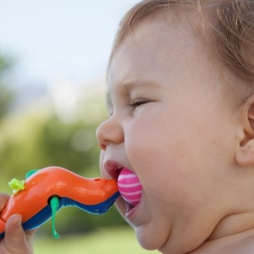
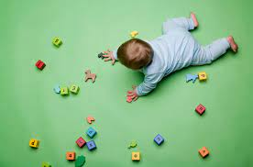
Define
Some of the toys that our children use are dangerous and probably not safe .
Parents sometimes do not read the tags in the toys that indicate the age of a child who is supposed to be using this specific type of toys
A lot of children have been injured and some of them died.

Slide 5
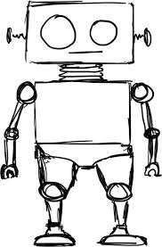
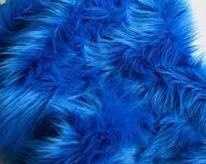
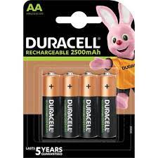
Ideate
Based on what toddlers go through while using certain types of toys, the solution here is to create a much more safer toy that these children can play with.
We cannot create a toy with sharp edges, also small types of toys are also not good for a toddler because they might swallow it.
A big sized toy would do ,with smooth edges, and it might include some features of a robot. It could maybe do some movements or sing a song…it must use batteries .

Slide 6
Prototype
I created a toy called “ROBO PUFF”, that is able to say “HELLO” and “I love you”, now this is safe for the toddlers to use and doesn’t contain any harmful features.
Toddlers can be able to use and play with .and this way parents can relax knowing that their kids have the correct toys to play with .

Slide 7
Test
To test our prototype we gave this robot to two toddlers to see how they would use it.
It turns out that they where happy with the design of the robot ,however we realized that the robot was too big but we came up with another idea of making the robot in a medium sized robot.
We saw that their parents were happy with the design and were impressed by the way their kids were able to interact with the toy .

