Slide 1
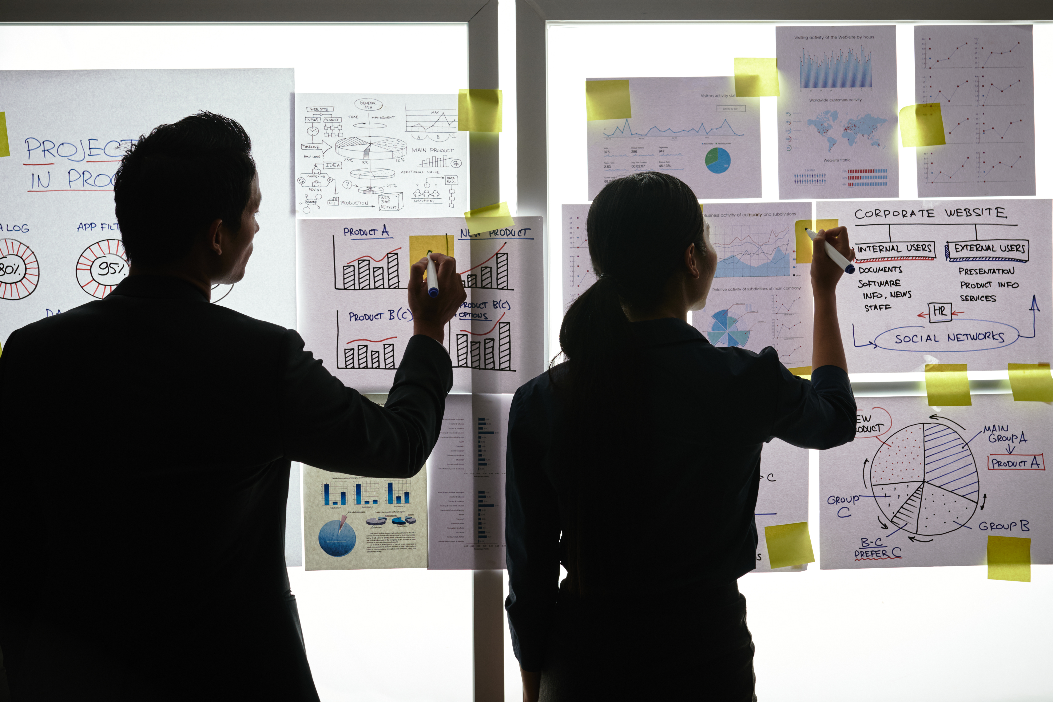

Practical Exercise

Slide 2
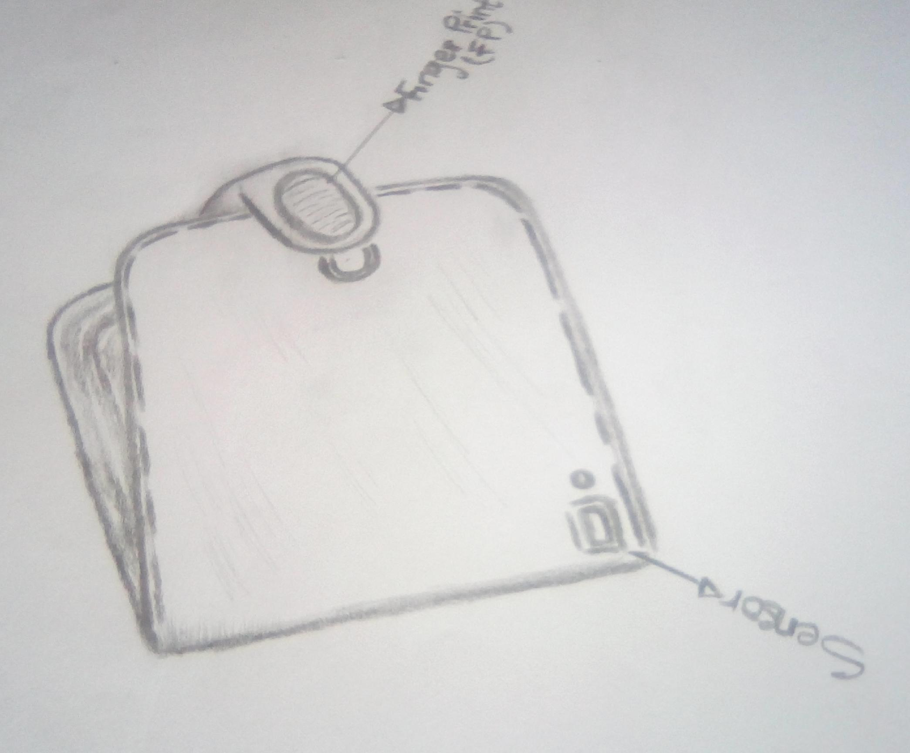
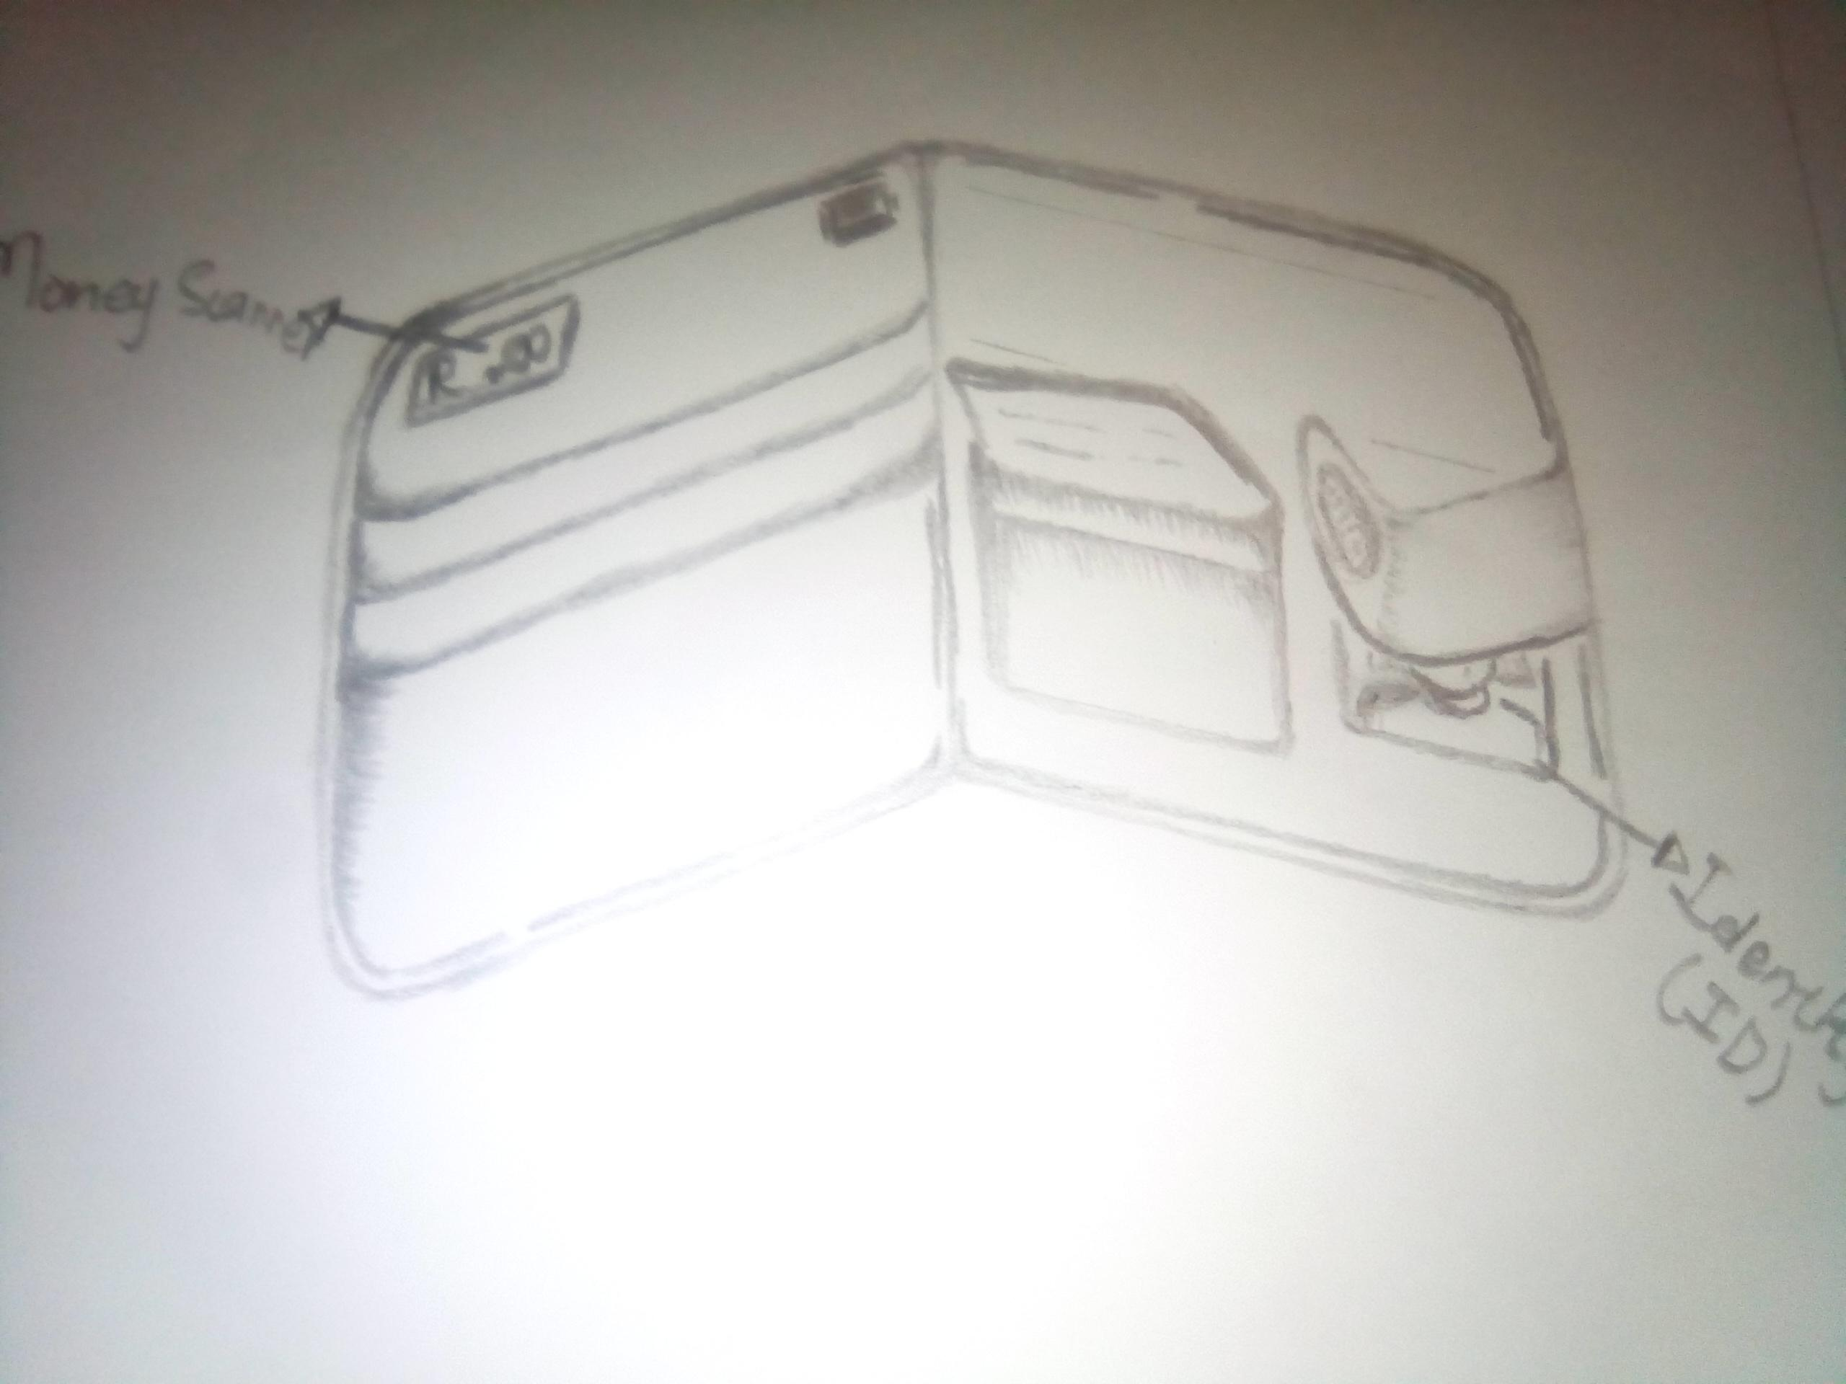
Design your Ideal Wallet
Draw you ideal wallet in this block you have 5 min – Please take a photo and insert in the Powerpoint deck provided which you will upload later under your Wallet project
Font view of the walket
Inside the walket

Slide 3
Empathy – Identify a partner and Engage
Dig Deeper – Considering what you learned really try to dig into your partners feelings and motivations - 5 min each
Interview your partner you each have - 5 min
Notes from first interview
Notes from second interview
A leather wallet
Like it with alot of pockets
It could calculate money
Brown or black leather colour
Could carry alot of cards
Must be portable and comfortable
Medium sized
And could get inside the pocket

Slide 4
Define and understand the problem and gain insights
Capture Findings - 5 min
Take a Stand with a point of view - 5 min
Needs: things your partner is trying to do Use verbs
____________________________________________
Needs a way to _____________________________
Because … or but ……. or surprisingly…….
_____________________________________________
_____________________________________________
_____________________________________________
Feel secured
Keep things safe inthe walle
Obakeng Seleka
Partner’s Name
Feel secured and comfortable
User’s need
Insights: new learnings about your partners feelings and motivations. What’s something you see about your partners experience that he she does not see? Use what you heard them say
Circle one
The wallet is something they have been looking for along time
Atleast their cards and other stuff will be safe in the wallet
They take where ever they go
Because the gadget(Wallet) has to be useful to the user.
And the user must feel the protetion of the wallet.
Insight

Slide 5
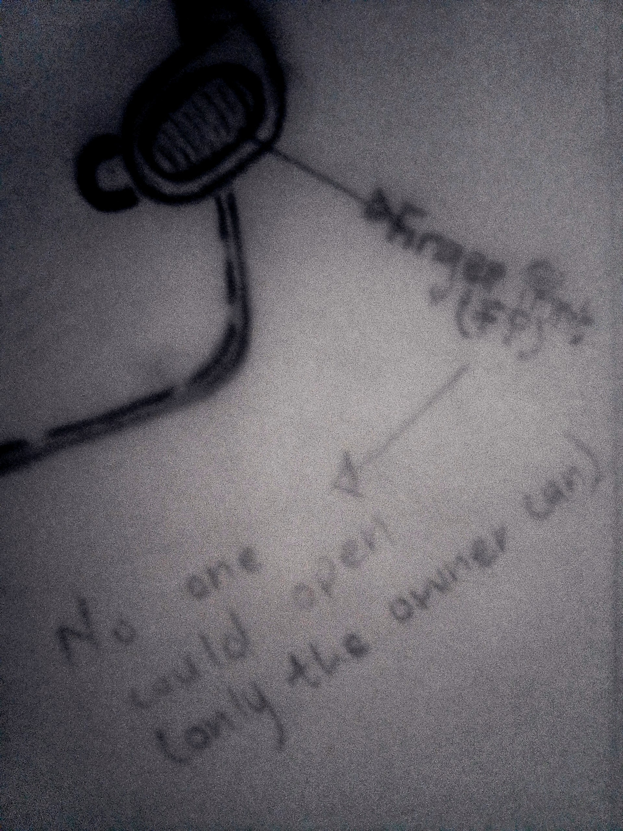
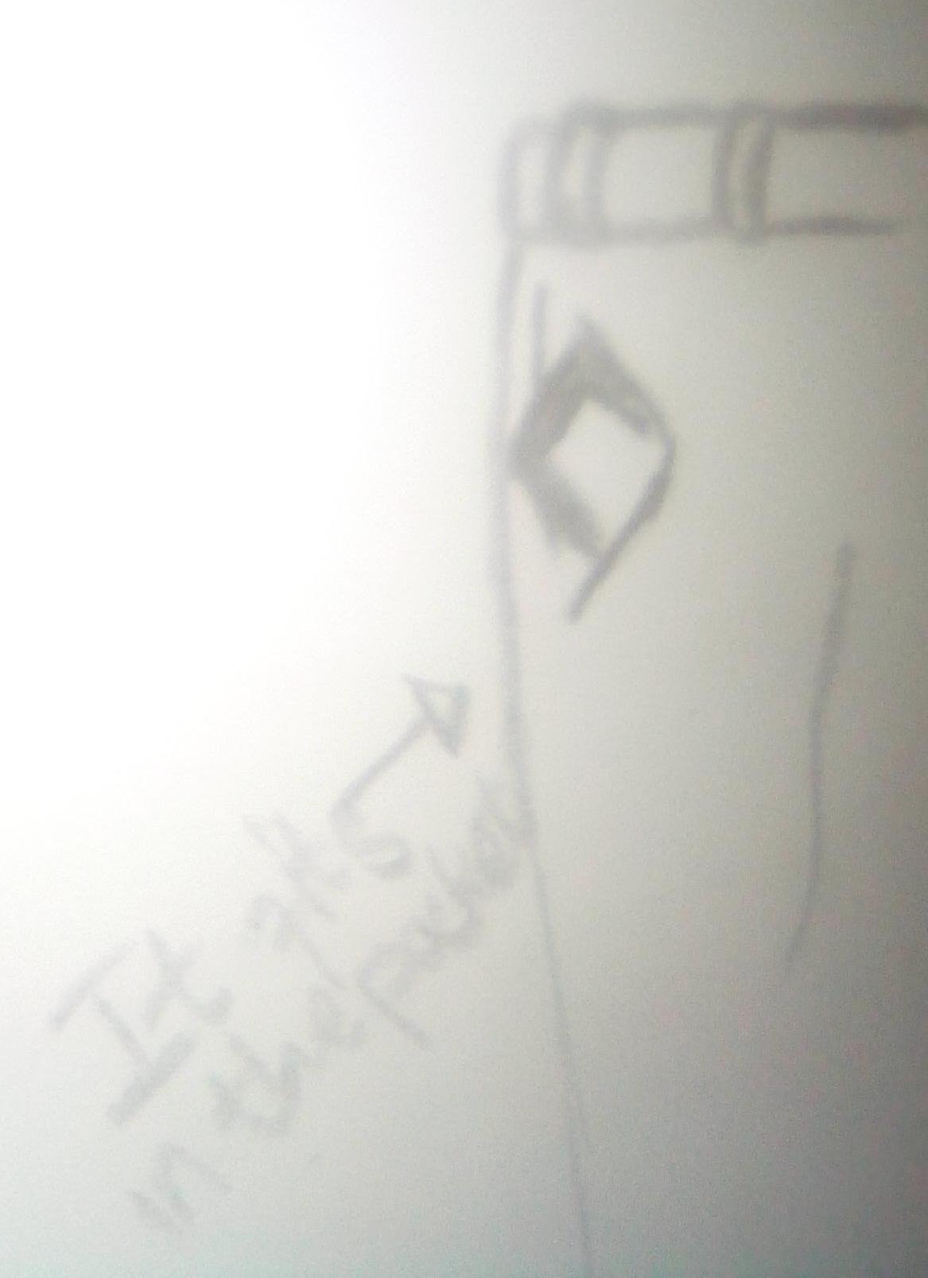
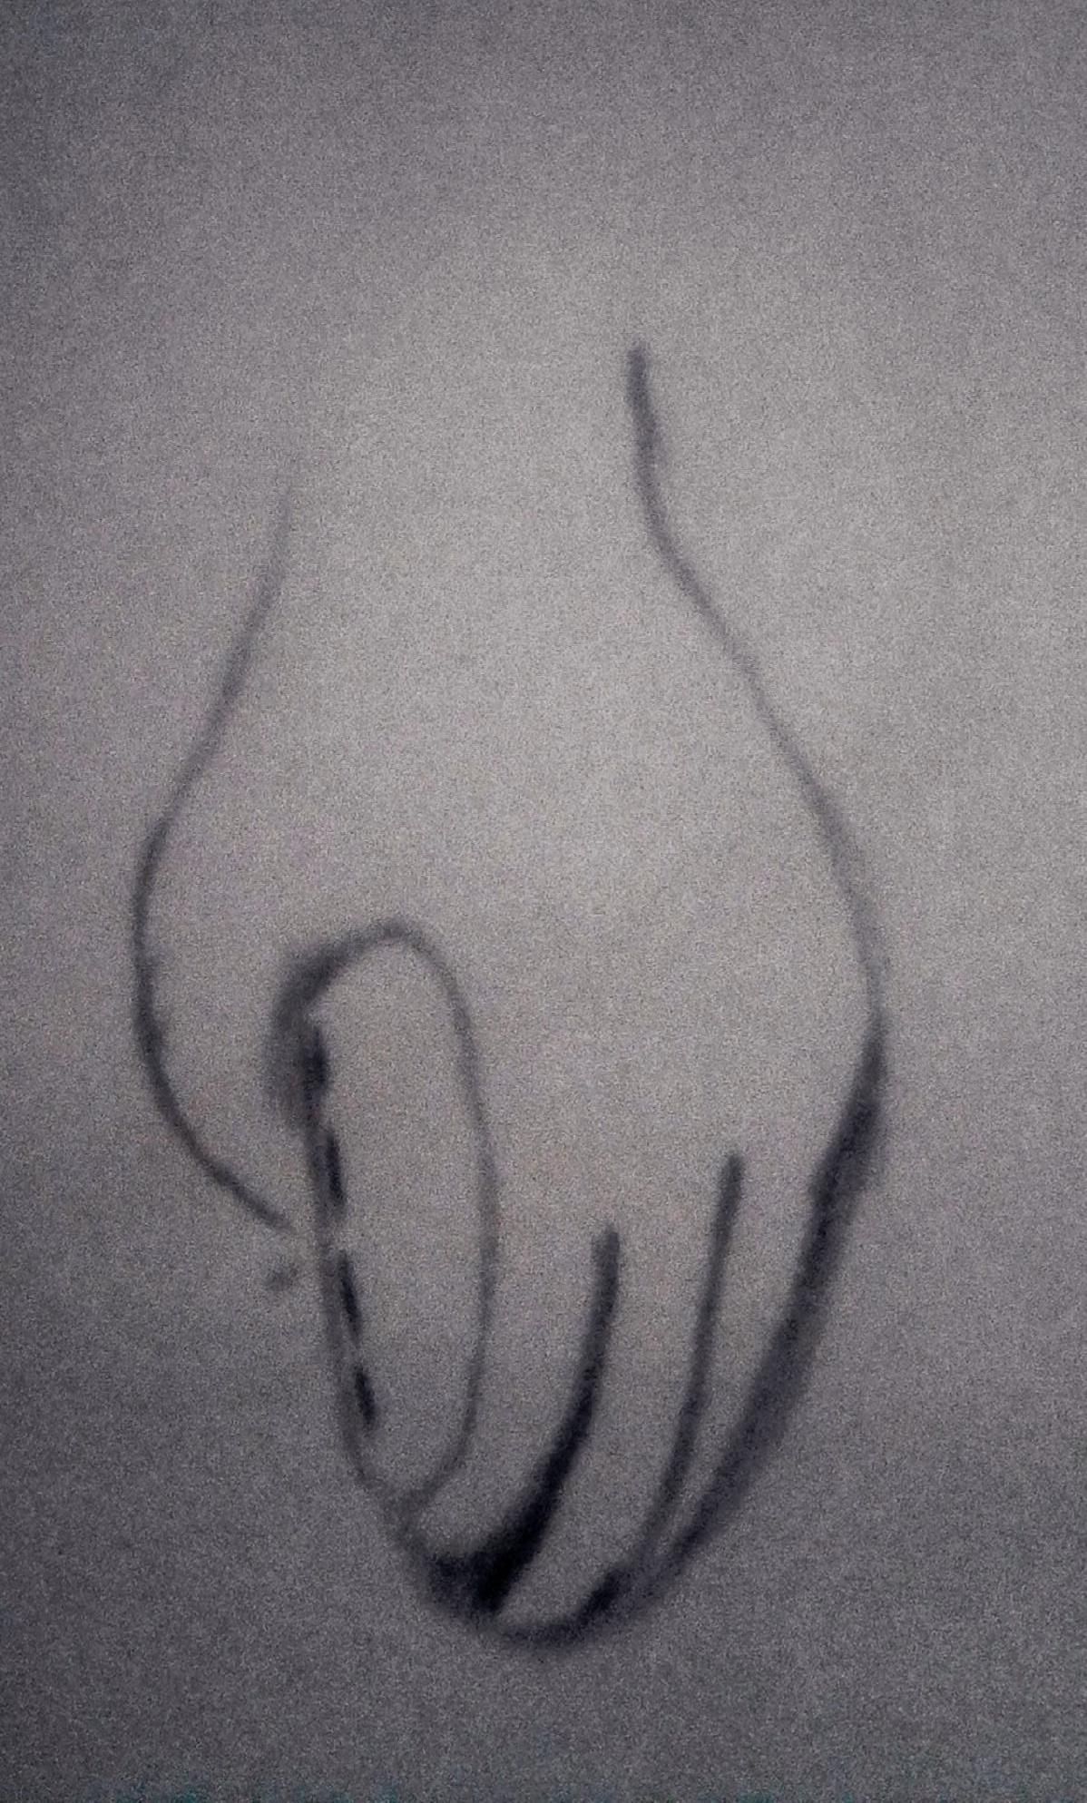
Ideate – Generate alternatives to test
Sketch at least 5 radical ways to meet your users needs - 10 min
The user wants something portable and comfortable
________________________________________________________________________________________________
Write your problem statement above
Once you try to harm the wallet or open the wallet forcefully it send a message to the owners phone
You can even track the wallets location
Share your solution with your partner and capture feedback - 5 min each
Notes:
The user needs a gadget (wallet) which they could carry everywhere and it’ll keep their things safe.

Slide 6
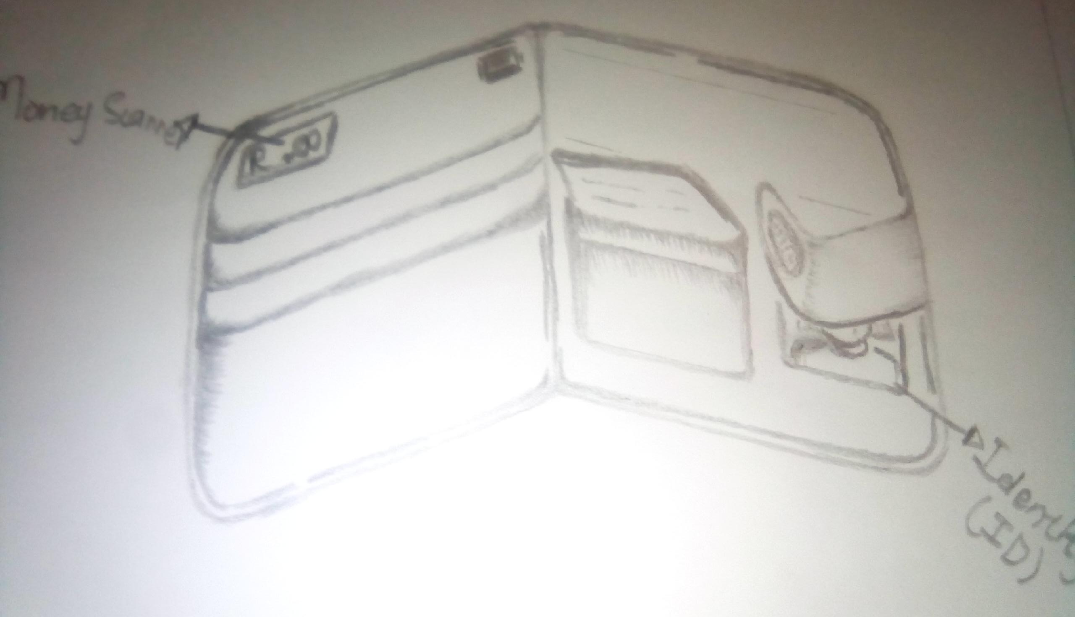
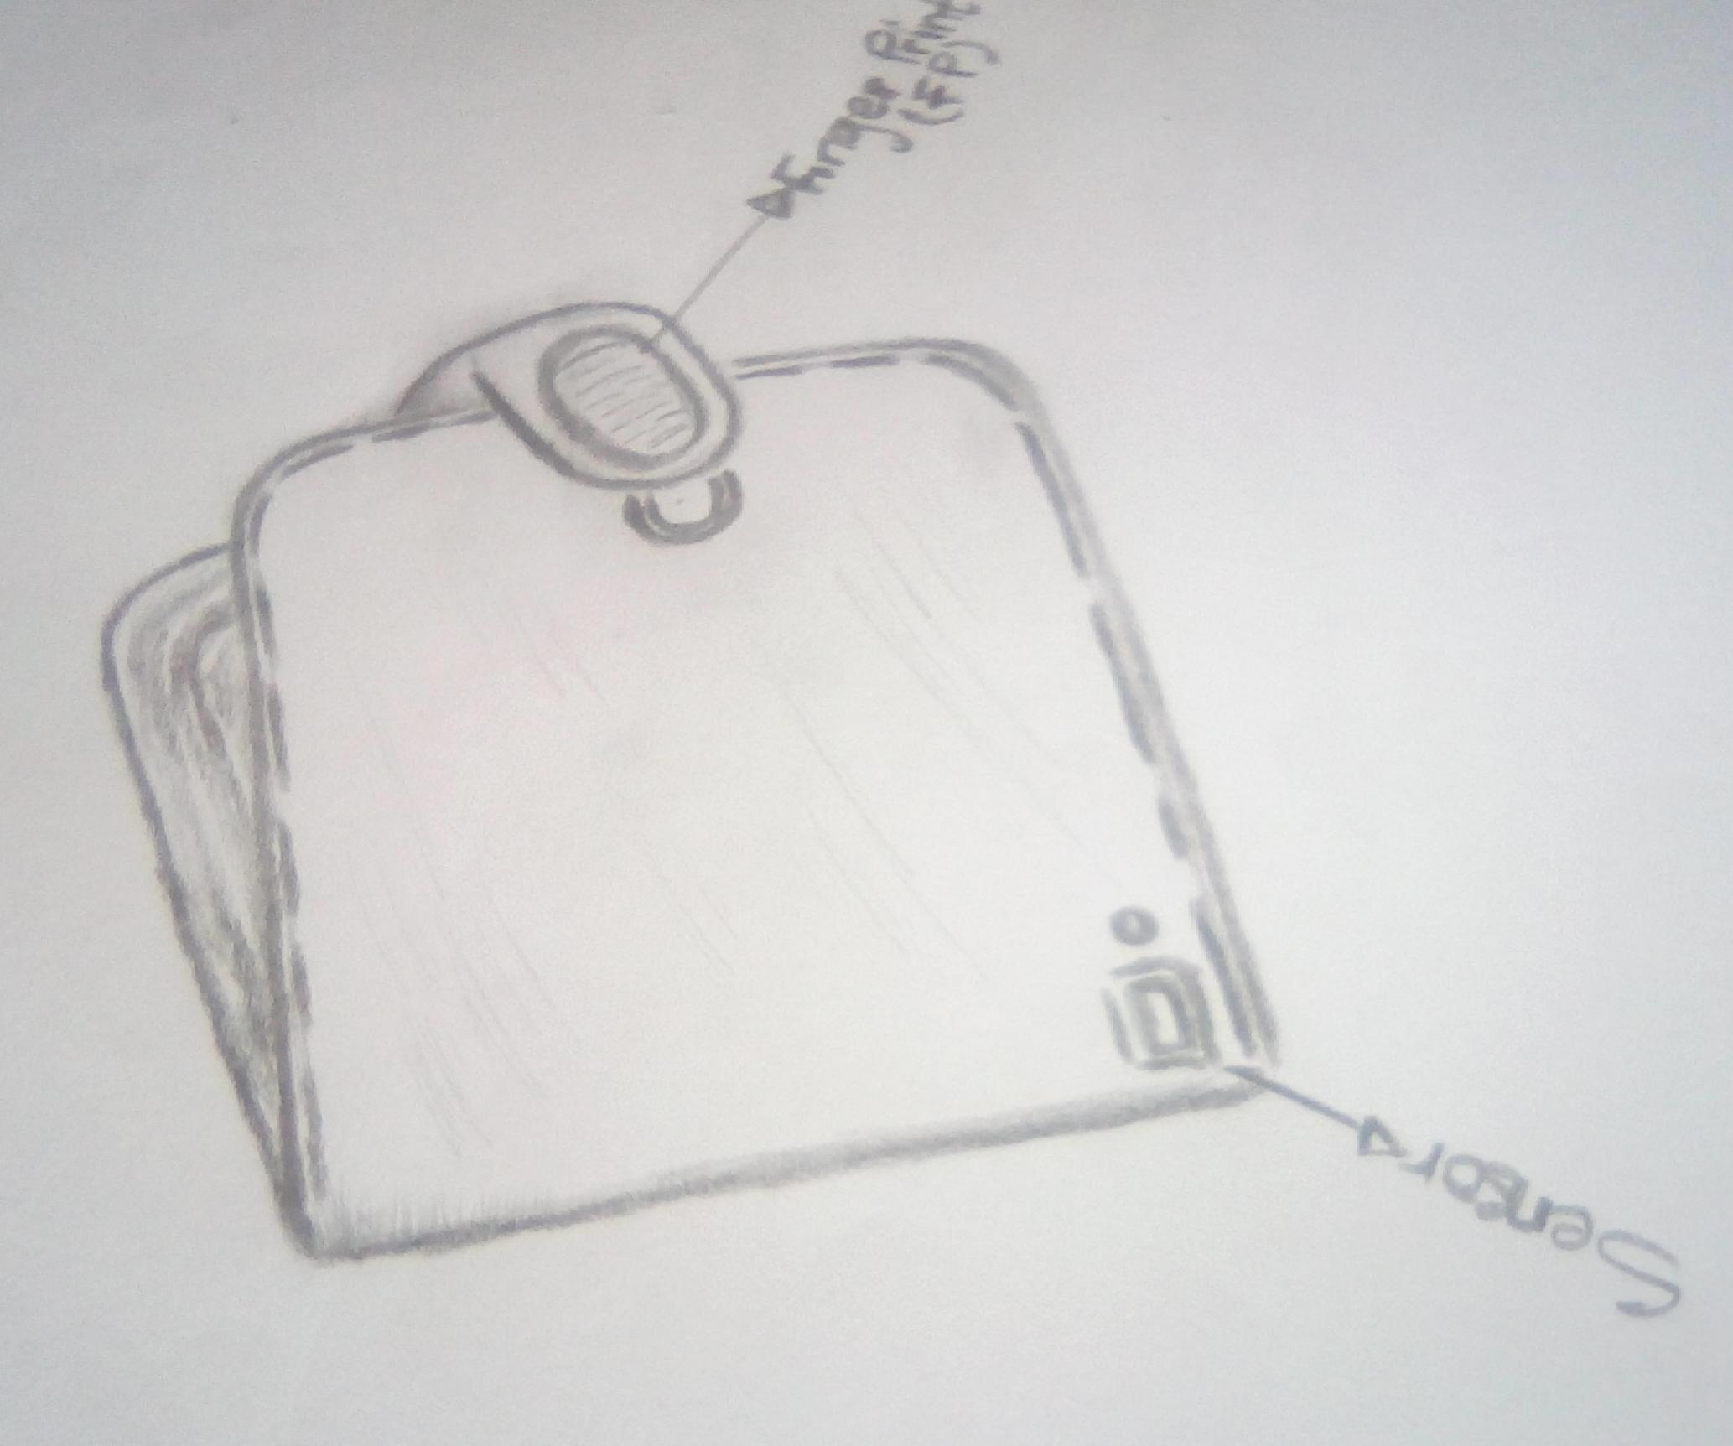
Iterate on Feedback
Reflect and generate a new solution 5 min
Sketch your idea and note details if necessary
It also calculates money too
It needs a finger print to open its a smart Ewallet.And has a sensor as well as a tracker.

Slide 7
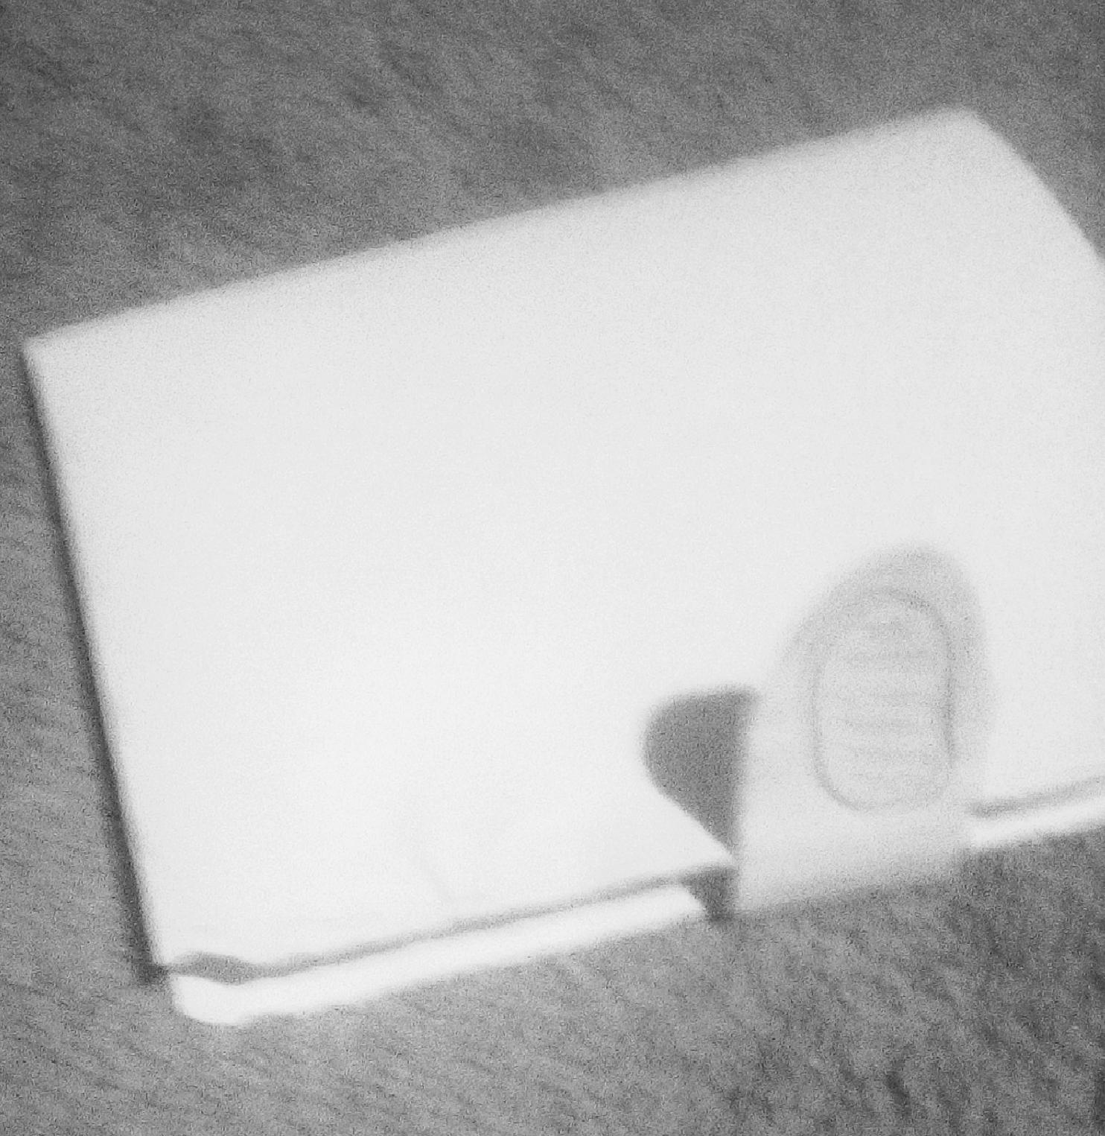
Build and Test
Build your solution
Share your solution and get feedback – 5min each
Make something your partner can interact with use anything you want paper cardboard etc. Place photo’s here (10min)
What worked
What can be improved
The technology of the gadget(wallet) and the fabric
Some of them and this could take a while to see the real outcomes
Questions
Ideas
What’s so interesting about the wallet?
We should do wantever it takes to improve the quality of the wallet
•Will the wallet be useful?

Slide 8
Your experience
Please upload your completed wallet exercise project in the projects section tagging your partner
Please share your thoughts comments experiences during this work session in the Design thinking group.

