Slide 1
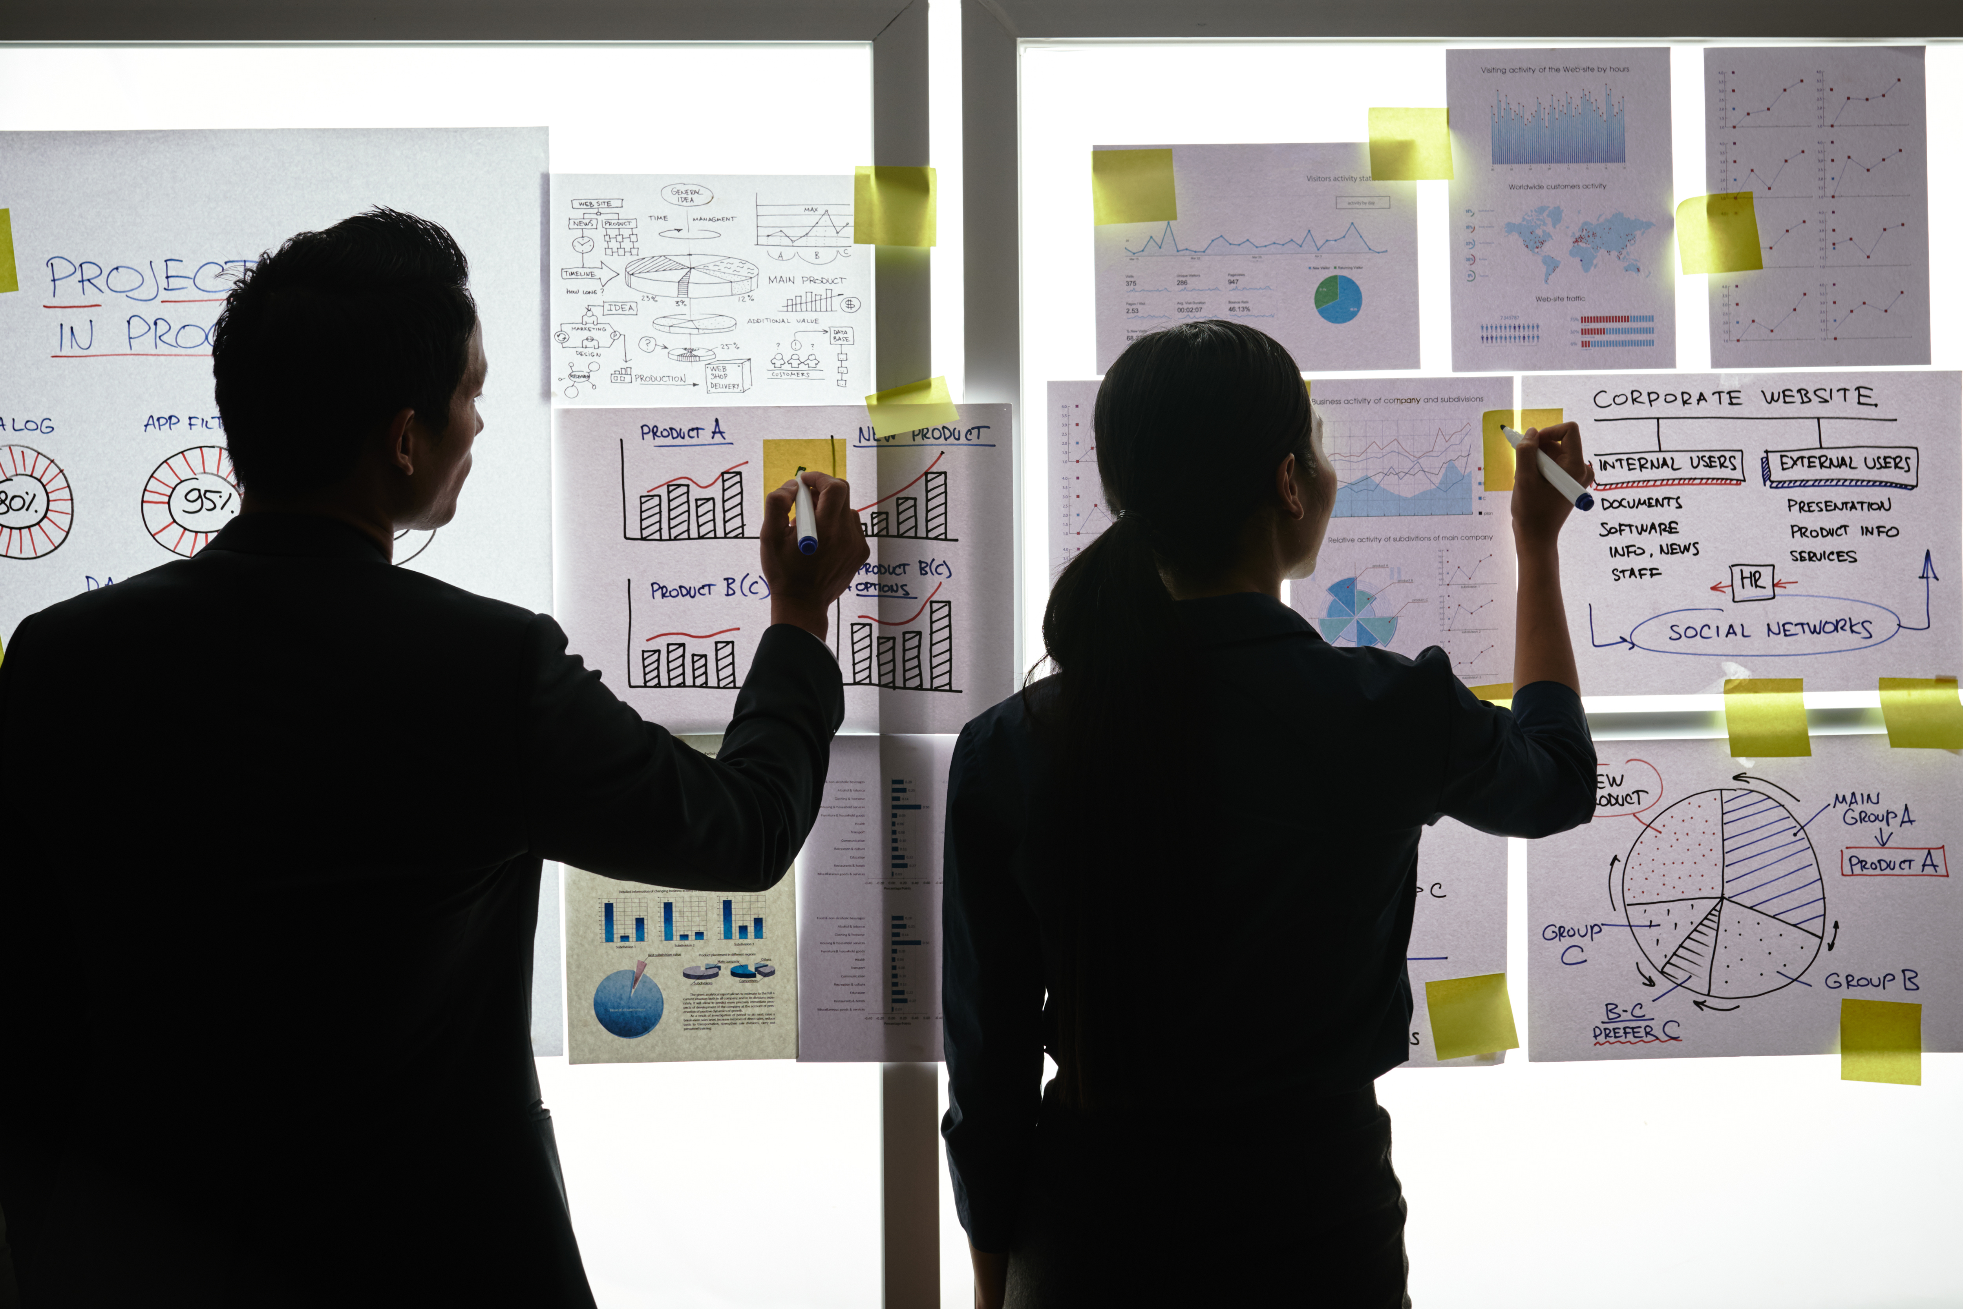

Practical Exercise

Slide 2
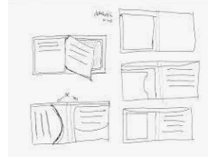
Design your Ideal Wallet
Draw you ideal wallet in this block you have 5 min – Please take a photo and insert in the Powerpoint deck provided which you will upload later under your Wallet project

Slide 3
Empathy – Identify a partner and Engage
Dig Deeper – Considering what you learned really try to dig into your partners feelings and motivations - 5 min each
Interview your partner you each have - 5 min
Notes from second interview
Prefer a wallet that is comfortable.
That will be able to fit in a small pocket
Must have be strong ,so that it won’t be shattered
  Notes from first interview
  All cards and money is able to fit inside a slim wallet
  The wallet is able to fit inside the pocket
  Current wallet has five pocket
  Likes a slim strong wallet

Slide 4
Define and understand the problem and gain insights
Capture Findings - 5 min
Take a Stand with a point of view - 5 min
Needs: things your partner is trying to do Use verbs
Make it to feel comfortable
Able to be able to carry all your licences,bank cards etc.
Tshiamo Makau
Needs a way to make a slim wallet that will
Because it is not comfortable to hold a wallet in public that is unable to fit in a pocket because it’s big and you can be robbed.
_____________________________________________
_____________________________________________
_____________________________________________
Partner’s Name
Be able to fit on the pocket
Insights: new learnings about your partners feelings and motivations. What’s something you see about your partners experience that he she does not see? Use what you heard them say
She does not see that she have to make sketch before she make a wallet.
Insight

Slide 5
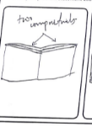
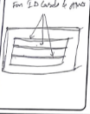
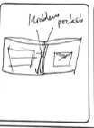
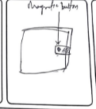
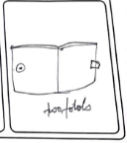
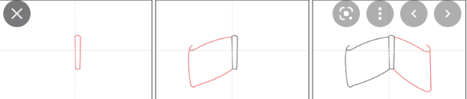
Ideate – Generate alternatives to test
Sketch at least 5 radical ways to meet your users needs - 10 min
________________________________________________________________________________________________
Write your problem statement above
swfrydfg
Share your solution with your partner and capture feedback - 5 min each
Notes:
Make it small to fit in the pocket and also be able to hide it
Make to be comfortable

Slide 6
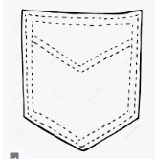
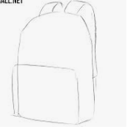
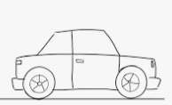
Iterate on Feedback
Reflect and generate a new solution 5 min
Sketch your idea and note details if necessary
Able to fit in the pocket to fit in the school bag dashboard

Slide 7
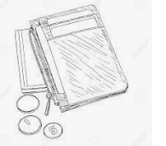
Build and Test
Build your solution
Share your solution and get feedback – 5min each
What worked
We managed to make it
thin and strong.
It can fit in the pocket
What can be improved
The structure of the
walllet.
Make something your partner can interact with use anything you want paper cardboard etc. Place photo’s here (10min)
Questions
Is it strong enough?
Will people love it the
way it is ?
Ideas
Make it colourful,
so that people can be
attracted.

Slide 8
Your experience
Please upload your completed wallet exercise project in the projects section tagging your partner
Please share your thoughts comments experiences during this work session in the Design thinking group.

