Slide 1
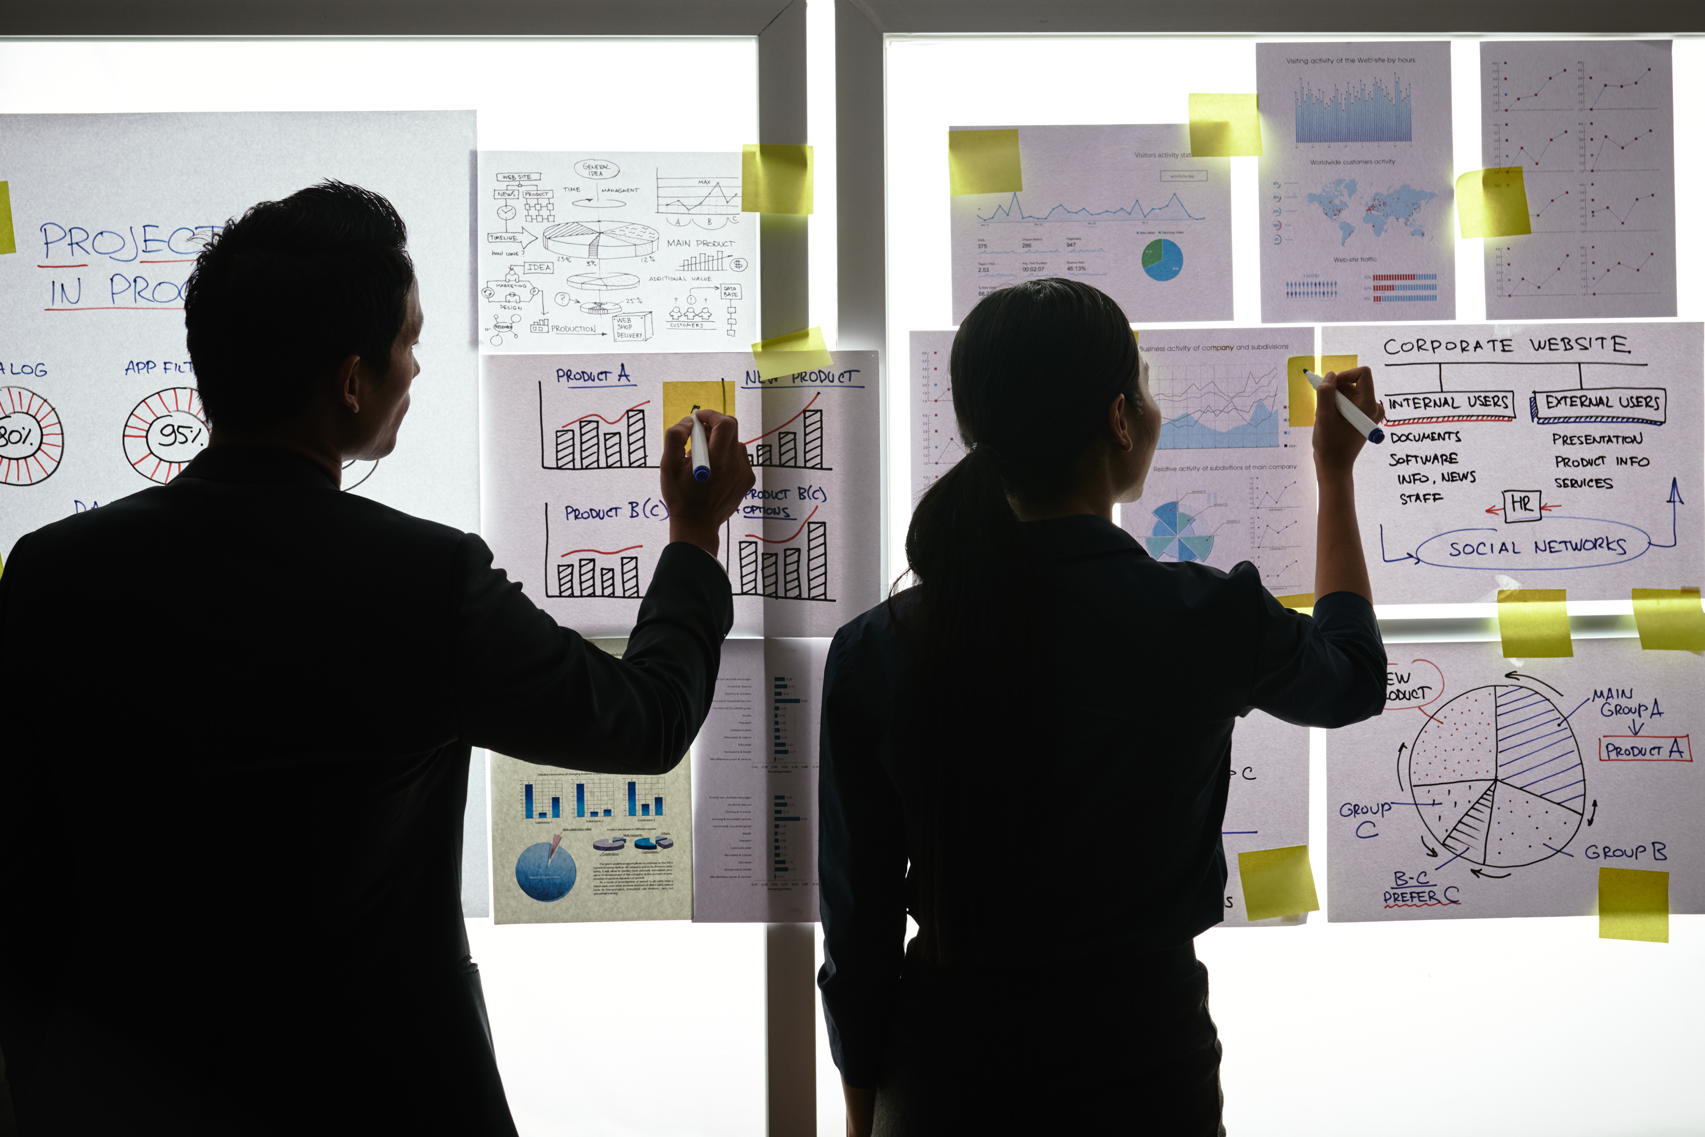
Practical Exercise

Slide 2
Wallet project
ﹰOBAKENG SELEKA
WINTERVELDT HIGH SCHOOL

Slide 3
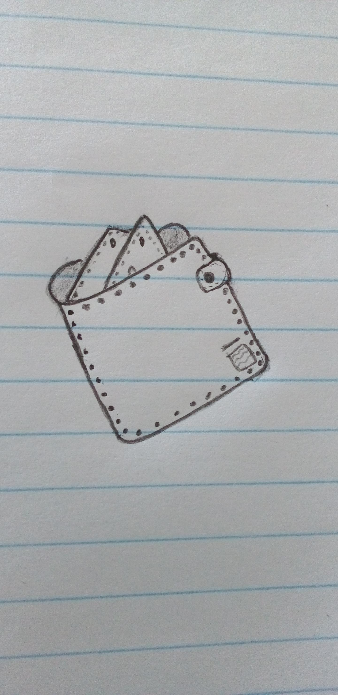
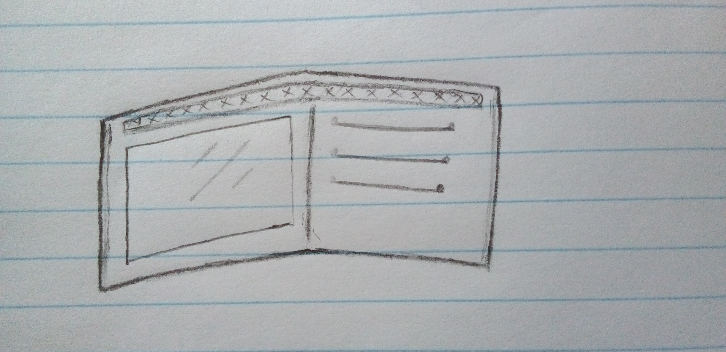
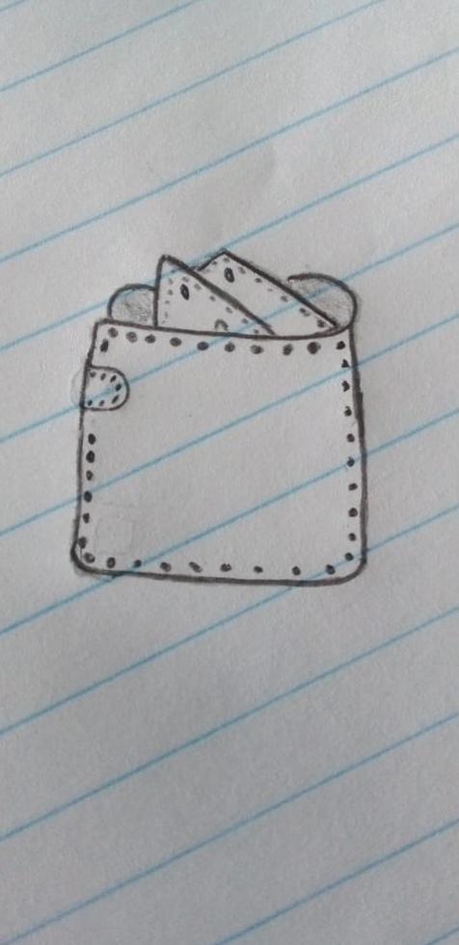
Design your Ideal Wallet
Draw you ideal wallet in this block you have 5 min – Please take a photo and insert in the Powerpoint deck provided which you will upload later under your Wallet project
Inside
Front
Back

Slide 4
Empathy – Identify a partner and Engage
Interview your partner you each have - 5 min
Dig Deeper – Considering what you learned really try to dig into your partners feelings and motivations - 5 min each
Notes from first interview
Notes from second interview
1. It has to be leathery
1. Wants a hidden pocket
2. Small and portable
2. Small and portable
2. Wants a plain, leather wallet. No styles.
3. Carry cards and money
4. Must have information tag

Slide 5
Define and understand the problem and gain insights
Capture Findings - 5 min
Take a Stand with a point of view - 5 min
Needs: things your partner is trying to do Use verbs
____________________________________________
Needs a way to _____________________________
Because … or but ……. or surprisingly…….
_____________________________________________
_____________________________________________
_____________________________________________
Richie
1. Be able to carry his money and cards
2. He wants to carry it everywhere
Partner’s Name
Have a small wallet to keep money safe
3. Wants it to be plain
User’s need
Insights: new learnings about your partners feelings and motivations. What’s something you see about your partners experience that he she does not see? Use what you heard them say
Circle one
The size of the secret pocket is too small to
1. Wallet is a bit tight, there is not enough space
2. Feels good about the size and colour
fit anything and must align perfectly with the
Wallet to be unoticable
Insight
Wallet to be unoticable

Slide 6
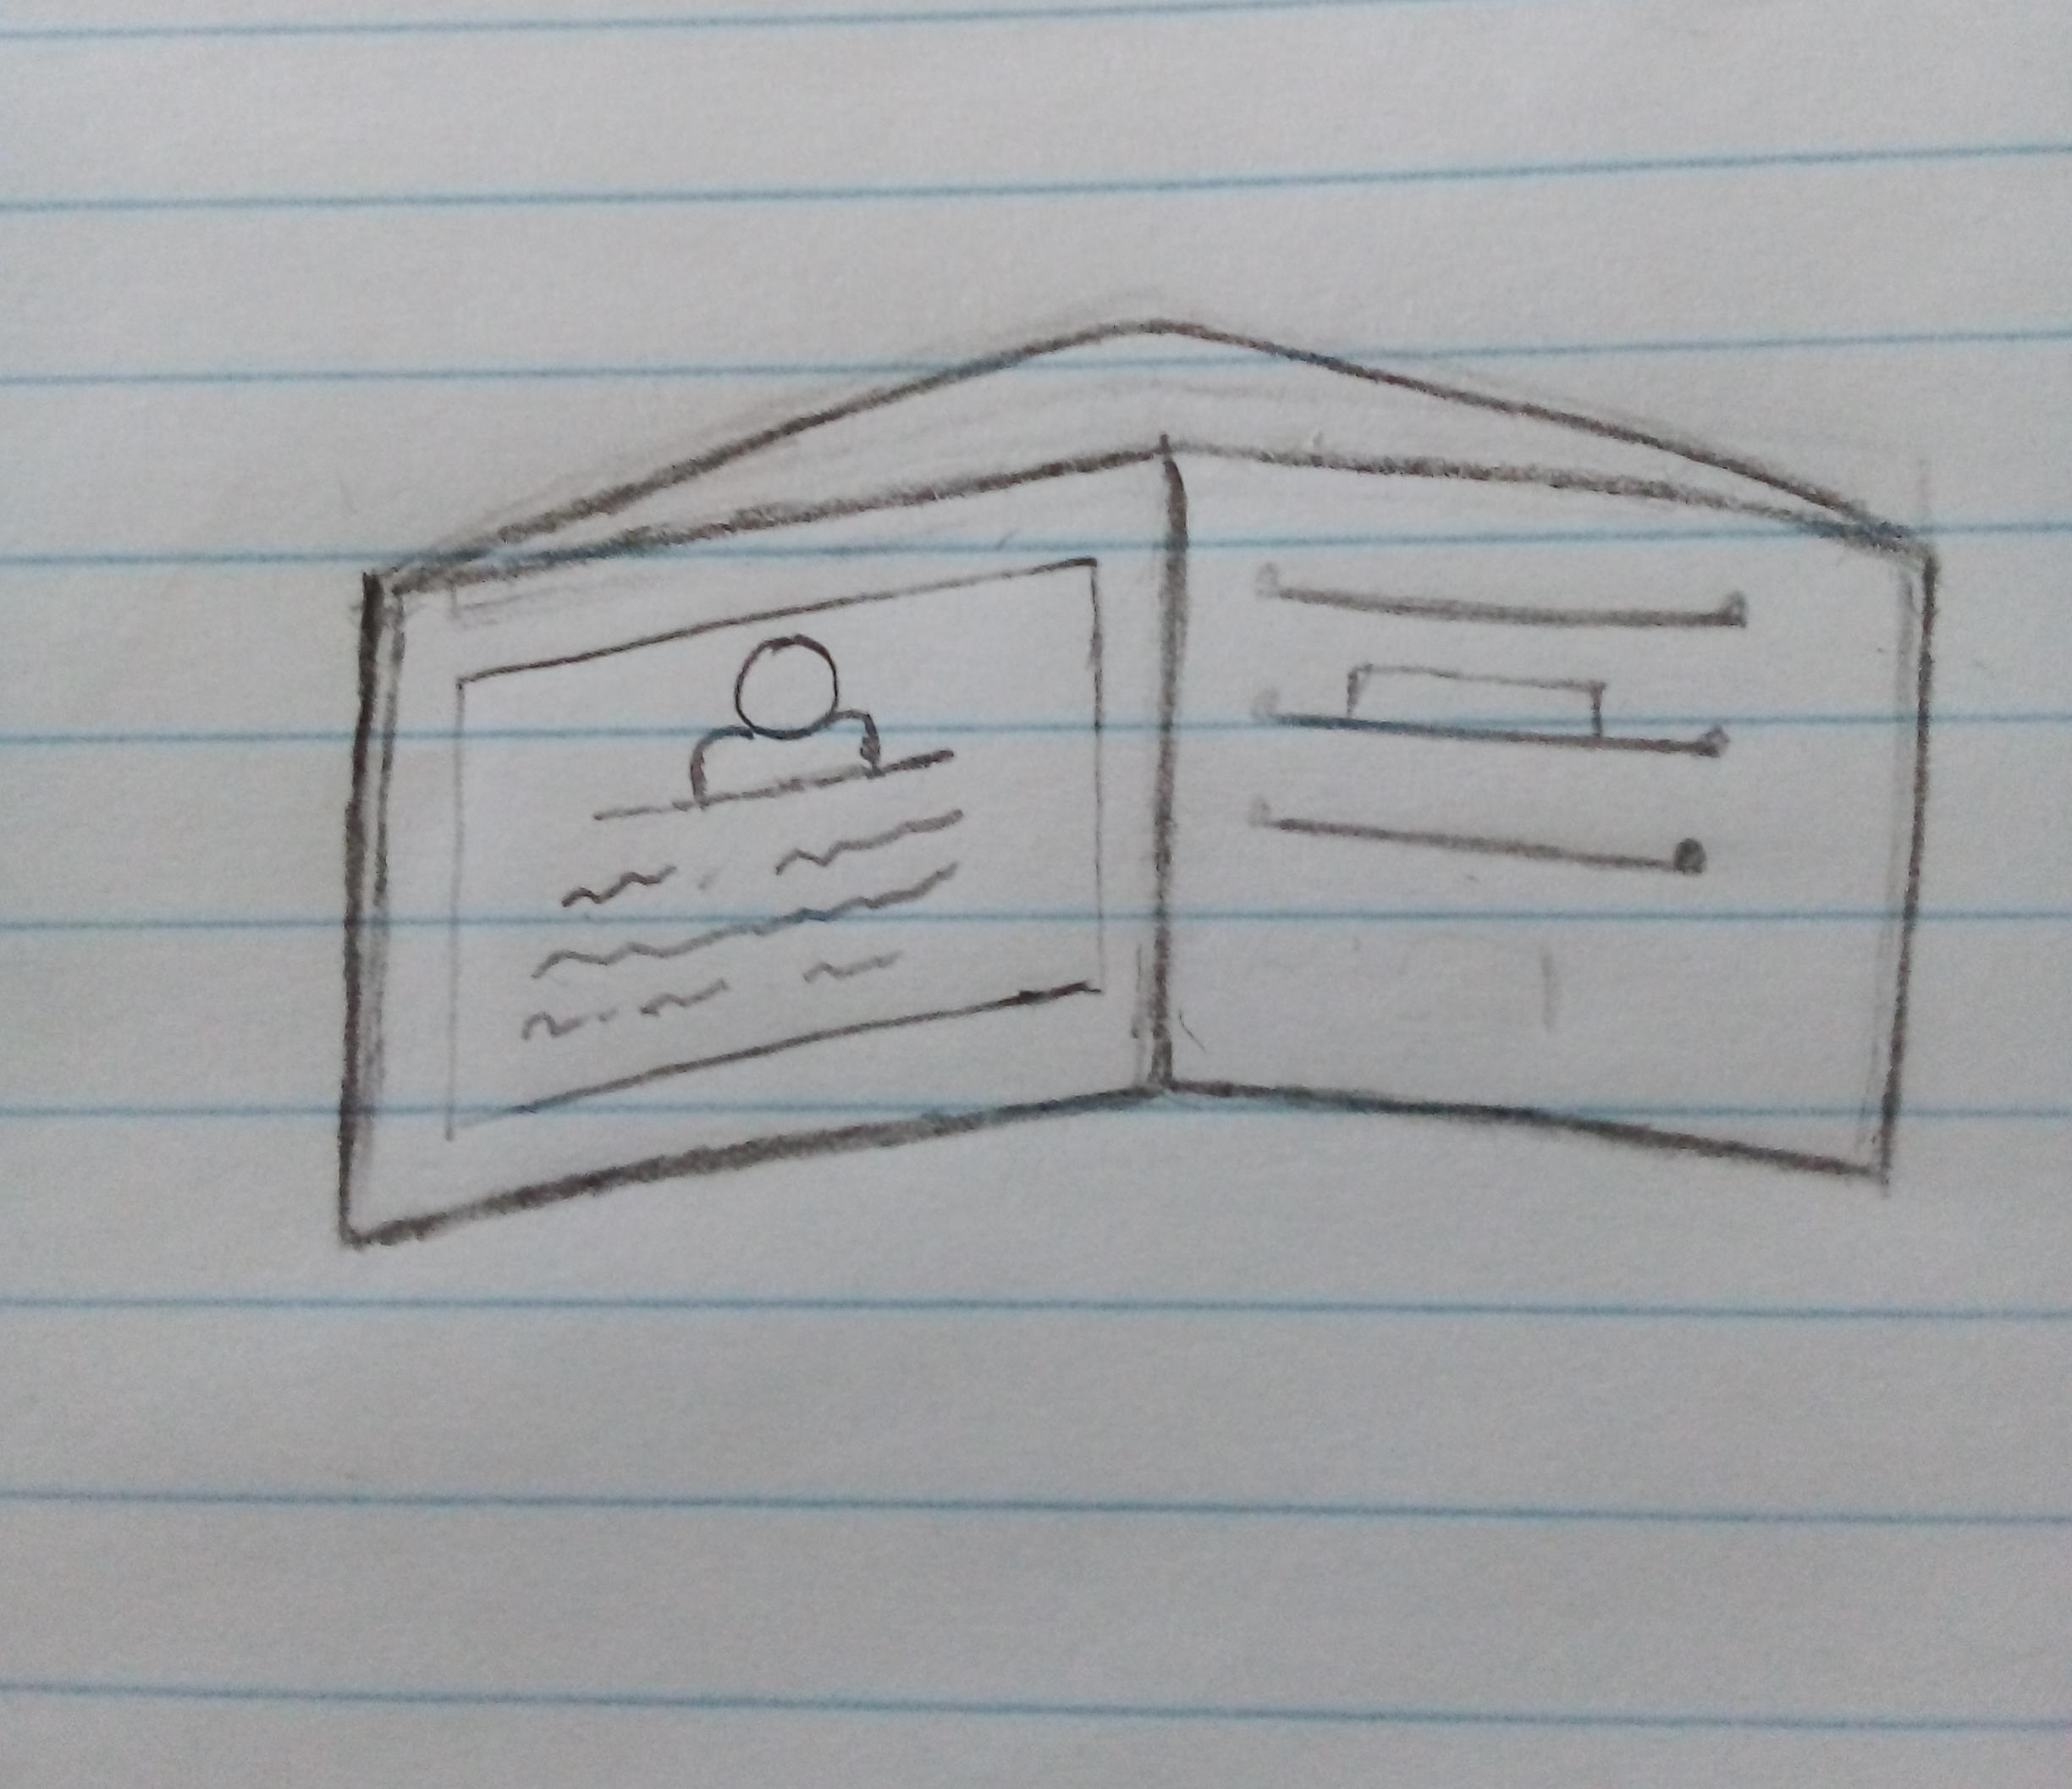
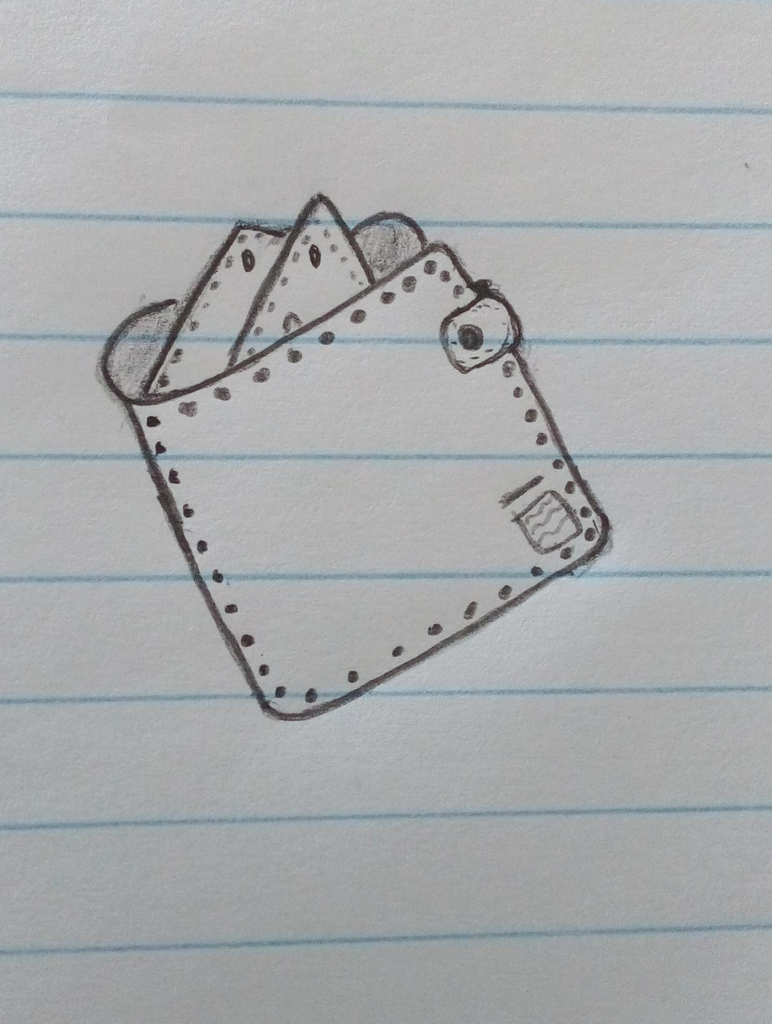
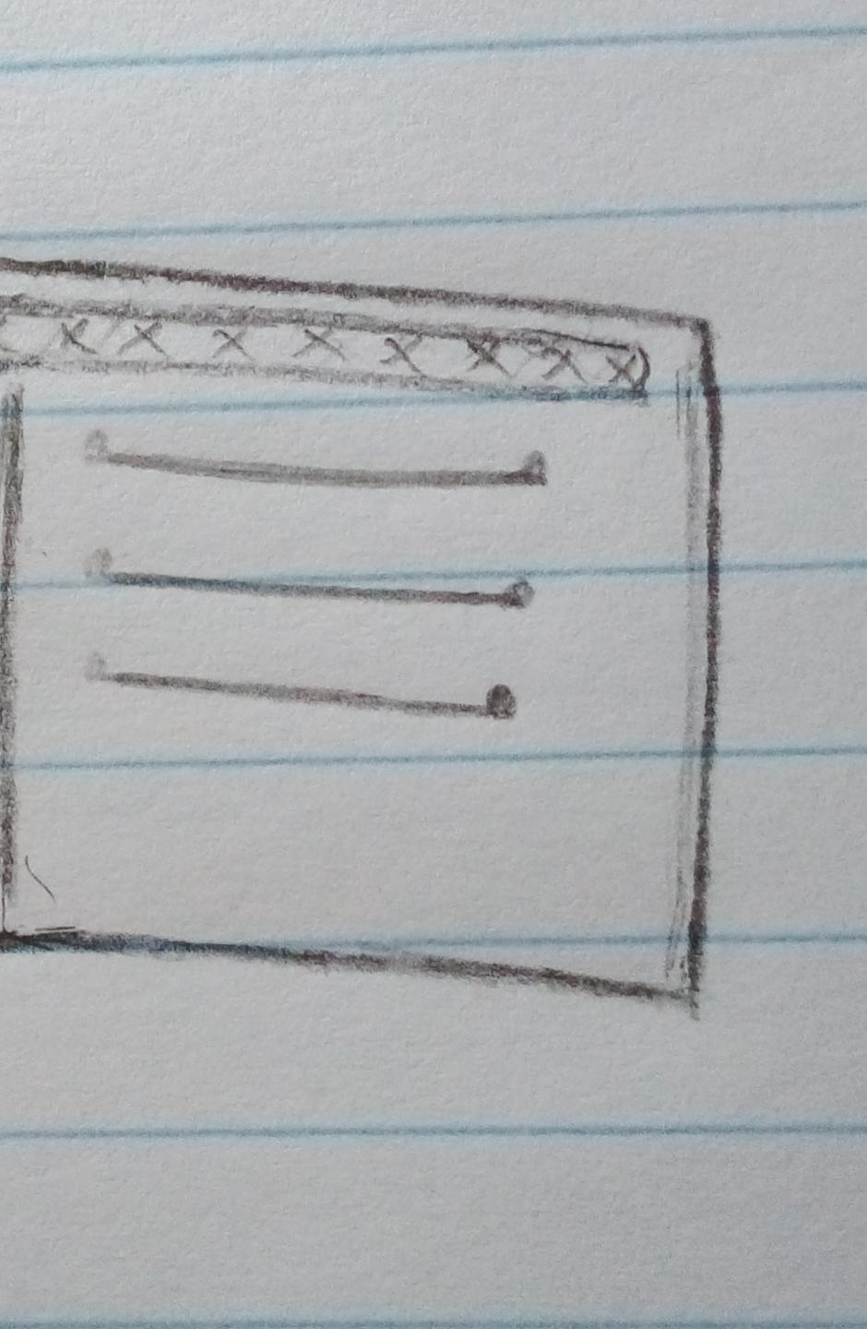
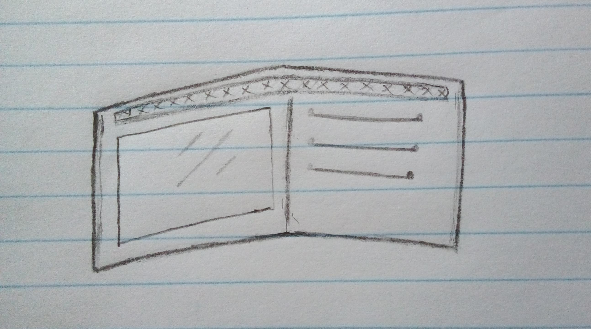
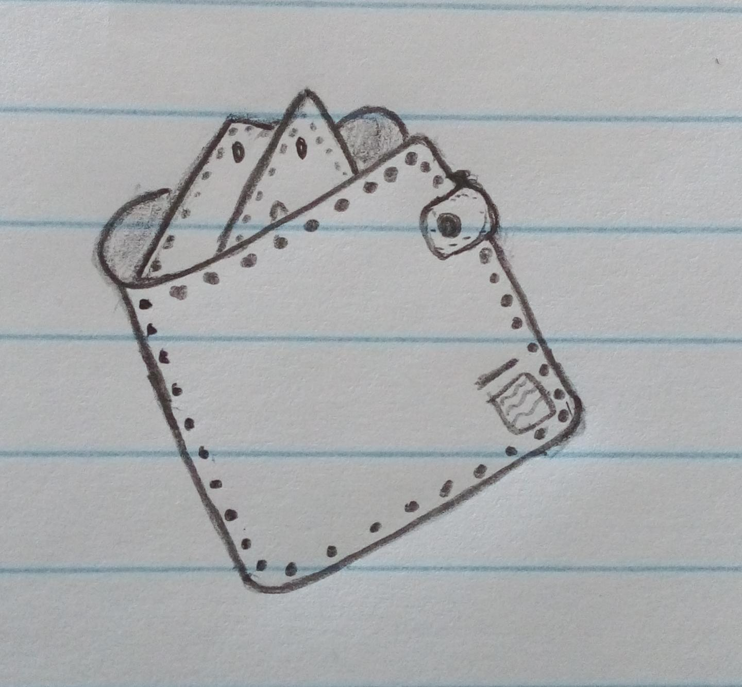
Ideate – Generate alternatives to test
Sketch at least 5 radical ways to meet your users needs - 10 min
Richie needs a small wallet that can keep his money and cards safe. Also have an information tag incase it got lost.
________________________________________________________________________________________________
Write your problem statement above
Small and portable. Can be carried anywhere
Has an identity tag for personal info incase lost
Keep you money and bank cards safe
Secret pocket to keep your small keys (Unoticable)
Plain, manly wallet
Share your solution with your partner and capture feedback - 5 min each
Notes:
We went through the ideas togethe and he loved them

Slide 7
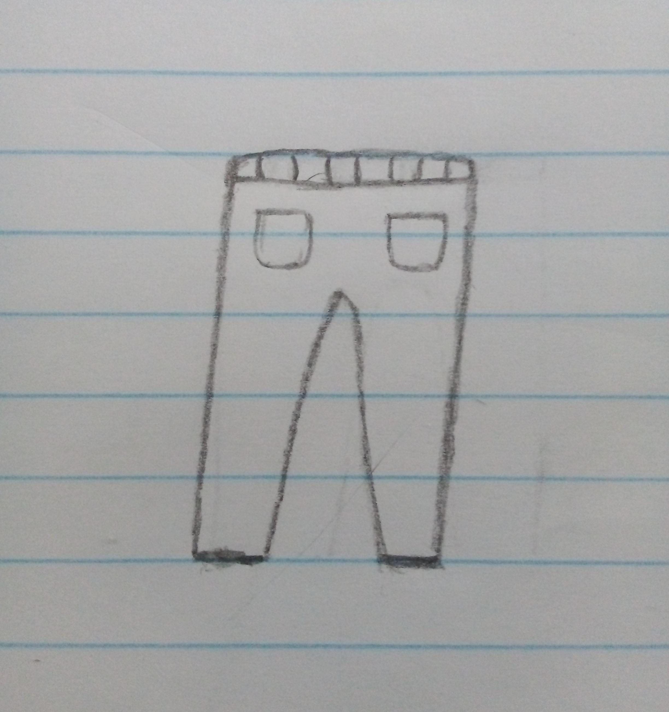
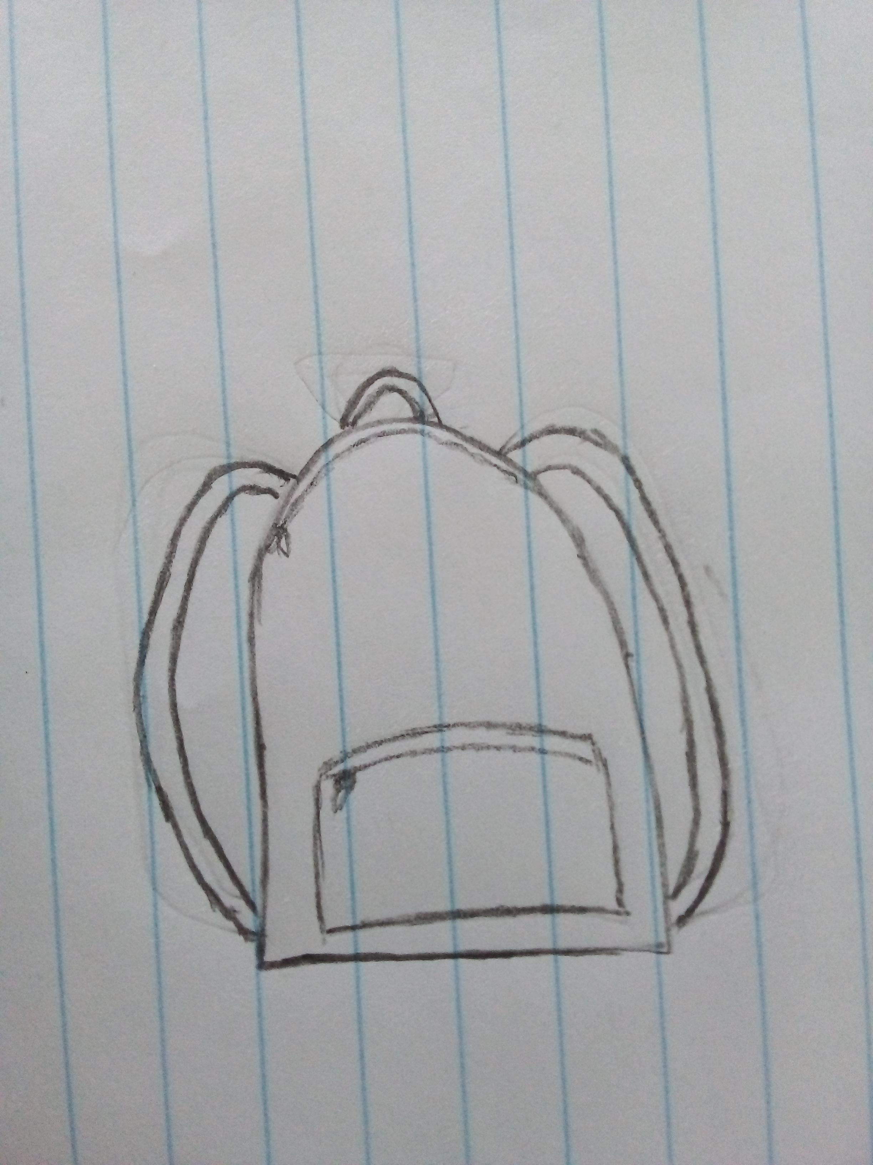
Iterate on Feedback
Reflect and generate a new solution 5 min
Sketch your idea and note details if necessary
The wallet can be kept in a trouser pocket
Wallet can be carried in a bag

Slide 8
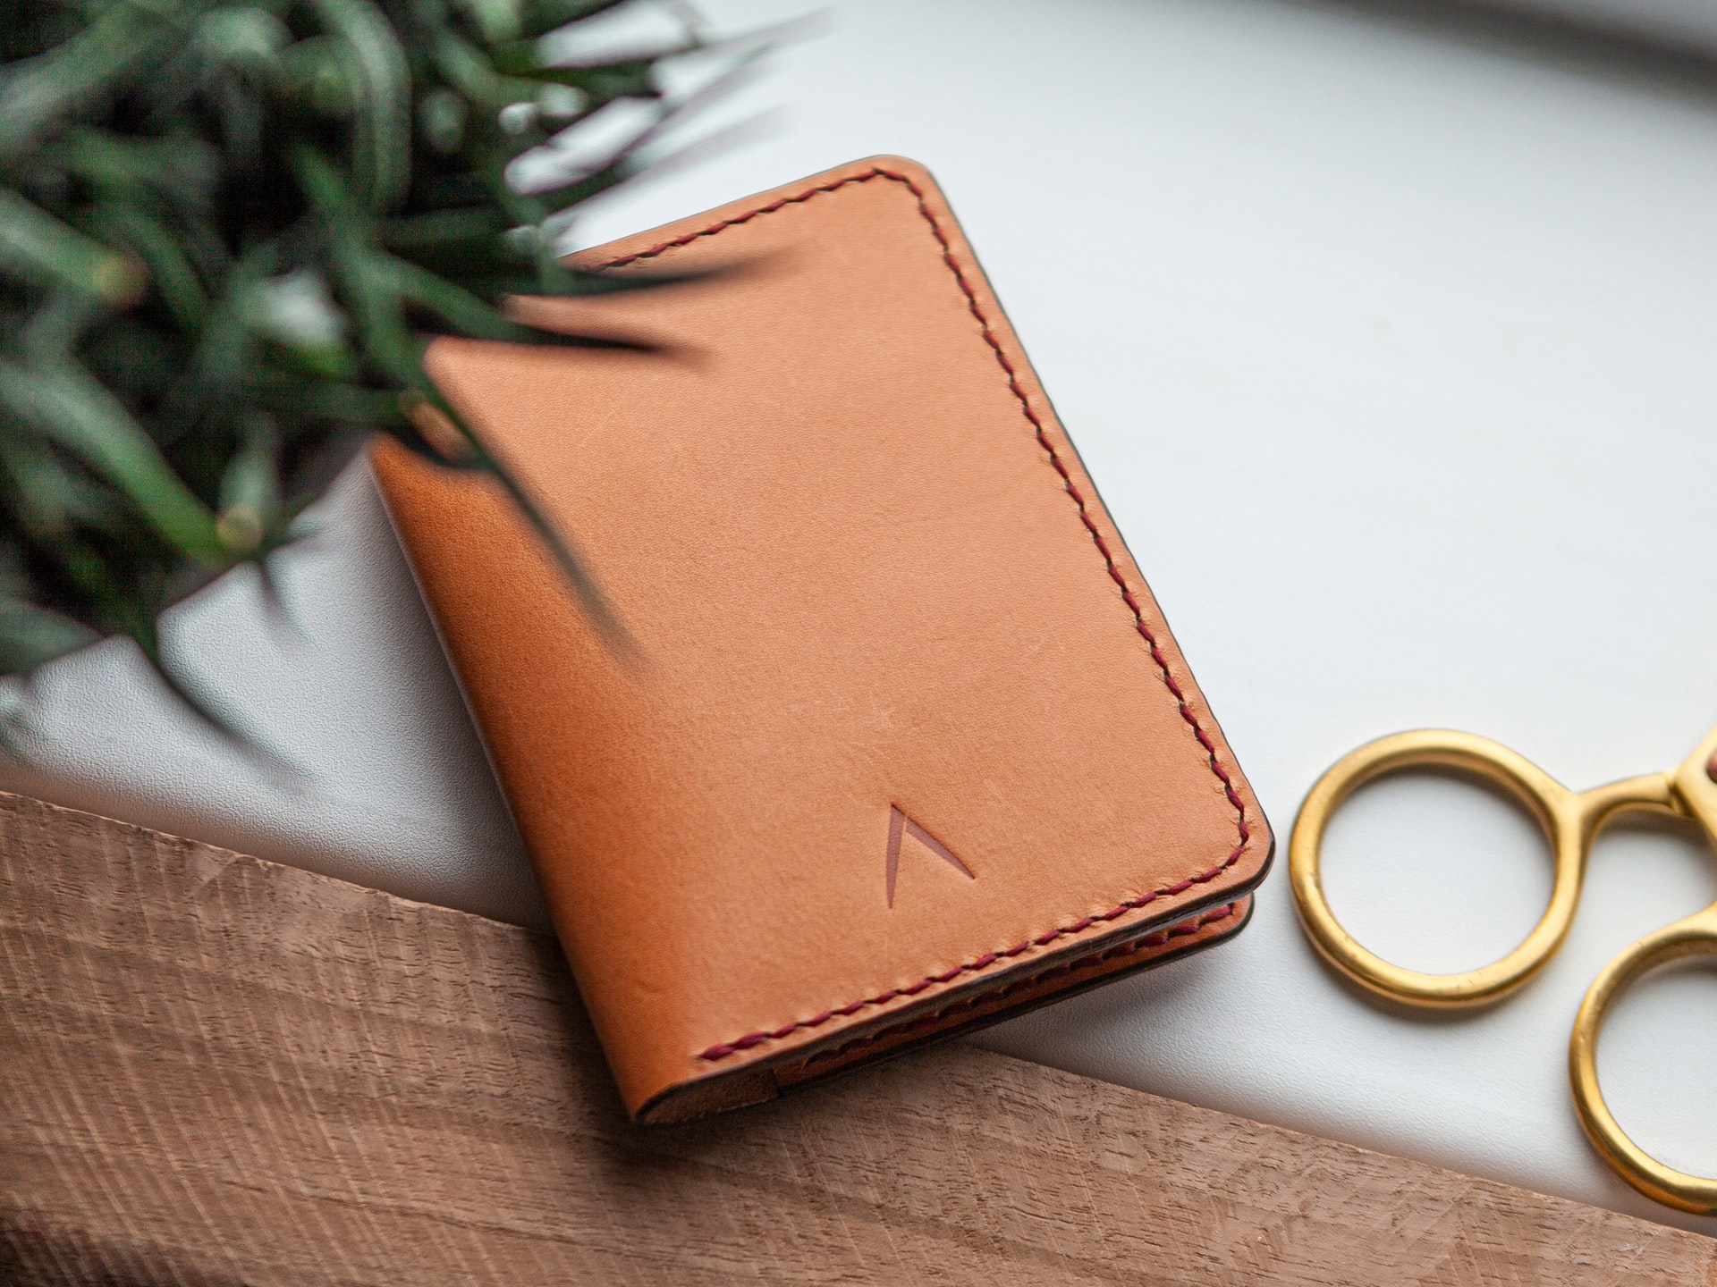
Build and Test
Build your solution
Share your solution and get feedback – 5min each
Make something your partner can interact with use anything you want paper cardboard etc. Place photo’s here (10min)
What worked
What can be improved
1. Leather
1. Quality of the leather
2. Pockets for cards
2. Must be thin
3. Small
3. Pockets too small
Questions
Ideas
1. Is it confortable?
1. Use cotton for confortability
2. Is it portable?
2. Increase the size of the private pocket

