Slide 1
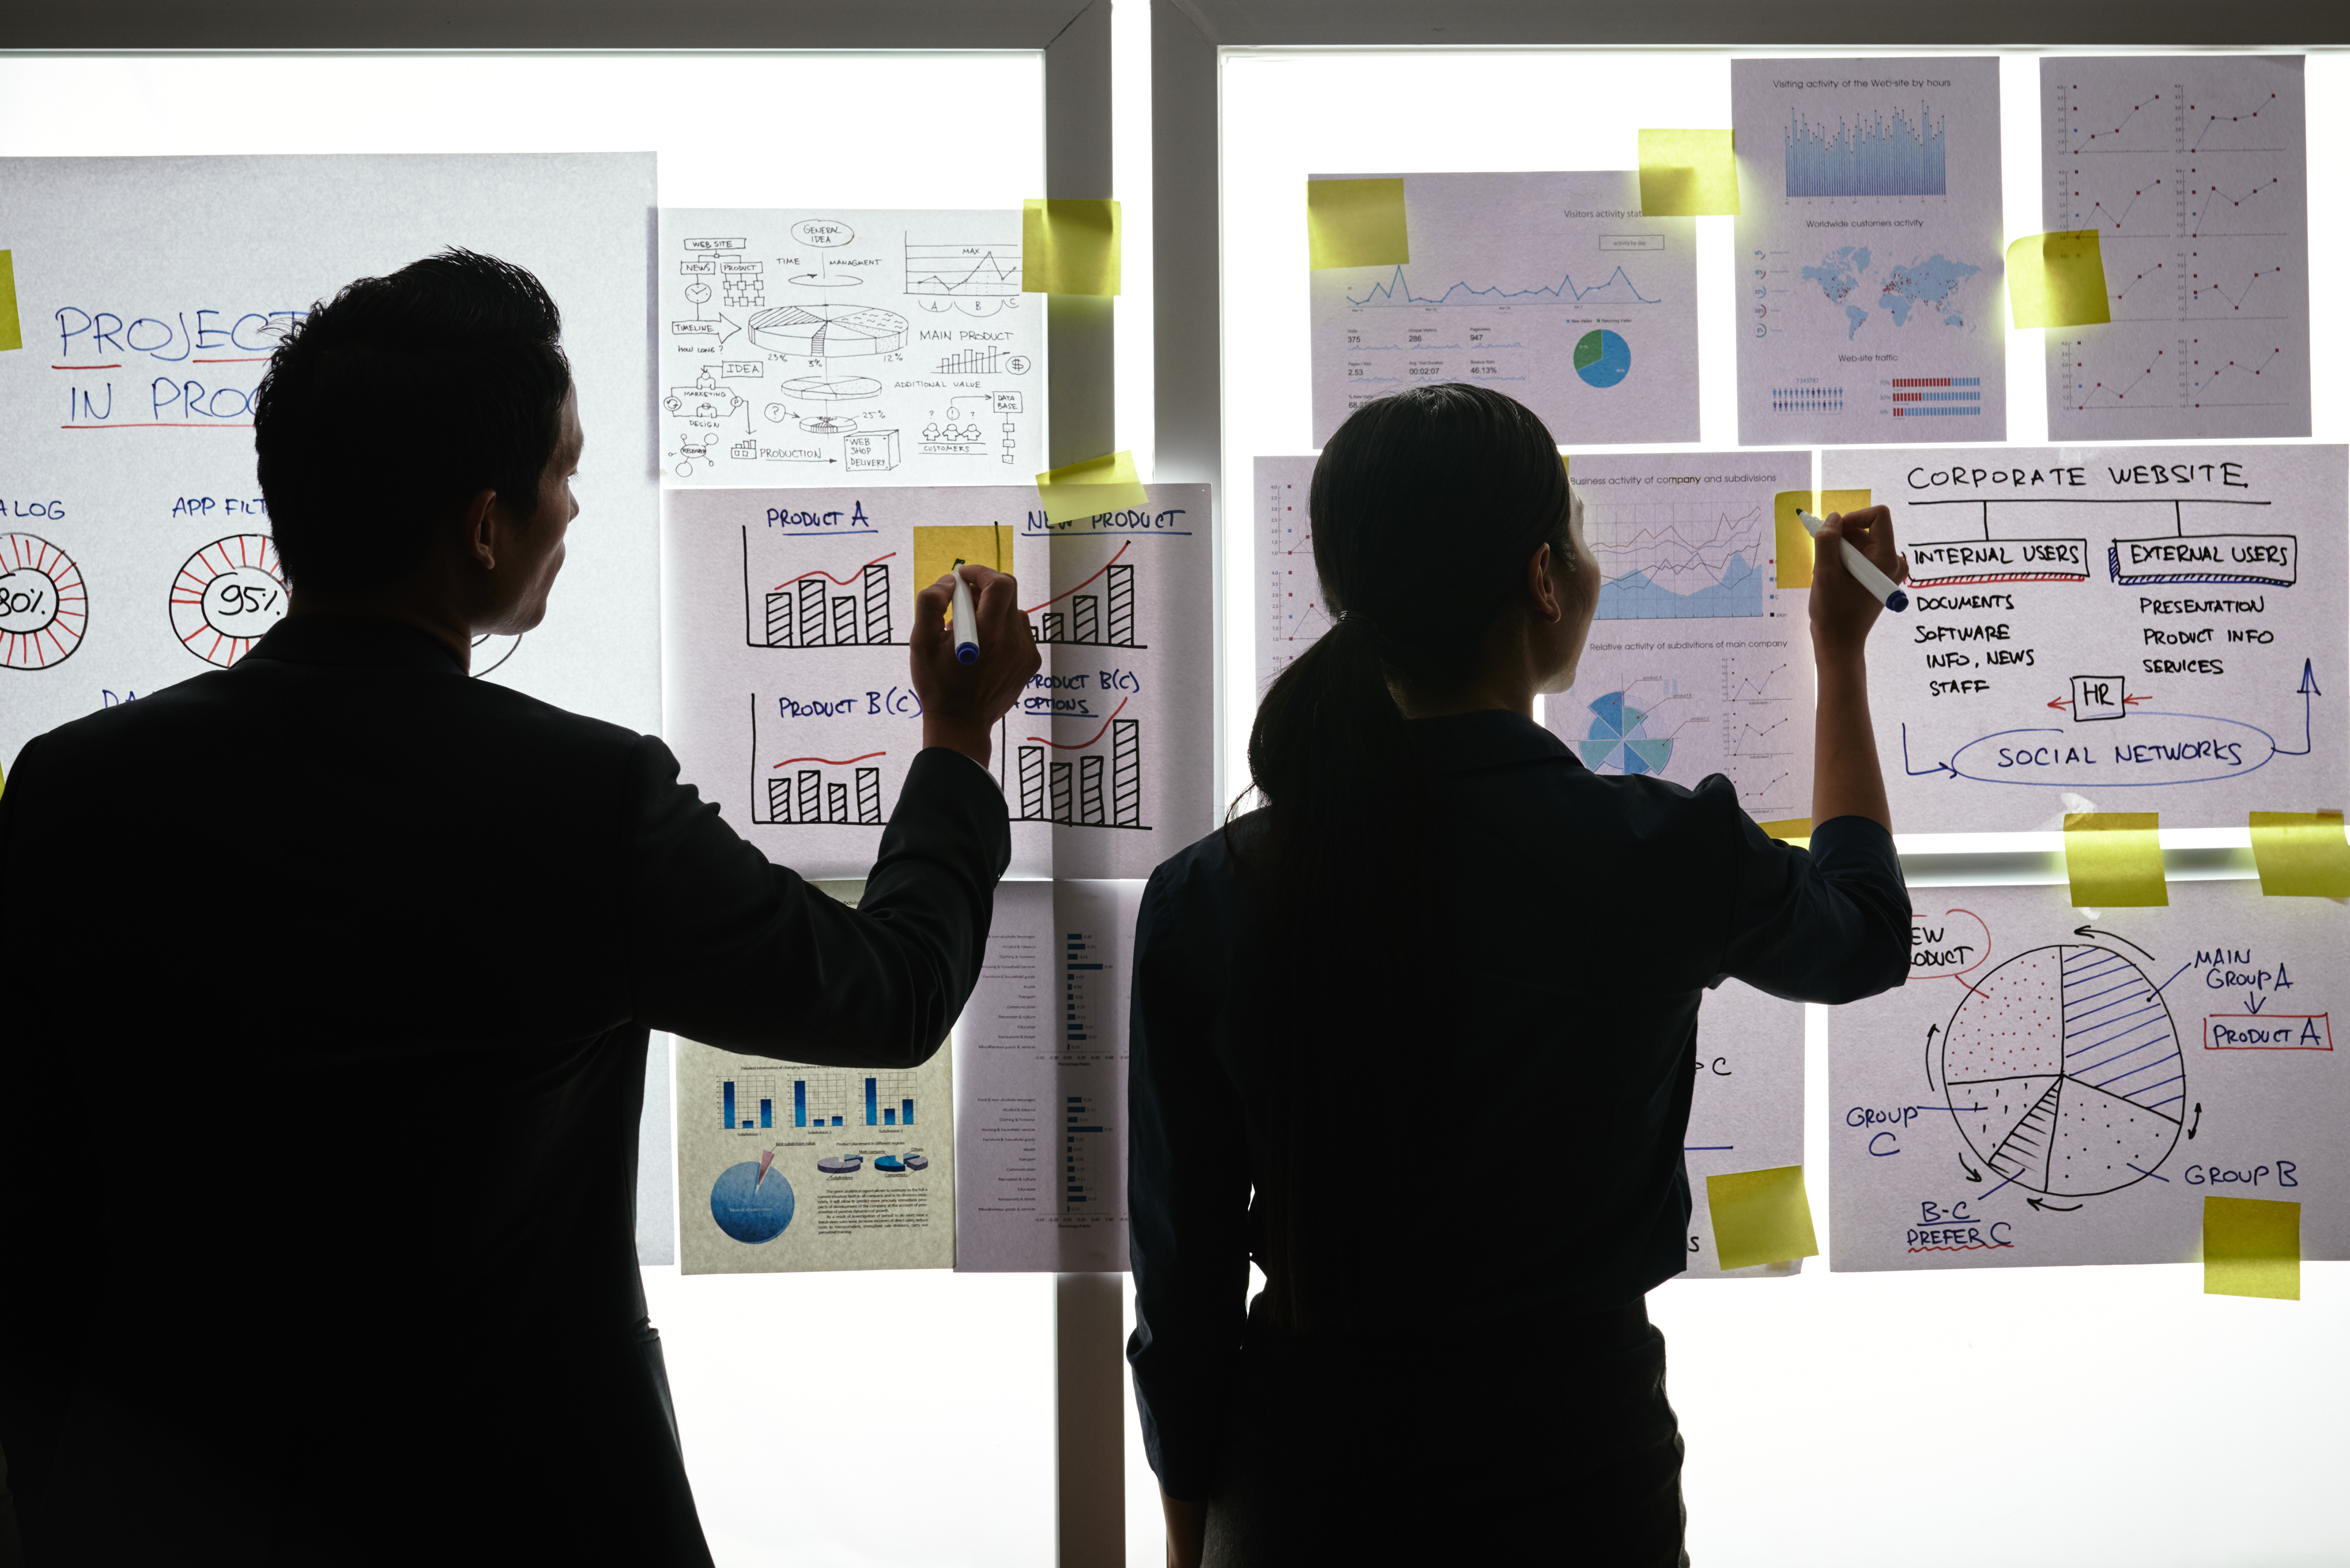
My wallet

Slide 2
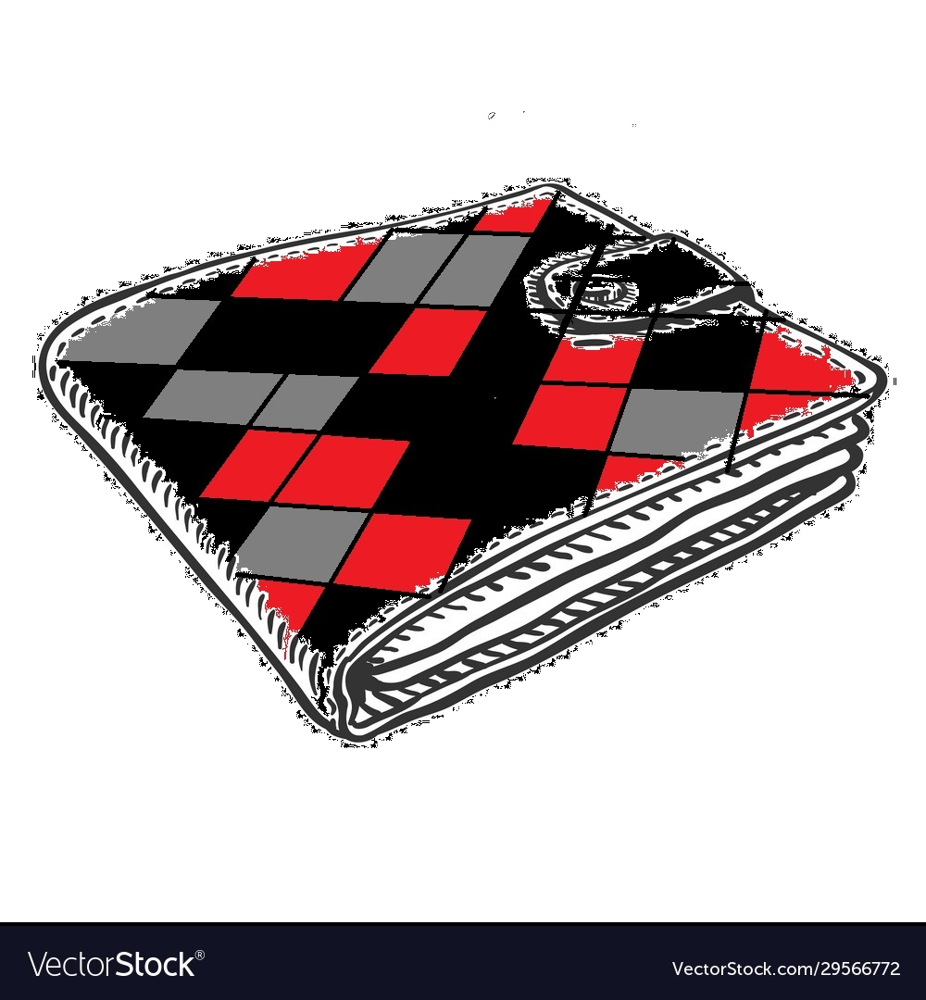
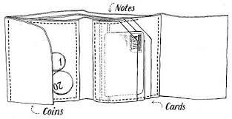
Design your Ideal Wallet
Draw you ideal wallet in this block you have 5 min – Please take a photo and insert in the Powerpoint deck provided which you will upload later under your Wallet project

Slide 3
Empathy – Identify a partner and Engage
Dig Deeper – Considering what you learned really try to dig into your partners feelings and motivations - 5 min each
Interview your partner you each have - 5 min
Notes from first interview
He loves a colourful wallet
With triangles
He want his wallet to use batten not are zip
The walled must be prorated into 3 parts
It must have a part that you put your notes
A part that u put all your bank cards
A part that you put your coins
Notes from second interview
He loves colourful things

Slide 4
Define and understand the problem and gain insights
Capture Findings - 5 min
Take a Stand with a point of view - 5 min
Needs: things your partner is trying to do Use verbs
Wants a wallet that can fit in a pocket to avoid being robbed.
Obakeng
____________________________________________
Needs a way to _zip and batten____________________________
Because … or but ……. or surprisingly…….
So that it it can be more protected _____________________________________________
_____________________________________________
_____________________________________________
Partner’s Name
Insights: new learnings about your partners feelings and motivations. What’s something you see about your partners experience that he she does not see? Use what you heard them say
Batten & small zip
Insight

Slide 5
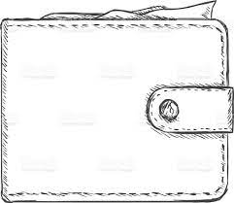
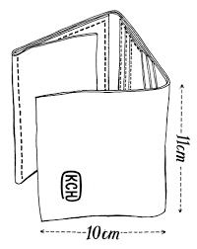
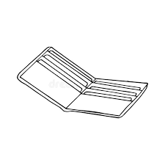
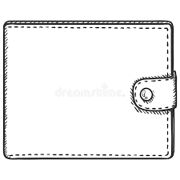
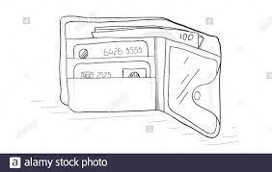
Ideate – Generate alternatives to test
Sketch at least 5 radical ways to meet your users needs - 10 min
________________________________________________________________________________________________
Write your problem statement above
Share your solution with your partner and capture feedback - 5 min each
Notes: The wallet must be colourful and it must have 3 sides . The wallet must be flat so that it can fit in the pocked

Slide 6
Iterate on Feedback
Reflect and generate a new solution 5 min
Sketch your idea and note details if necessary

Slide 7
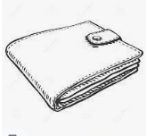
Build and Test
Build your solution
Share your solution and get feedback – 5min each
Make something your partner can interact with use anything you want paper cardboard etc. Place photo’s here (10min)
What worked
Yes it worked
Now it is more protected
than before.
What can be improved
Improve the fabric
& batten
Questions
Will people like it the way it is now?
Ideas
Use big display
They must choose their logos

Slide 8
Your experience
Please upload your completed wallet exercise project in the projects section tagging your partner
Please share your thoughts comments experiences during this work session in the Design thinking group.

