Slide 1
Crime and Safety in South Africa
By
AMT0611(Tsoarelo Mosala)
Gee(George Chauke)
T1h2a3b4a5n6g(Thabang Seima)

Slide 2
Empathize
South Africa is becoming one of the highest rated countries in heists, rape, murder, housebreakings and sexual assaults rates.
A large number of rape and sexually assault cases have increased drastically since the uprising of covid-19

Slide 3
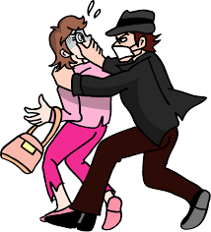
Define
Many South African homes found themselves in the beak of abuse, and now with the pandemic going on, the rates of domestic abuse have increased at a rapid rate, and not only with abuse but with all types of crimes such as heists and murder, with all the crimes happening in our country we can’t really move on to new highs.

Slide 4
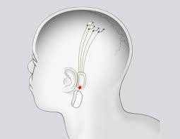
Ideate
Since the new era of neuralinks is coming to our world and with the hope that every single individual would be implemented with these brain-machine interfaces developed by The company Neuralink. Now we hope to add on top of what is already a great invention, we hope to add our own interface which can detect one’s behave such as abusing and to keep a live record of their actions, and one’s whereabouts (e.g Google’s ability to track individuals, used by the FBI to identify if a particular person was at a crime scene at the time of the crime.
This interface will also be of great help to individuals that are faced with danger as they can send SOS messages by just a single thought.

Slide 5
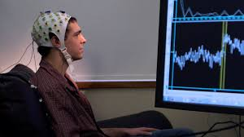
Prototype
We created a more simple and a helmet-like cheaper version of the neuralink to test it on individuals, and run it with our Safety-handy interface that interprets the individuals behave and actions, and the ability to send SOS messages if the individual is faced with danger

Slide 6
Test
In our final stage of testing we found that 9/10 of individuals, were able to transfer their, actions and behaviour by their thoughts, to be displayed on the screen and to be able to send SOS messages to authorities and technicians but however the it takes 12-20 seconds to transfer. We hope we can boost the system to take at least 100 milliseconds to send info/SOS’s, and to find an alternative method of bringing this technology at the most lowest price possible.

