Slide 1
Final Assessment project
By Onthatile Mamabolo
From Ruabohlale

Slide 2
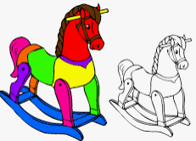
A SAFE AND INEXPENSIVE TOY FOR TODDLER

Slide 3
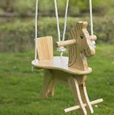
Empathise
I want to make a riding horse swing, but I don’t want the one that have ropes that balances it ,just the one that doesn’t have rope. I think like it’s not safe for toddlers to ride it . Those ropes can be broken any time so it is not safe at all. I will make the one that don’t have rope , I think is better .

Slide 4
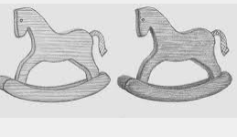
Define
I want to make a riding horse toy for toddlers. The toy will be safe for toddlers to ride it. It won’t be big because they won’t be able to ride it if it is over their size.

Slide 5
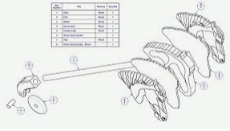
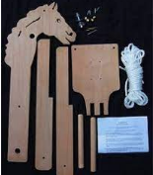
Ideate
Things that I need to build my riding horse toy

Slide 6
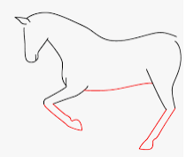
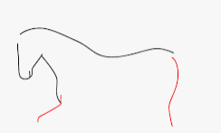
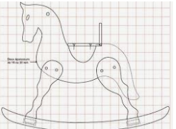
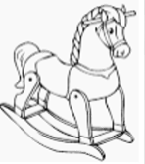
Prototype
Step no 2
step no 1
Step no 3
Step no 4

Slide 7
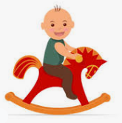
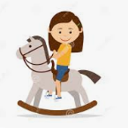
Testing
My riding horse is ready to go.

