Slide 1
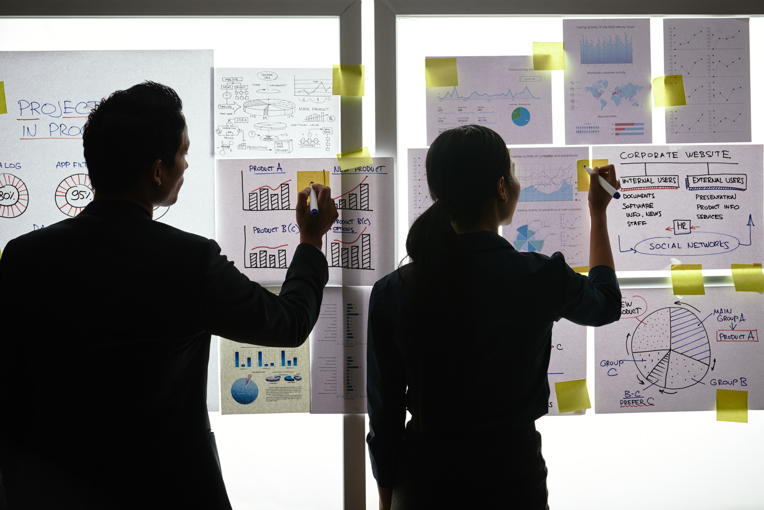
Practical Exercise

Slide 2
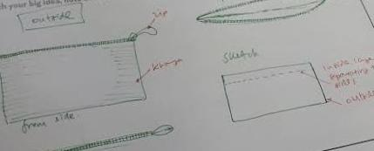
Design your Ideal Wallet
Draw you ideal wallet in this block you have 5 min – Please take a photo and insert in the Powerpoint deck provided which you will upload later under your Wallet project

Slide 3
Empathy – Identify a partner and Engage
Dig Deeper – Considering what you learned really try to dig into your partners feelings and motivations - 5 min each
Interview your partner you each have - 5 min
Hey 11_{small size of wallet}
He doesn’t insert all of his cash
Mostly he doesn’t put coins there
He doesn’t want a heavy pocket
Notes from second interview
Notes from first interview
He wants a light weight wallet
He doesn’t like heavy wallet
He doesn’t pack all the things
Notes:
Goo

Slide 4
Define and understand the problem and gain insights
Capture Findings - 5 min
Take a Stand with a point of view - 5 min
Needs: things your partner is trying to do Use verbs
____________Sinovuyo_______________________________
Needs a way to _____________________________
Because … or but ……. or surprisingly…….
Because he don’t like carrying heavy weight
_____________________________________________
_____________________________________________
_____________________________________________
Partner’s Name
Make the wallet small
Insights: new learnings about your partners feelings and motivations. What’s something you see about your partners experience that he she does not see? Use what you heard them say
Insight

Slide 5
Ideate – Generate alternatives to test
Sketch at least 5 radical ways to meet your users needs - 10 min
________________________________________________________________________________________________
Write your problem statement above
Share your solution with your partner and capture feedback - 5 min each
We gonna make wallet where there’s other side for paper money and coins
Notes:

Slide 6
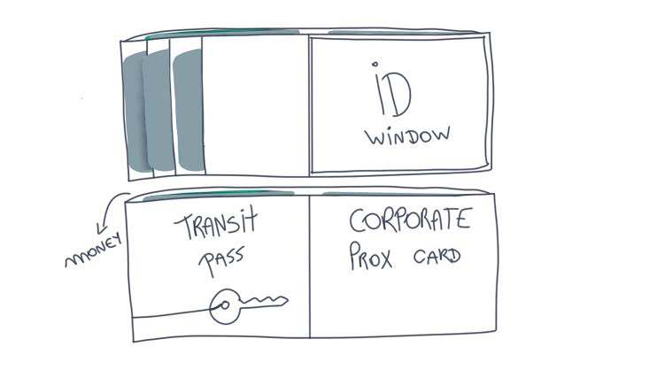
Iterate on Feedback
Reflect and generate a new solution 5 min
Sketch your idea and note details if necessary

Slide 7
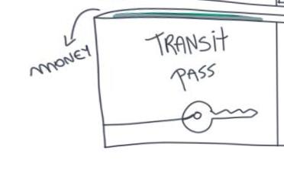
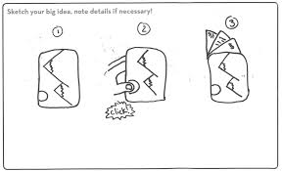
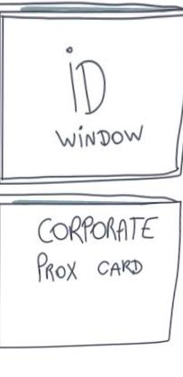
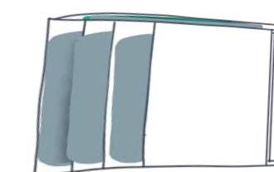
Build and Test
Build your solution
Share your solution and get feedback – 5min each
Make something your partner can interact with use anything you want paper cardboard etc. Place photo’s here (10min)
What worked
What can be improved
Questions
Ideas

Slide 8
Your experience
Please upload your completed wallet exercise project in the projects section tagging your partner
Please share your thoughts comments experiences during this work session in the Design thinking group.

