Slide 1
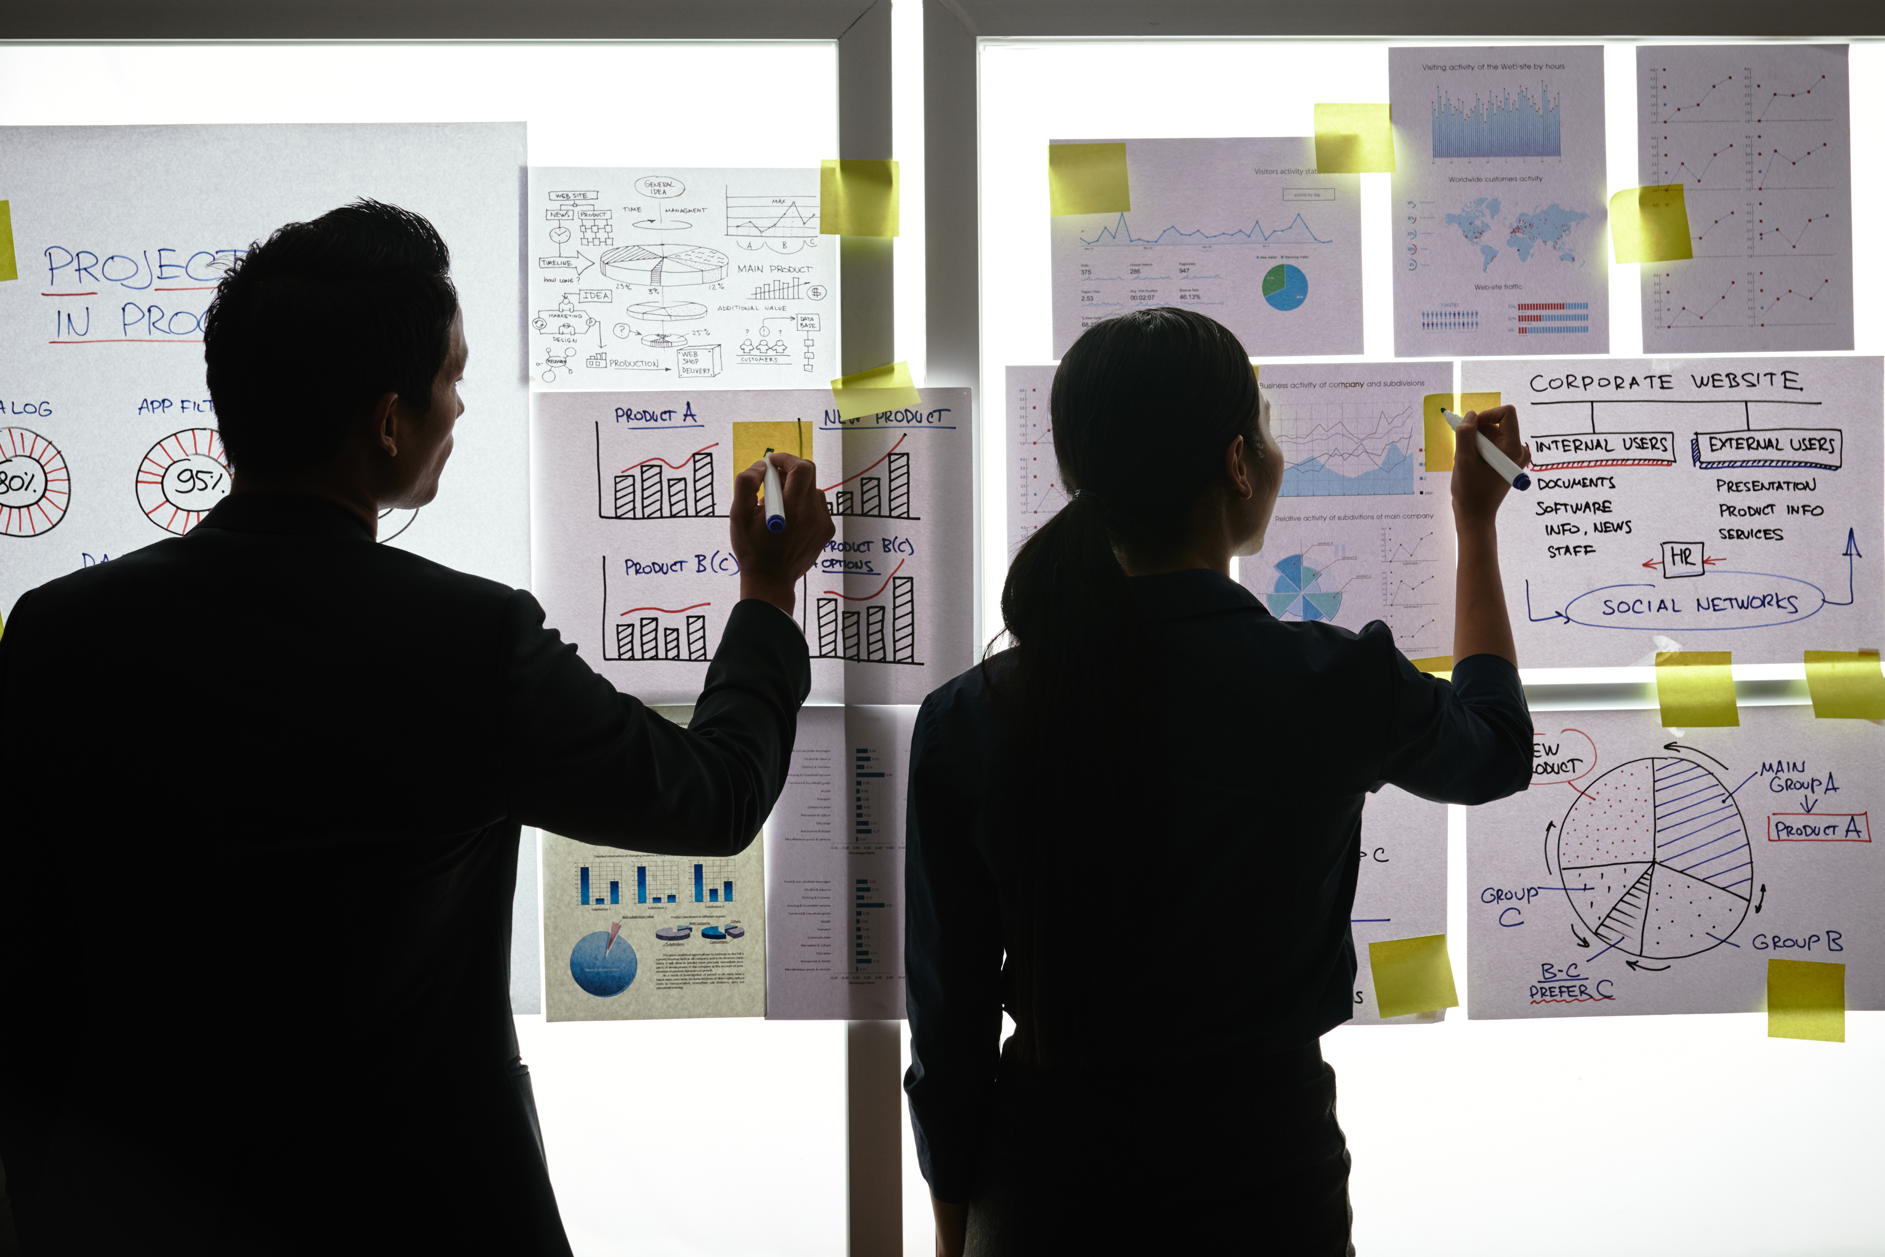
Practical Exercise

Slide 2
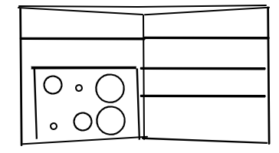
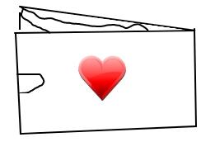
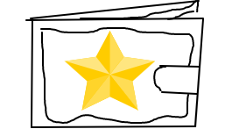
Design your Ideal Wallet
Draw you ideal wallet in this block you have 5 min – Please take a photo and insert in the Powerpoint deck provided which you will upload later under your Wallet project

Slide 3
Empathy – Identify a partner and Engage
Dig Deeper – Considering what you learned really try to dig into your partners feelings and motivations - 5 min each
Interview your partner you each have - 5 min
ted
Notes from first interview
Notes from second interview
: Style and comfort is important
: Likes carrying necessary things
: Likes bright colors
: Likes it to be lightweight, thin, stylish and durable
: Prefers it to have for thin pockets
: All personal information mustn’t be exposed
: Some Cards can be hidden
: Need something where he can store some cash in the wallet

Slide 4
Define and understand the problem and gain insights
Capture Findings - 5 min
Take a Stand with a point of view - 5 min
Needs: things your partner is trying to do Use verbs
_____________________________________________
Needs a way to________________________
Because … or but ……. or surprisingly…….
_____________________________________________
_____________________________________________
_____________________________________________
: Be responsible bank and ID card, drivers license, and change
: Feel comfortable
: Keep belongs of the owner safe in wallet
Mzwakhe
Partner’s Name
feel stress free and efficient
User’s need
Insights: new learnings about your partners feelings and motivations. What’s something you see about your partners experience that he she does not see? Use what you heard them say
Circle one
His wallet size is terribly small and because of
: How the wallet’s appearance represents the owner
: Needs to know that everything is in order
: Feels like it’s the safest thing than carrying your belongs carelessly
that he can’t keep everything he needs safe,
and it is not fashionable
Insight

Slide 5
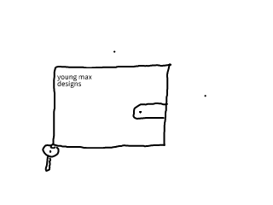
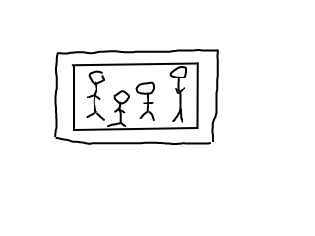
Ideate – Generate alternatives to test
Sketch at least 5 radical ways to meet your users needs - 10 min
Mzwakhe needs a way to feel comfortable and stress free because his wallet is terribly small and is forced to leave his important stuff behind
________________________________________________________________________________________________
Write your problem statement above
Family photo
Wallet unfolded
Key holder
Share your solution with your partner and capture feedback - 5 min each
Notes:
He has seen all 3 ideas and he likes them all.
He doesn’t like leaving he’s things behind, he sees this as a major improvement.

Slide 6
Iterate on Feedback
Reflect and generate a new solution 5 min
Sketch your idea and note details if necessary
: You can now put all the important information you need, plus there’s a zip pocket where you can store your change.
: The wallet can easily fit on your jean and can be perfectly hidden.

Slide 7
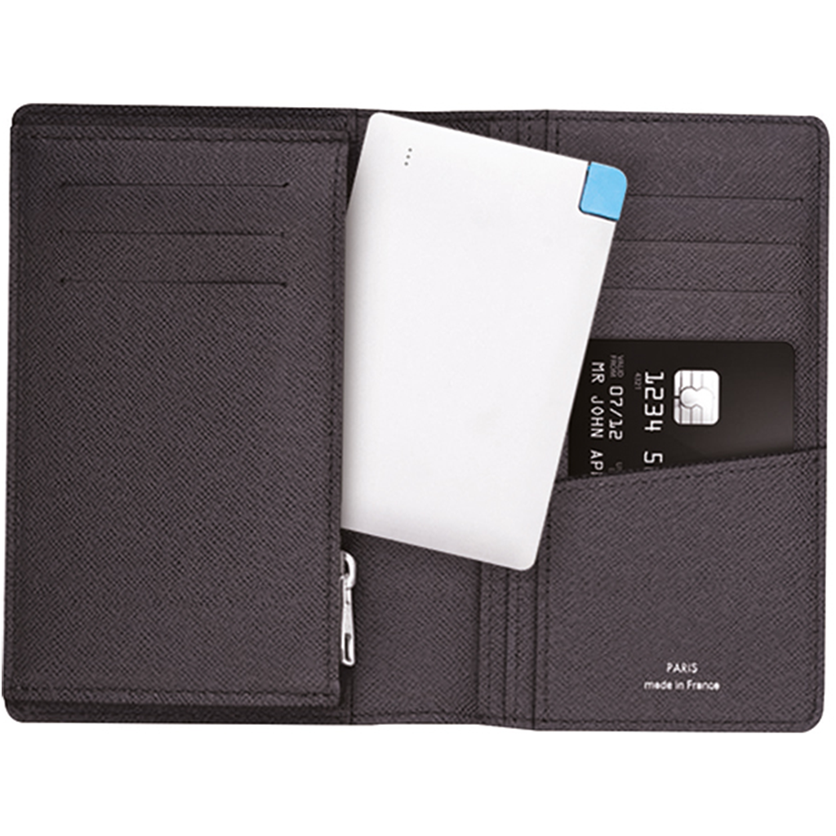
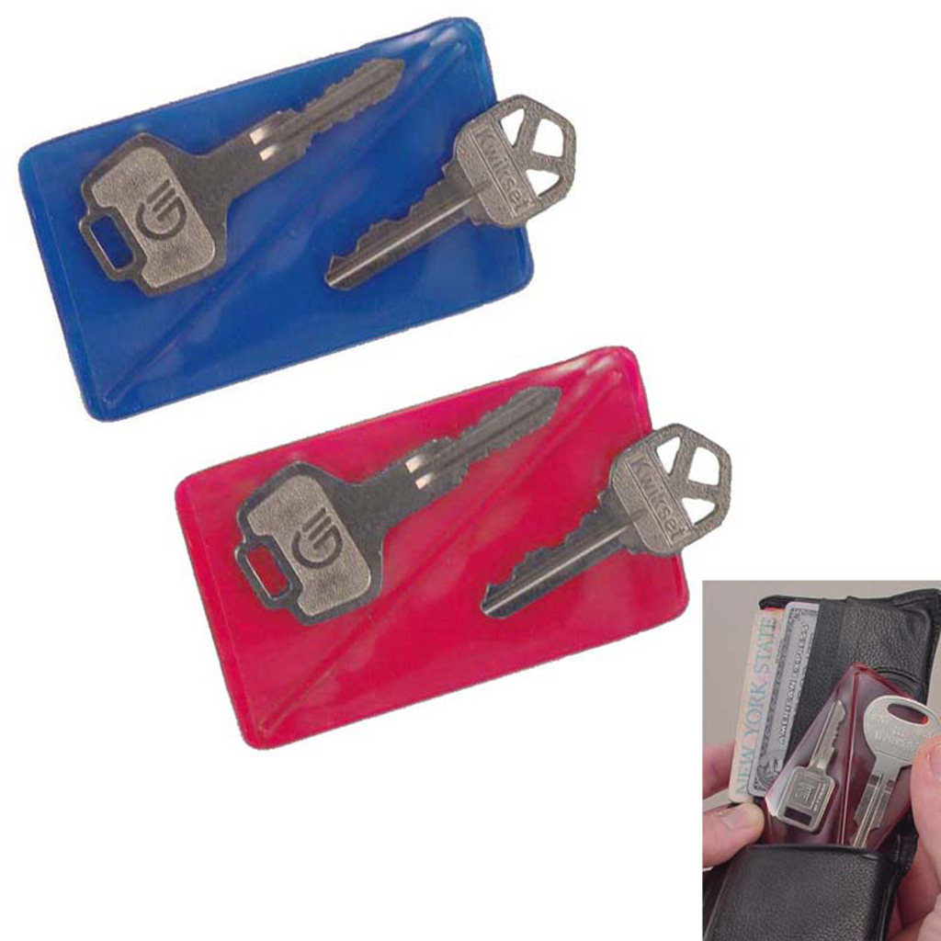
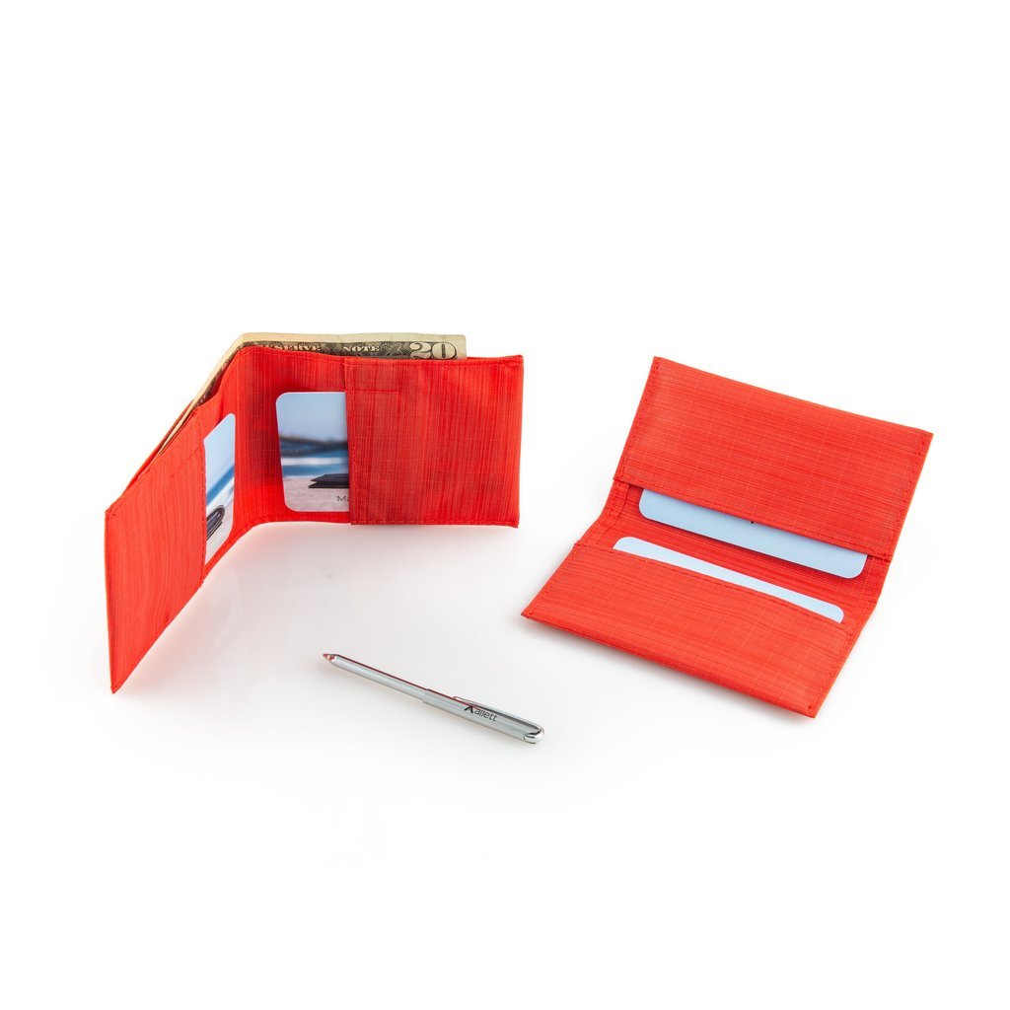
Build and Test
Build your solution
Share your solution and get feedback – 5min each
Make something your partner can interact with use anything you want paper cardboard etc. Place photo’s here (10min)
What worked
What can be improved
Key holder
Four card pocket
Pocket for change
Family photo slot
The design
The wallet’s colors
Power bank
Questions
Ideas
By making it comfortable and presentable.
Fashionable colors, by looking at today’s fashion.
keys
How can we fix the wallet’s design ?
What colors should be added?
change

