Slide 1
My School Garden
By Young Max The Sauce God

Slide 2
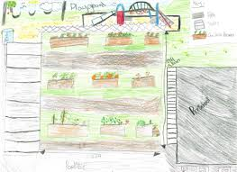
Design of my school garden

Slide 3
Empathy
The garden should be able to get sunlight.
It should have access to water and be close to the kitchen.
The soil should be checked if it’s in good condition.
What vegetables should be planted.
The garden should be checked I its organic or not.
Tools needed for the garden.
Fencing.
Interview from the principal
Interview from the school

Slide 4
Define
Needs a way to __________________________________________
User’s need
Because finance is starting to be tight, so the school needs to start saving some money for other nutritions
Ndzondelelo Secondary School
_______________________________________________________
Needs: things/tools needed for the garden.
School’s Name
Gloves
Pruning shears
Loopers
Garden fork
Hand trowel
Spade
Hoes
Grow vegetables

Slide 5
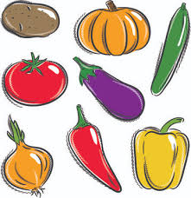
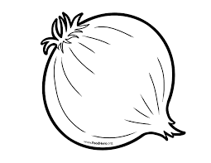
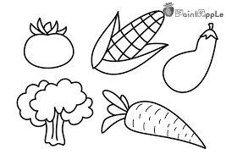
Ideate
Ndzondelelo Secondary School needs a way to garden vegetables because money is becoming tight and the need to start saving
Onions too are important.
We shouldn’t have only basic veges
Different vegetables so that we can get enough nutrition
I have shown the school the 3 ideas
They think it’s a great way to start our garden

Slide 6
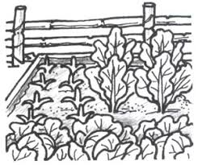
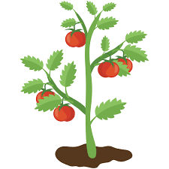
Prototype
Our garden needs a fence to protect it
Need to look out of bugs that can destroy our garden

Slide 7
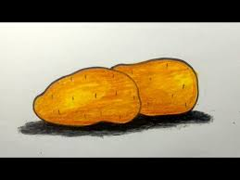
Testing
What worked?
Checking the soil
Making sure it receives sunlight
Access to water
What can be improved?
The fence
Keep the garden and the vegetables safe
Questions
How can we fix the fence of our school garden?
Ideas
We can start by upgrading it then measure the size of our garden.

Slide 8
Conclusion
Based on the testing do you believe your solution meets the Desirable, Feasible, Viable criteria? Why?
Yes, because the school garden can be put to action if we have the right tools, seeds and fencing to protect the garden. Also can sprays to kill the bugs that will be in the garden.

