Slide 1
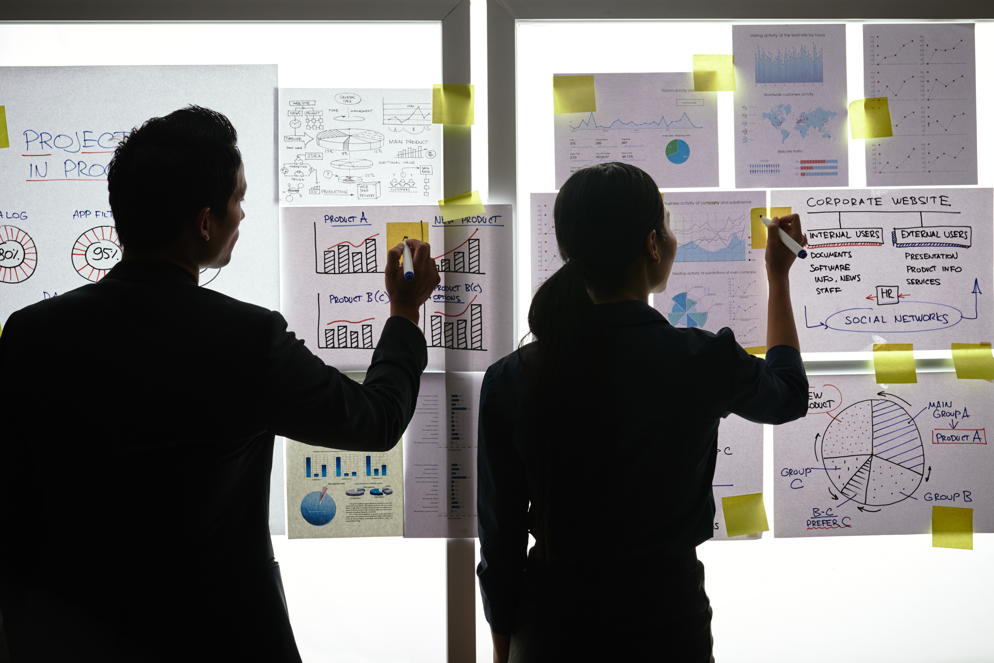
MY IDEAL WALLET
Practical Exercise

Slide 2
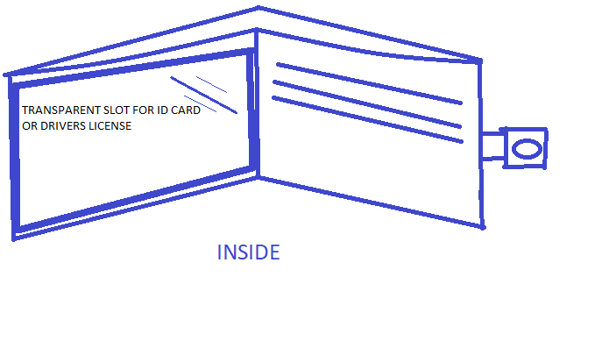
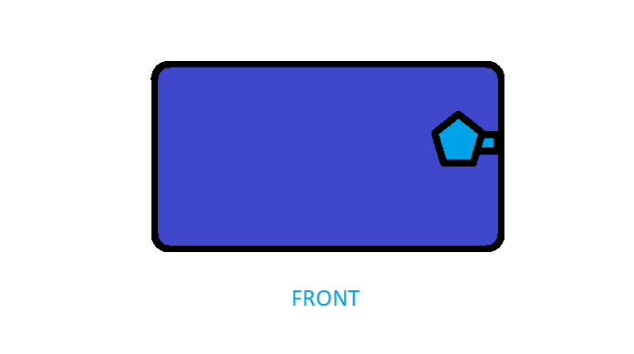
Design your Ideal Wallet
Draw you ideal wallet in this block you have 5 min – Please take a photo and insert in the Powerpoint deck provided which you will upload later under your Wallet project

Slide 3
Empathy – Identify a partner and Engage
Dig Deeper – Considering what you learned really try to dig into your partners feelings and motivations - 5 min each
Interview your partner you each have - 5 min
Notes from first interview
Notes from second interview
likes durable material
Would like transparent slot for important things(ID card, Drivers license etc.)
Currently has a thick wallet.
All cards can be hidden
Somewhat wishes to have a new wallet.
Likes all colors especially blue with the exception of brown
Prefers a thin weightless wallet
Prefers fabric(DENIM) over synthetics
Loves stylish desings

Slide 4
Define and understand the problem and gain insights
Capture Findings - 5 min
Take a Stand with a point of view - 5 min
Needs: things your partner is trying to do Use verbs
____________________________________________
Needs a way to _____________________________
Because … or but ……. or surprisingly…….
_____________________________________________
_____________________________________________
_____________________________________________
Be comfortable
Keep belongings safe and protected
ERNEST
Partner’s Name
Be in style and safe keep belongings
User’s need
Insights: new learnings about your partners feelings and motivations. What’s something you see about your partners experience that he she does not see? Use what you heard them say
Circle one
He has an enormous wallet that makes
him feel beyond age and is a color he does
Not like which also feels unsecure.
Wants to feel responsible
Wants to be in style and up to date
Loves making a good impression
Insight

Slide 5
Ideate – Generate alternatives to test
5 radical ways to meet my users needs - 10 min
PROBLEM STATEMENT:ERNEST needs a wallet that is stylish and up to date because he has an enormous uncomfortable wallet which makes him feel beyond age and is a colour that he does not like not to mention that it feels unsafe
Keep your ID
Close at all times
Convenient removable hook for attaching to trouser loop
Safe keep your
Drivers
Made from fashionable denim
Share your solution with your partner and capture feedback - 5 min each
Notes: He likes most of the ideas especially safe keeping your drivers licence
He feels the hook can be a permanent one to attach to a bag or something
He loves the denim part

Slide 6
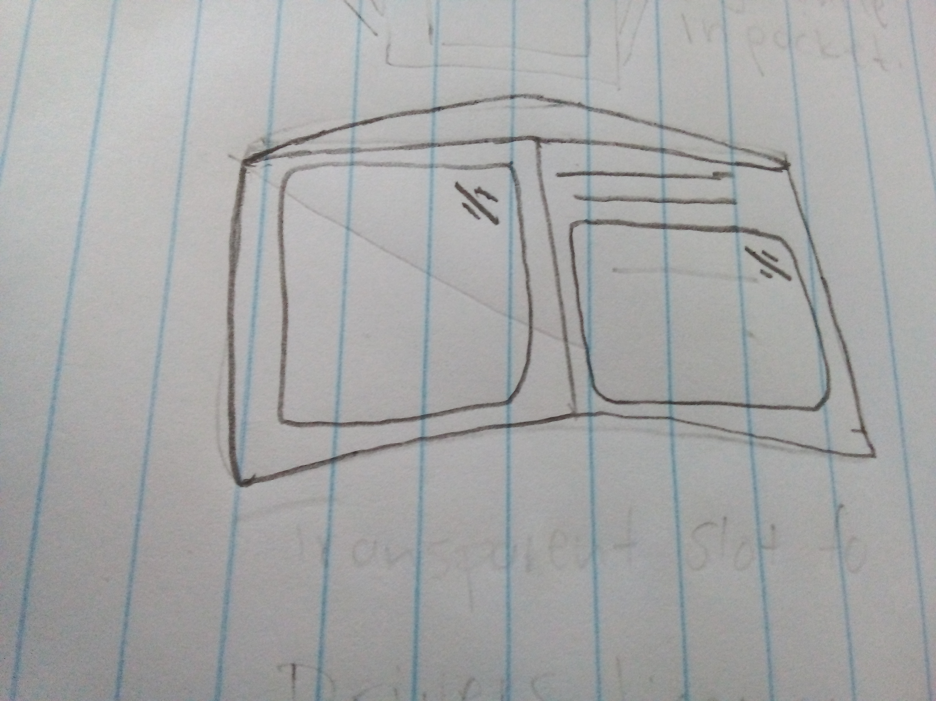
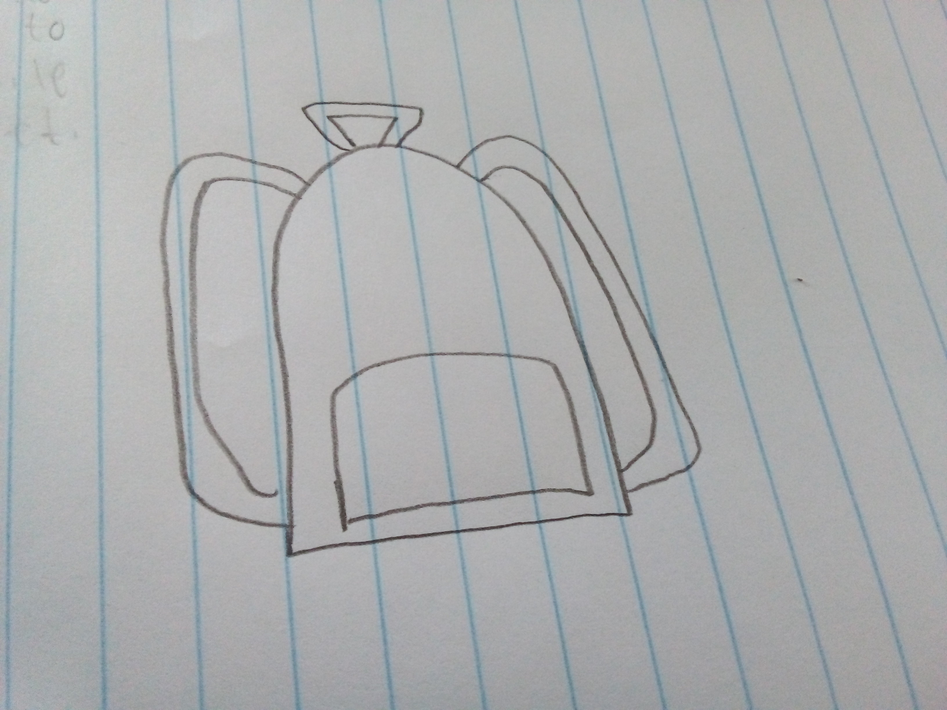
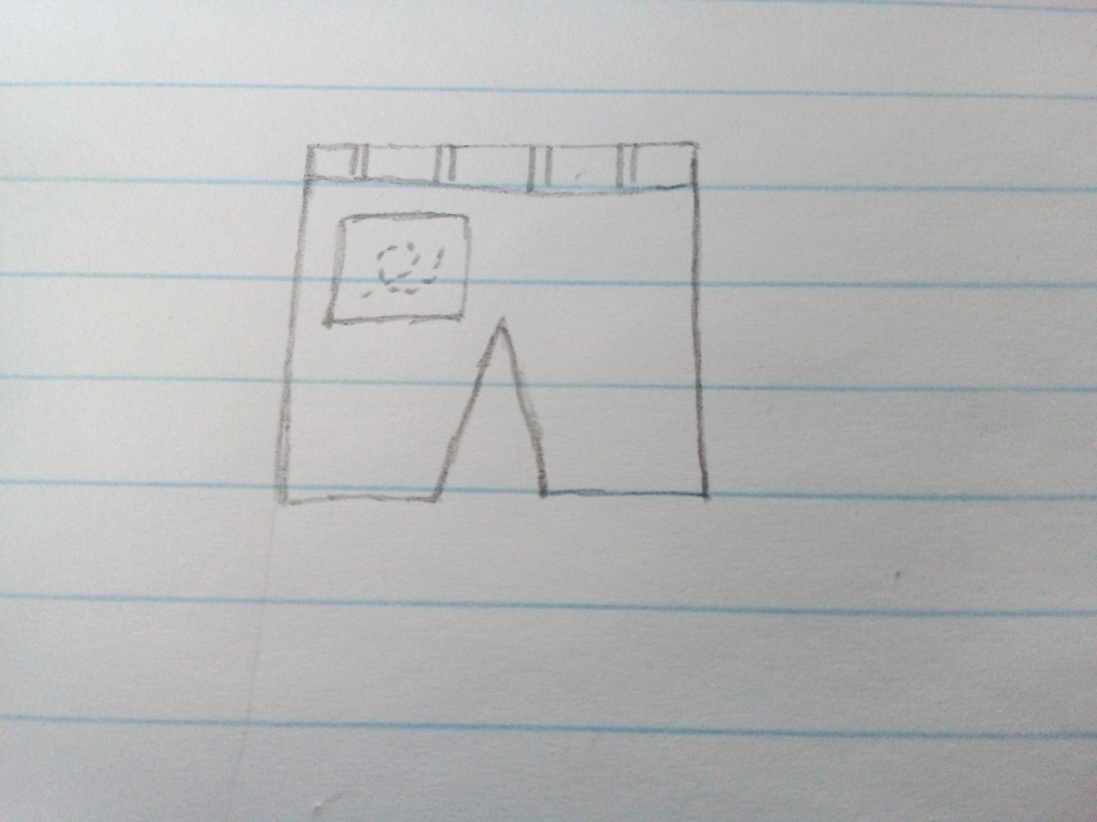
Iterate on Feedback
Reflect and generate a new solution 5 min
Sketch your idea and note details if necessary
2 slots for ID, DRIVERS License etc
Convenient hook can attach wallet to bag pack
Wallet is lightweight and can fit in pocket
Hook can attach wallet to trouser loop

Slide 7
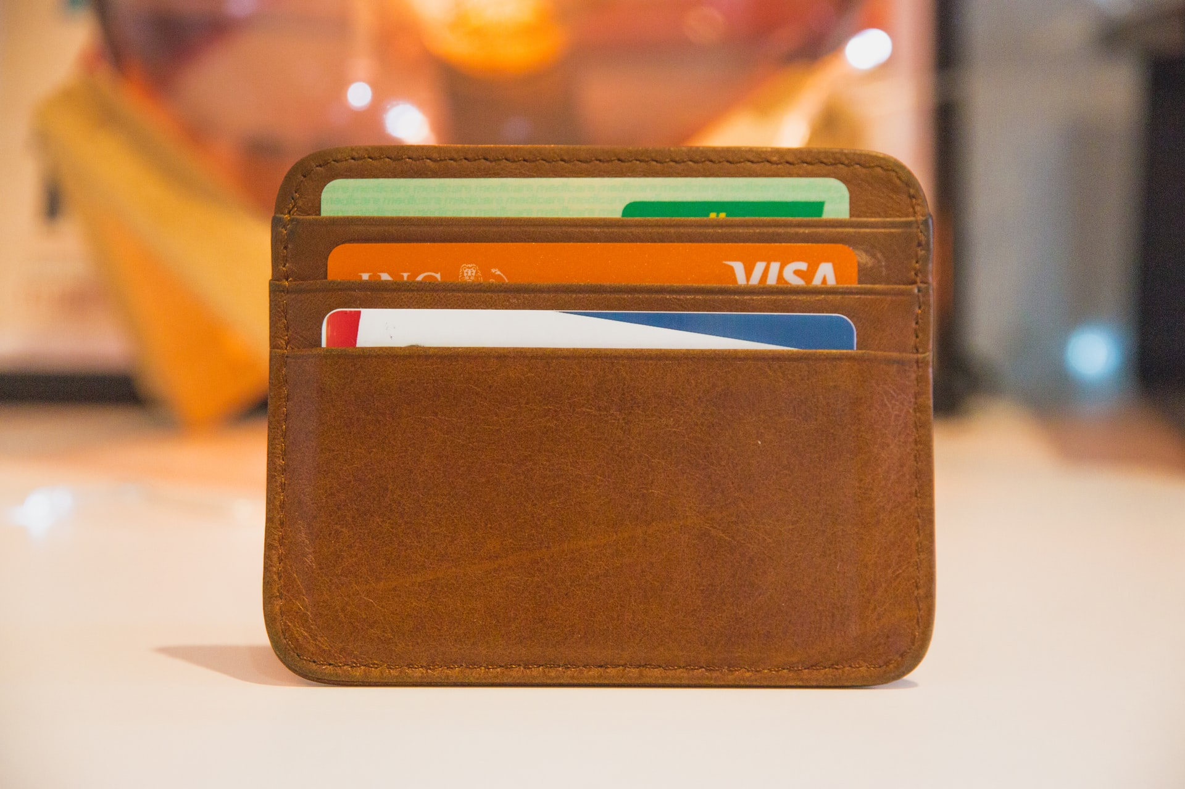
Build and Test
Build your solution
Share your solution and get feedback – 5min each
Make something your partner can interact with use anything you want paper cardboard etc. Place photo’s here (10min)
What worked
What can be improved
Denim
Convenient hook
Transparent slot
The hook can be lengthened for more convenience
Questions
Ideas
Is it durable
Is it stylish
Is the colour a catch
Is it lightweight
A zip can be added for more security
One more transparent slot can be added

Slide 8
Your experience
Share your thoughts

